Slide 1

The Process of Making Hypotheses
Understanding how to formulate and test hypotheses
University of Patras – civil engineering_S1
Dr. manousakis
Notes:
AI-generated content may be incorrect. ---

Slide 2
Introduction to Hypotheses in Civil Engineering
Notes:
What is a Hypothesis and Its Importance

Slide 3
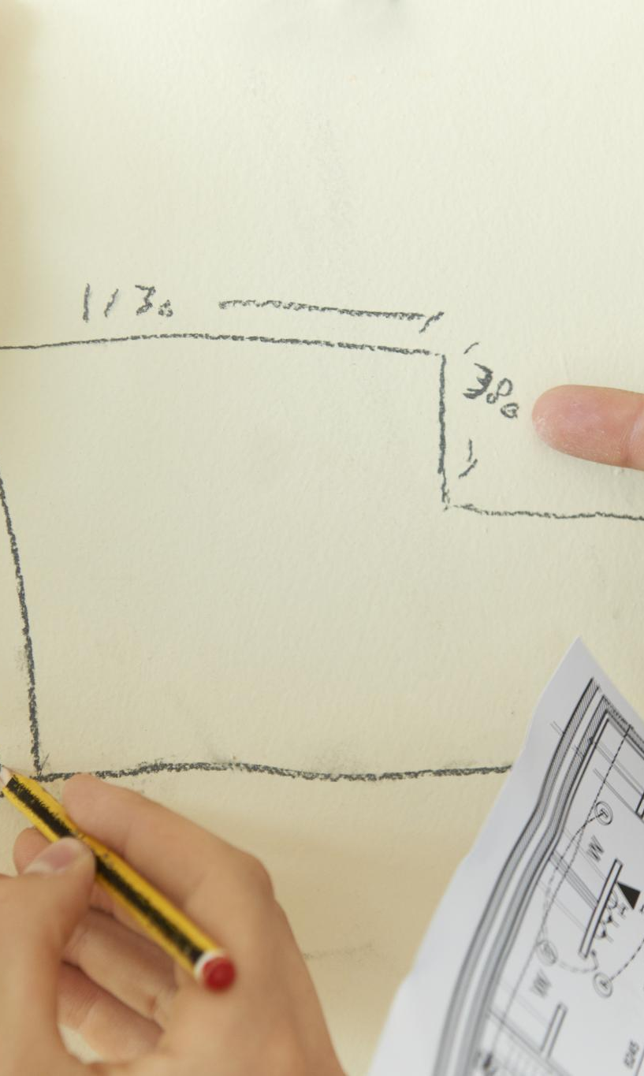
What is a Hypothesis and Its Importance
Definition of Hypothesis
A hypothesis is a proposed explanation based on limited evidence, guiding further investigation.
Role in Civil Engineering
Hypotheses direct experiment design and decision-making, helping predict outcomes in engineering projects.
Example of Concrete Cracks
Engineers hypothesize causes like temperature or material defects before testing concrete cracks.
Benefits of Hypotheses
Using hypotheses saves time, resources, and prevents costly mistakes in large-scale projects.
Notes:
A hypothesis is a proposed explanation for a phenomenon based on limited evidence, serving as a starting point for further investigation. In civil engineering, hypotheses are essential because they guide the design of experiments, inform decision-making, and help engineers predict outcomes before implementing costly solutions. For example, when cracks appear in concrete structures, engineers hypothesize potential causes such as temperature fluctuations or material defects before conducting tests. This process ensures efficient resource allocation and minimizes risks. Discussion Prompt: Why do engineers need hypotheses before testing? Consider how hypotheses can save time and prevent unnecessary expenses in large-scale projects.

Slide 4
Poorly-formed Hypotheses | Well-formed Hypotheses
"I think my friend will like this movie because I like it." | "If I increase the amount of sunlight that my plants receive, they will grow taller."
"The earth is flat because it looks flat from the ground." | "If I expose bacteria to varying levels of antibiotics, the growth rate of the bacteria will vary."
"If I wear my lucky socks, I will do well on the test." | "If I increase the number of repetitions in my exercise routine, my muscle strength will increase."
"If I eat more vegetables, I will live forever." | "If I consume more fruits and vegetables in my diet, my risk of developing certain chronic diseases will decrease."

Slide 5
Hypothesis | Prediction
"If a person exercises regularly, their cardiovascular health will improve." | "If a person exercises regularly for six months, their resting heart rate will decrease."
"If a student takes regular breaks while studying, they will perform better on exams." | "If a student takes a 10-minute break every hour while studying for an exam, they will score 10% higher on the exam compared to students who don't take breaks."
"If a deep learning algorithm is trained on a large dataset, it will perform better at image recognition." | "If a deep learning algorithm is trained on a dataset of 10,000 images, it will correctly classify 95% of test images."
"If a company increases its marketing budget, it will increase its sales revenue." | "If a company increases its marketing budget by 20%, it will see a 10% increase in sales revenue in the next quarter."
"If a new material is used for a bridge construction, it will increase the bridge's durability and safety." | "If a bridge is constructed using a new composite material, it will withstand a Category 5 hurricane with minimal damage."

Slide 6
Hypotheses with Multiple Interpretations
"Increased physical activity leads to improved mental health."
"Higher levels of caffeine intake lead to increased risk of heart disease."
"Exposure to violent media increases aggressive behavior in children."
"Consuming a high-fat diet leads to increased risk of heart disease."
"Exposure to environmental toxins increases risk of cancer."

Slide 7
Occam's Razor
According to the principle known as Occam’s razor or law of parsimony, there may be multiple hypotheses and explanations for the same phenomenon, some of them being more complex and intricate. However, in the case of more complex alternatives, causalities might be very hard to test and prove.
For this reason, when presented with multiple explanations for a phenomenon, researchers should select the simplest one, the one that makes the fewest assumptions or proposes the fewest number of agents. By selecting simpler explanations that are able to account for the available evidence, scientists can reduce the need for additional assumptions or unnecessary complexities.

Slide 8
Scenarios | Hypotheses
Problem: A person wakes up with a headache and a stuffy nose. | Hypothesis 1: The headache and stuffy nose are due to a common cold. Hypothesis 2: The headache and stuffy nose are caused by an exotic tropical disease.
Problem: A car won't start. | Hypothesis 1: The car won't start because the battery is dead. Hypothesis 2: The car won't start because there is a complex electrical issue in the engine.
Problem: A person is late for work. | Hypothesis 1: The person is late for work because there was heavy traﬃc. Hypothesis 2: The person is late for work because there was a massive conspiracy to delay their commute.
Problem: An experiment investigating the effects of a new drug on a particular disease yields unexpected findings. | Hypothesis 1: The unexpected findings are a result of experimental error or uncontrolled variables. Hypothesis 2: The unexpected findings are due to the drug's interaction with a previously unknown genetic factor in the participants.

Slide 9
Hypothesis | Dependent variable | Independent variable
Increased study time leads to higher test scores. | Test scores | Study time
Plants that receive more water grow taller and produce more leaves. | Plant growth | Amount of water
People who are distracted by visual stimuli have slower reaction times than those who are distracted by auditory stimuli. | Reaction time | Types of distraction (auditory or visual)
Changing the colour of a website will increase user engagement. | Level of user engagement | Colour of the website
Providing employees with additional training will improve their job performance. | Job performance of the employees | The training provided to the employees
Exposure to violent media will increase aggressive behavior in children. | The level of aggressive behaviour in children | Exposure to violent media
Using a new teaching method will increase students' test scores. | Students’ test scores | The teaching method used

Slide 10
Fact-Based Hypothesis Formation
Notes:
Scenario 1: Cracks in Concrete After Heavy Rain, Scenario 2: Bridge Vibrations During Peak Traffic

Slide 11
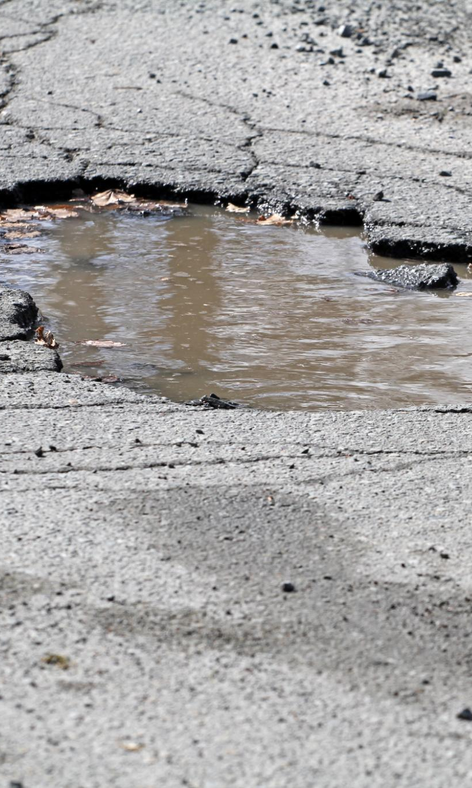
Scenario 1: Cracks in Concrete After Heavy Rain
Water Infiltration Effects
Water entering beneath the concrete can weaken the subgrade, causing cracks to form after rainfall.
Improper Concrete Curing
Insufficient or improper curing of concrete can lead to surface cracks especially after exposure to moisture.
Temperature-Induced Expansion
Fluctuating temperatures can cause expansion and contraction in concrete, leading to cracks over time.
Testing and Validation
Testing soil conditions and curing practices helps verify the cause of cracks in real-world engineering scenarios.
Notes:
Fact: A newly constructed concrete pavement shows cracks after a week of heavy rainfall. Students are asked to hypothesize the cause. Possible hypotheses include water infiltration weakening the subgrade, improper curing, or temperature-induced expansion. This exercise encourages critical thinking and application of engineering principles. Discussion Prompt: What could be the simplest explanation for these cracks? How would you test your hypothesis in a real-world setting?

Slide 12
Scenario 2: Bridge Vibrations During Peak Traffic
Observation of Vibrations
The suspension bridge shows noticeable vibrations during peak traffic times, indicating dynamic stress factors.
Potential Causes
Hypotheses include wind-induced oscillations, resonance from traffic patterns, and structural imbalance affecting stability.
Hypothesis Testing
Prioritize testing methods to confirm hypotheses, such as structural analysis, wind simulation, and traffic flow monitoring.
Notes:
Fact: A suspension bridge experiences noticeable vibrations during rush hour traffic. Students should hypothesize potential causes such as wind-induced oscillations, resonance due to traffic patterns, or structural imbalance. This scenario demonstrates how observations lead to hypothesis formation in structural engineering. Discussion Prompt: What hypothesis explains this phenomenon? How would you prioritize testing methods to confirm your hypothesis?

Slide 13
Ockham’s Razor in Civil Engineering
Notes:
Principle and Practical Examples

Slide 14

Principle and Practical Examples
Ockham’s Razor Principle
The simplest explanation is often the most accurate, helping to avoid unnecessary complexity in engineering.
Concrete Crack Causes
Concrete cracks are often caused by temperature variation rather than complex chemical reactions.
Traffic Delay Explanation
Traffic delays typically result from congestion instead of multiple rare or complex factors.
Value of Simplicity
Applying simplicity saves time and resources, improving problem-solving efficiency and accuracy.
Notes:
Ockham’s Razor suggests that the simplest explanation is often the correct one. In civil engineering, this principle helps avoid overcomplicating problems. For example, cracks in concrete might be due to temperature variation rather than complex chemical reactions. Similarly, traffic delays are more likely caused by congestion than multiple rare factors. Applying this principle saves time and resources while maintaining accuracy. Discussion Prompt: Why is simplicity valuable in engineering problem-solving? Share examples where complex explanations led to wasted effort.

Slide 15
Interactive Group Activity
Notes:
Applying Ockham’s Razor to Real Scenarios

Slide 16

Applying Ockham’s Razor to Real Scenarios
Collaborative Scenario Analysis
Students work in groups to analyze real-world scenarios like foundation settlement and uneven roads.
Applying Ockham’s Razor
Groups propose multiple hypotheses and select the simplest plausible explanation using Ockham’s Razor.
Critical Thinking and Problem-Solving
The exercise reinforces critical thinking and collaborative problem-solving among students.
Discussion on Simplicity
Discussion prompts reflection on how simplicity influences confidence in chosen explanations.
Notes:
Activity: Students work in groups to analyze scenarios such as unexpected settlement in a foundation or uneven road surfaces. They must propose multiple hypotheses and then apply Ockham’s Razor to select the simplest plausible explanation. This exercise reinforces critical thinking and collaborative problem-solving. Discussion Prompt: Which explanation would you choose and why? How does simplicity influence your confidence in the hypothesis?

Slide 17
Key Takeaways
Notes:
Summary of Hypothesis-Making and Simplicity

Slide 18

Summary of Hypothesis-Making and Simplicity
Role of Hypothesis-Making
Hypothesis-making enables systematic investigation and supports informed decision-making in engineering projects.
From Facts to Hypotheses
Collected facts lead to hypotheses that guide subsequent testing and validation processes.
Ockham’s Razor Principle
Favor simplicity to reduce complexity and resource use in engineering solutions.
Efficient Problem-Solving
Combining hypothesis-making and simplicity ensures effective and resource-efficient problem-solving.
Notes:
Hypothesis-making is a foundational skill in civil engineering that enables systematic investigation and informed decision-making. Facts lead to hypotheses, which guide testing and validation. Ockham’s Razor reminds engineers to favor simplicity, reducing complexity and resource use. Together, these principles ensure efficient and effective problem-solving in real-world projects.

Slide 19
Conclusion
Notes:
Thank You Slide

Slide 20

Notes:
Thank you for participating! Remember: Always start with a clear hypothesis and apply simplicity when analyzing engineering problems. Questions and discussions are welcome.

