Slide 1
Structure of a Research Paper in Civil Engineering
Key components and organization of engineering research papers
University of Patras – Civil Engineering – Semester 1
Notes:
---

Slide 2
Introduction to Research in Civil Engineering
Notes:
Why Do We Research?

Slide 3

Why Do We Research?
Advancing Infrastructure Design
  Research improves infrastructure design by developing innovative solutions for urbanization and climate challenges.
Enhancing Safety Measures
  Studies on earthquake-resistant structures have reduced casualties and improved construction safety standards.
Promoting Sustainability
  Research in sustainable materials like recycled aggregates helps minimize environmental impact in construction.
Fostering Critical Skills
  Research fosters critical thinking and problem-solving skills essential for complex engineering challenges.
Notes:
Research in Civil Engineering is essential for advancing infrastructure design, improving safety, and promoting sustainability. It enables engineers to develop innovative solutions for real-world challenges such as urbanization, climate change, and resource management. Through research, engineers can validate new materials, optimize construction techniques, and ensure compliance with evolving standards. For example, studies on earthquake-resistant structures have significantly reduced casualties during seismic events. Similarly, research on sustainable materials like recycled aggregates helps minimize environmental impact. By engaging in research, civil engineers contribute to technological progress, economic development, and societal well-being. It also fosters critical thinking and problem-solving skills, which are vital for addressing complex engineering problems. Ultimately, research ensures that infrastructure systems remain reliable, efficient, and resilient in the face of future demands.

Slide 4
Structure of a Research Paper
Notes:
Overview of Sections

Slide 5

Overview of Sections
Purpose of Paper Sections
  Each research paper section has a distinct role to organize ideas and information effectively.
Summary and Context
  The Abstract summarizes the paper, while the Introduction sets the research context and objectives.
Research and Methodology
  Literature Review reviews existing studies; Methodology details how research is conducted.
Results, Conclusion, References
  Results & Discussion explain findings; Conclusion summarizes insights; References cite sources.
Notes:
A well-structured research paper typically includes the following sections: Title, Abstract, Introduction, Literature Review, Methodology, Results & Discussion, Conclusion, and References. Each section serves a distinct purpose. The Title should be concise and informative, reflecting the core topic. The Abstract summarizes the entire paper, providing readers with a quick overview of objectives, methods, and findings. The Introduction sets the context, defines the problem, and states the research objectives. The Literature Review synthesizes existing studies to highlight gaps and justify the research. Methodology explains how the study was conducted, detailing experimental setups or analytical approaches. Results & Discussion present findings and interpret their significance. The Conclusion summarizes key insights and suggests future research directions. References ensure proper attribution and allow readers to explore related work. This structure enhances clarity, credibility, and accessibility for academic and professional audiences.

Slide 6
Detailed Sections with Examples
Notes:
Introduction Section, Literature Review, Methodology, Results & Discussion, Conclusion Section

Slide 7

Introduction Section
Purpose of Introduction
  The introduction sets context, defines problems, and outlines research objectives clearly.
Example: Pavement Design
  Example explains cracking issues in asphalt and proposes polymer-modified asphalt as a solution.
Significance and Impact
  Introduction highlights the research's importance and potential impact on engineering practice.
Exercise Prompt
  Encourages writing an introduction on rainwater harvesting impacts in urban infrastructure.
Notes:
The Introduction provides background information, defines the research problem, and outlines objectives. For example, in a Civil Engineering paper on pavement design, the introduction might state: 'Cracking under heavy loads is a persistent issue in asphalt pavements. Existing solutions include reinforcement techniques, but these often fail under extreme conditions. This study proposes polymer-modified asphalt as a solution and evaluates its performance through load-bearing tests.' This section should also explain the significance of the research and its potential impact on practice. Exercise Prompt: Write an introduction for a paper on 'Impact of Rainwater Harvesting on Urban Infrastructure.' Consider including context, problem statement, and objectives.

Slide 8

Literature Review
Purpose of Literature Review
  Synthesizes previous research to build a foundation and justify the current study's need.
Identifying Gaps and Trends
  Highlights inconsistencies and areas for improvement by analyzing trends and gaps in existing work.
Organization and Citation
  Organizes review thematically or chronologically and emphasizes proper citation for academic integrity.
Notes:
The Literature Review synthesizes previous research to establish the foundation for the study. It identifies gaps, trends, and methodologies used in related work. For instance, a review on bridge design standards might compare seismic performance criteria across different regions, highlighting inconsistencies and areas for improvement. This section demonstrates familiarity with existing knowledge and justifies the need for the current research. It should be organized thematically or chronologically, ensuring clarity and relevance. Proper citation is crucial to maintain academic integrity and guide readers toward additional resources.

Slide 9

Methodology
Experimental Setup
  Describes preparation of samples including water-cement ratios and curing conditions for concrete testing.
Data Collection Techniques
  Details the procedures used to collect data ensuring accuracy and consistency in measurements.
Analytical Methods
  Explains methods used to analyze data for results interpretation and validation of research findings.
Transparency and Replication
  Provides detailed explanations and justifications to ensure research can be replicated reliably.
Notes:
The Methodology section explains how the research was conducted, detailing experimental setups, data collection techniques, and analytical methods. For example, in a study on concrete mix testing, the methodology might describe the preparation of samples with varying water-cement ratios, curing conditions, and testing procedures for compressive strength. This section should provide enough detail for replication and include justifications for chosen methods. Diagrams, flowcharts, or tables can enhance clarity. Transparency in methodology ensures credibility and allows others to validate or build upon the research.

Slide 10

Results & Discussion
Data Presentation
  Effective data presentation uses tables, charts, and graphs for clear visualization of research results.
Interpretation of Findings
  Discussion interprets results by linking them to research goals, existing studies, and explaining anomalies.
Limitations and Applications
  Acknowledging study limitations and suggesting practical applications enhances research relevance and future studies.
Notes:
Results & Discussion present the findings and interpret their implications. Data should be displayed using tables, graphs, or charts for clarity. For example, a study on concrete mixes might show compressive strength variations across different compositions, accompanied by statistical analysis. The discussion should relate findings to research objectives, compare them with previous studies, and explain anomalies. This section often addresses limitations and suggests practical applications. Effective interpretation transforms raw data into meaningful insights, guiding future research and informing engineering practice.

Slide 11

Conclusion Section
Purpose of Conclusion
  Summarizes key findings and highlights the importance of the study's results without introducing new information.
Restate Objectives
  Reiterate the study's original goals to remind the audience of the research focus and context.
Highlight Major Results
  Emphasize important findings such as improvements or innovations discovered during the study.
Future Research Directions
  Suggest areas for further investigation to build on current findings and advance the field.
Notes:
The Conclusion summarizes the study's key findings and their significance. It should restate objectives, highlight major results, and suggest future research directions. For example: 'Polymer-modified asphalt improves pavement durability by 20%, offering a cost-effective solution for heavy-load conditions.' Avoid introducing new information in this section. Exercise Prompt: Draft a conclusion for a study on 'Traffic Flow Optimization in Smart Cities.' Focus on summarizing results and implications for urban planning.

Slide 12
Final Thoughts
Notes:
Key Takeaways, Thank You

Slide 13
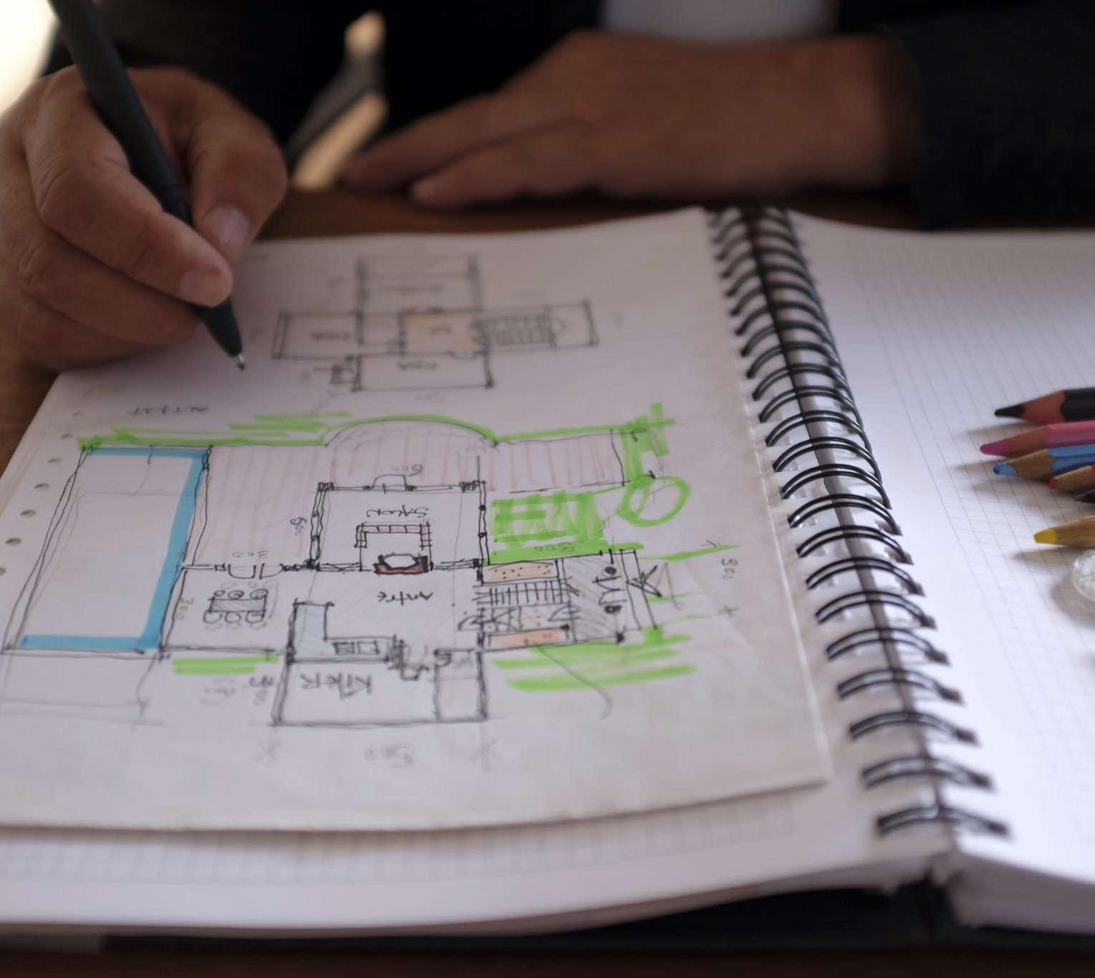
Key Takeaways
Thank you for your attention!
Importance of Structure
  A clear structure improves both readability and credibility of research papers across disciplines.
Role of Examples
  Practical civil engineering examples connect theory to real-world problems, enhancing engagement.
Effective Academic Communication
  Mastering research paper structure enables clear communication and influence in engineering fields.
Notes:
A clear and logical structure enhances the readability and credibility of research papers. Each section serves a distinct purpose, from setting the context in the introduction to summarizing insights in the conclusion. Civil Engineering examples demonstrate how theoretical concepts apply to practical problems, making the learning process more engaging. Exercises encourage students to practice writing, reinforcing their understanding of research conventions. By mastering the structure of research papers, students can effectively communicate their ideas, contribute to academic discourse, and influence engineering practices.

