Slide 1

Introduction to Civil Engineering: Foundations, Examples, and Innovations
Exploring milestones, projects, trends, and future of civil engineering
Notes:
AI-generated content may be incorrect. Civil engineering plays a crucial role in shaping the world we live in. This presentation will explore the fundamentals of civil engineering, historical milestones, notable projects, key concepts, current trends, and future directions in the field.

Slide 2

Agenda Items
Fundamentals of Civil Engineering
Historical Milestones in Civil Engineering
Notable Civil Engineering Projects
Key Concepts and Techniques
Current Trends and Future Directions
References and Further Learning
Notes:
We will delve into the core aspects of civil engineering, from its historical evolution to its modern applications. By exploring notable projects, key concepts, and emerging trends, we aim to provide a comprehensive introduction to this dynamic field.

Slide 3
Fundamentals of Civil Engineering
Notes:
Civil engineering encompasses a wide array of disciplines that focus on designing, constructing, and maintaining infrastructure. Civil engineers play a vital role in shaping the built environment and ensuring the safety and well-being of society.

Slide 4

Definition and Scope of Civil Engineering
Infrastructure Design and Construction
Civil engineering focuses on designing and constructing various types of infrastructure, including buildings, bridges, roads, and water supply systems.
Sub-disciplines of Civil Engineering
Civil engineering encompasses sub-disciplines such as structural engineering, transportation engineering, and geotechnical engineering, each specializing in specific aspects of infrastructure development.
Notes:
Civil engineering involves the design, construction, and maintenance of infrastructure such as buildings, bridges, roads, and water supply systems. It encompasses various sub-disciplines, including structural engineering, transportation engineering, and geotechnical engineering.

Slide 5

Key Branches and Disciplines
Structural Engineering
Structural engineering focuses on designing and constructing buildings, bridges, and other structures to ensure they are safe, stable, and resistant to various forces.
Transportation Engineering
Transportation engineering deals with the planning, design, and operation of transportation systems to ensure efficient and safe movement of people and goods.
Geotechnical Engineering
Geotechnical engineering focuses on the behavior of earth materials and their interaction with structures to ensure the stability and durability of construction projects.
Environmental Engineering
Environmental engineering deals with protecting the environment and public health through sustainable design and management of natural resources, waste disposal, and pollution control.
Notes:
Civil engineering branches include structural engineering, transportation engineering, geotechnical engineering, environmental engineering, and construction engineering. Each discipline plays a critical role in different aspects of infrastructure development and management.

Slide 6

Role of Civil Engineers in Society
Infrastructure Design and Implementation
Civil engineers play a crucial role in designing and implementing infrastructure projects to meet the needs of society, ensuring safety, sustainability, and cost-effectiveness.
Community Impact
The work of civil engineers directly impacts the quality of life for communities worldwide by providing essential infrastructure for transportation, water supply, and more.
Notes:
Civil engineers are responsible for designing and implementing infrastructure projects that meet the needs of society while considering factors such as safety, sustainability, and cost-effectiveness. Their work directly impacts the quality of life for communities around the world.

Slide 7
Historical Milestones in Civil Engineering
Notes:
Throughout history, civil engineering has been at the forefront of human achievement, shaping the built environment and enabling progress. From ancient engineering marvels to modern innovations, the field has continuously evolved.

Slide 8

Ancient Engineering Marvels (E.g., Roman Aqueducts)
Roman aqueducts were impressive structures built by ancient civilizations like the Romans to transport water over long distances. They showcased advanced knowledge of materials, hydraulics, and construction techniques.
Notes:
Ancient civilizations, such as the Romans, built impressive structures like aqueducts to transport water over long distances. These engineering marvels demonstrated advanced knowledge of materials, hydraulics, and construction techniques.

Slide 9

Medieval Advancements (E.g., Gothic Cathedrals)
Flying Buttresses
Medieval engineers utilized flying buttresses in Gothic cathedrals to provide structural support and allow for taller walls and larger windows, contributing to the grandeur of the architecture.
Pointed Arches
The use of pointed arches in Gothic cathedrals allowed for greater height and openness in the architecture, creating a sense of verticality and lightness in the structures.
Vaulted Ceilings
Vaulted ceilings in Gothic cathedrals not only provided structural integrity but also added a sense of grandeur and divine symbolism to the architecture, creating a heavenly atmosphere within the sacred spaces.
Notes:
Medieval engineers made significant advancements in architecture, as seen in the intricate Gothic cathedrals. These structures showcased innovative use of flying buttresses, pointed arches, and vaulted ceilings.

Slide 10

Industrial Revolution and Modern Innovations
Industrial Revolution Advancements
The Industrial Revolution brought rapid advancements in civil engineering, with the steam engine revolutionizing construction practices and paving the way for modern industrialization.
Modern Innovations in Civil Engineering
Modern technologies like Building Information Modeling (BIM) and sustainable design principles are driving further innovations in civil engineering, shaping the future of construction practices and sustainability.
Notes:
The Industrial Revolution marked a period of rapid advancements in civil engineering, with innovations such as the steam engine revolutionizing construction practices. Today, modern technologies like BIM and sustainable design principles are driving further innovations.

Slide 11
Notable Civil Engineering Projects
Notes:
Civil engineers have been responsible for the design and construction of iconic projects that push the boundaries of engineering excellence. These projects showcase the innovative solutions and collaborative efforts of the industry.

Slide 12

Rio-Antirrio Bridge: Overview and Significance
Architectural Marvel
The Rio-Antirrio Bridge is an architectural marvel that connects the Peloponnese peninsula to mainland Greece, showcasing modern engineering excellence.
Ingenious Design
The design and construction of the Rio-Antirrio Bridge over challenging geological conditions highlight the ingenuity and expertise of civil engineers involved in the project.
Notes:
The Rio-Antirrio Bridge, connecting the Peloponnese peninsula to mainland Greece, is a marvel of modern engineering. Its design and construction over challenging geological conditions demonstrate the ingenuity and expertise of civil engineers.

Slide 13

The Panama Canal: Engineering Challenges and Solutions
Excavation Challenges
The construction of the Panama Canal faced significant challenges in excavating through dense tropical forests, requiring innovative engineering solutions to clear the way for the canal.
Water Resource Management
Managing vast water resources was a key engineering challenge during the construction of the Panama Canal. The canal's completion required efficient water management strategies.
Notes:
The construction of the Panama Canal presented numerous engineering challenges, including excavating through dense tropical forests and managing vast water resources. The canal's completion revolutionized global trade and transportation.

Slide 14
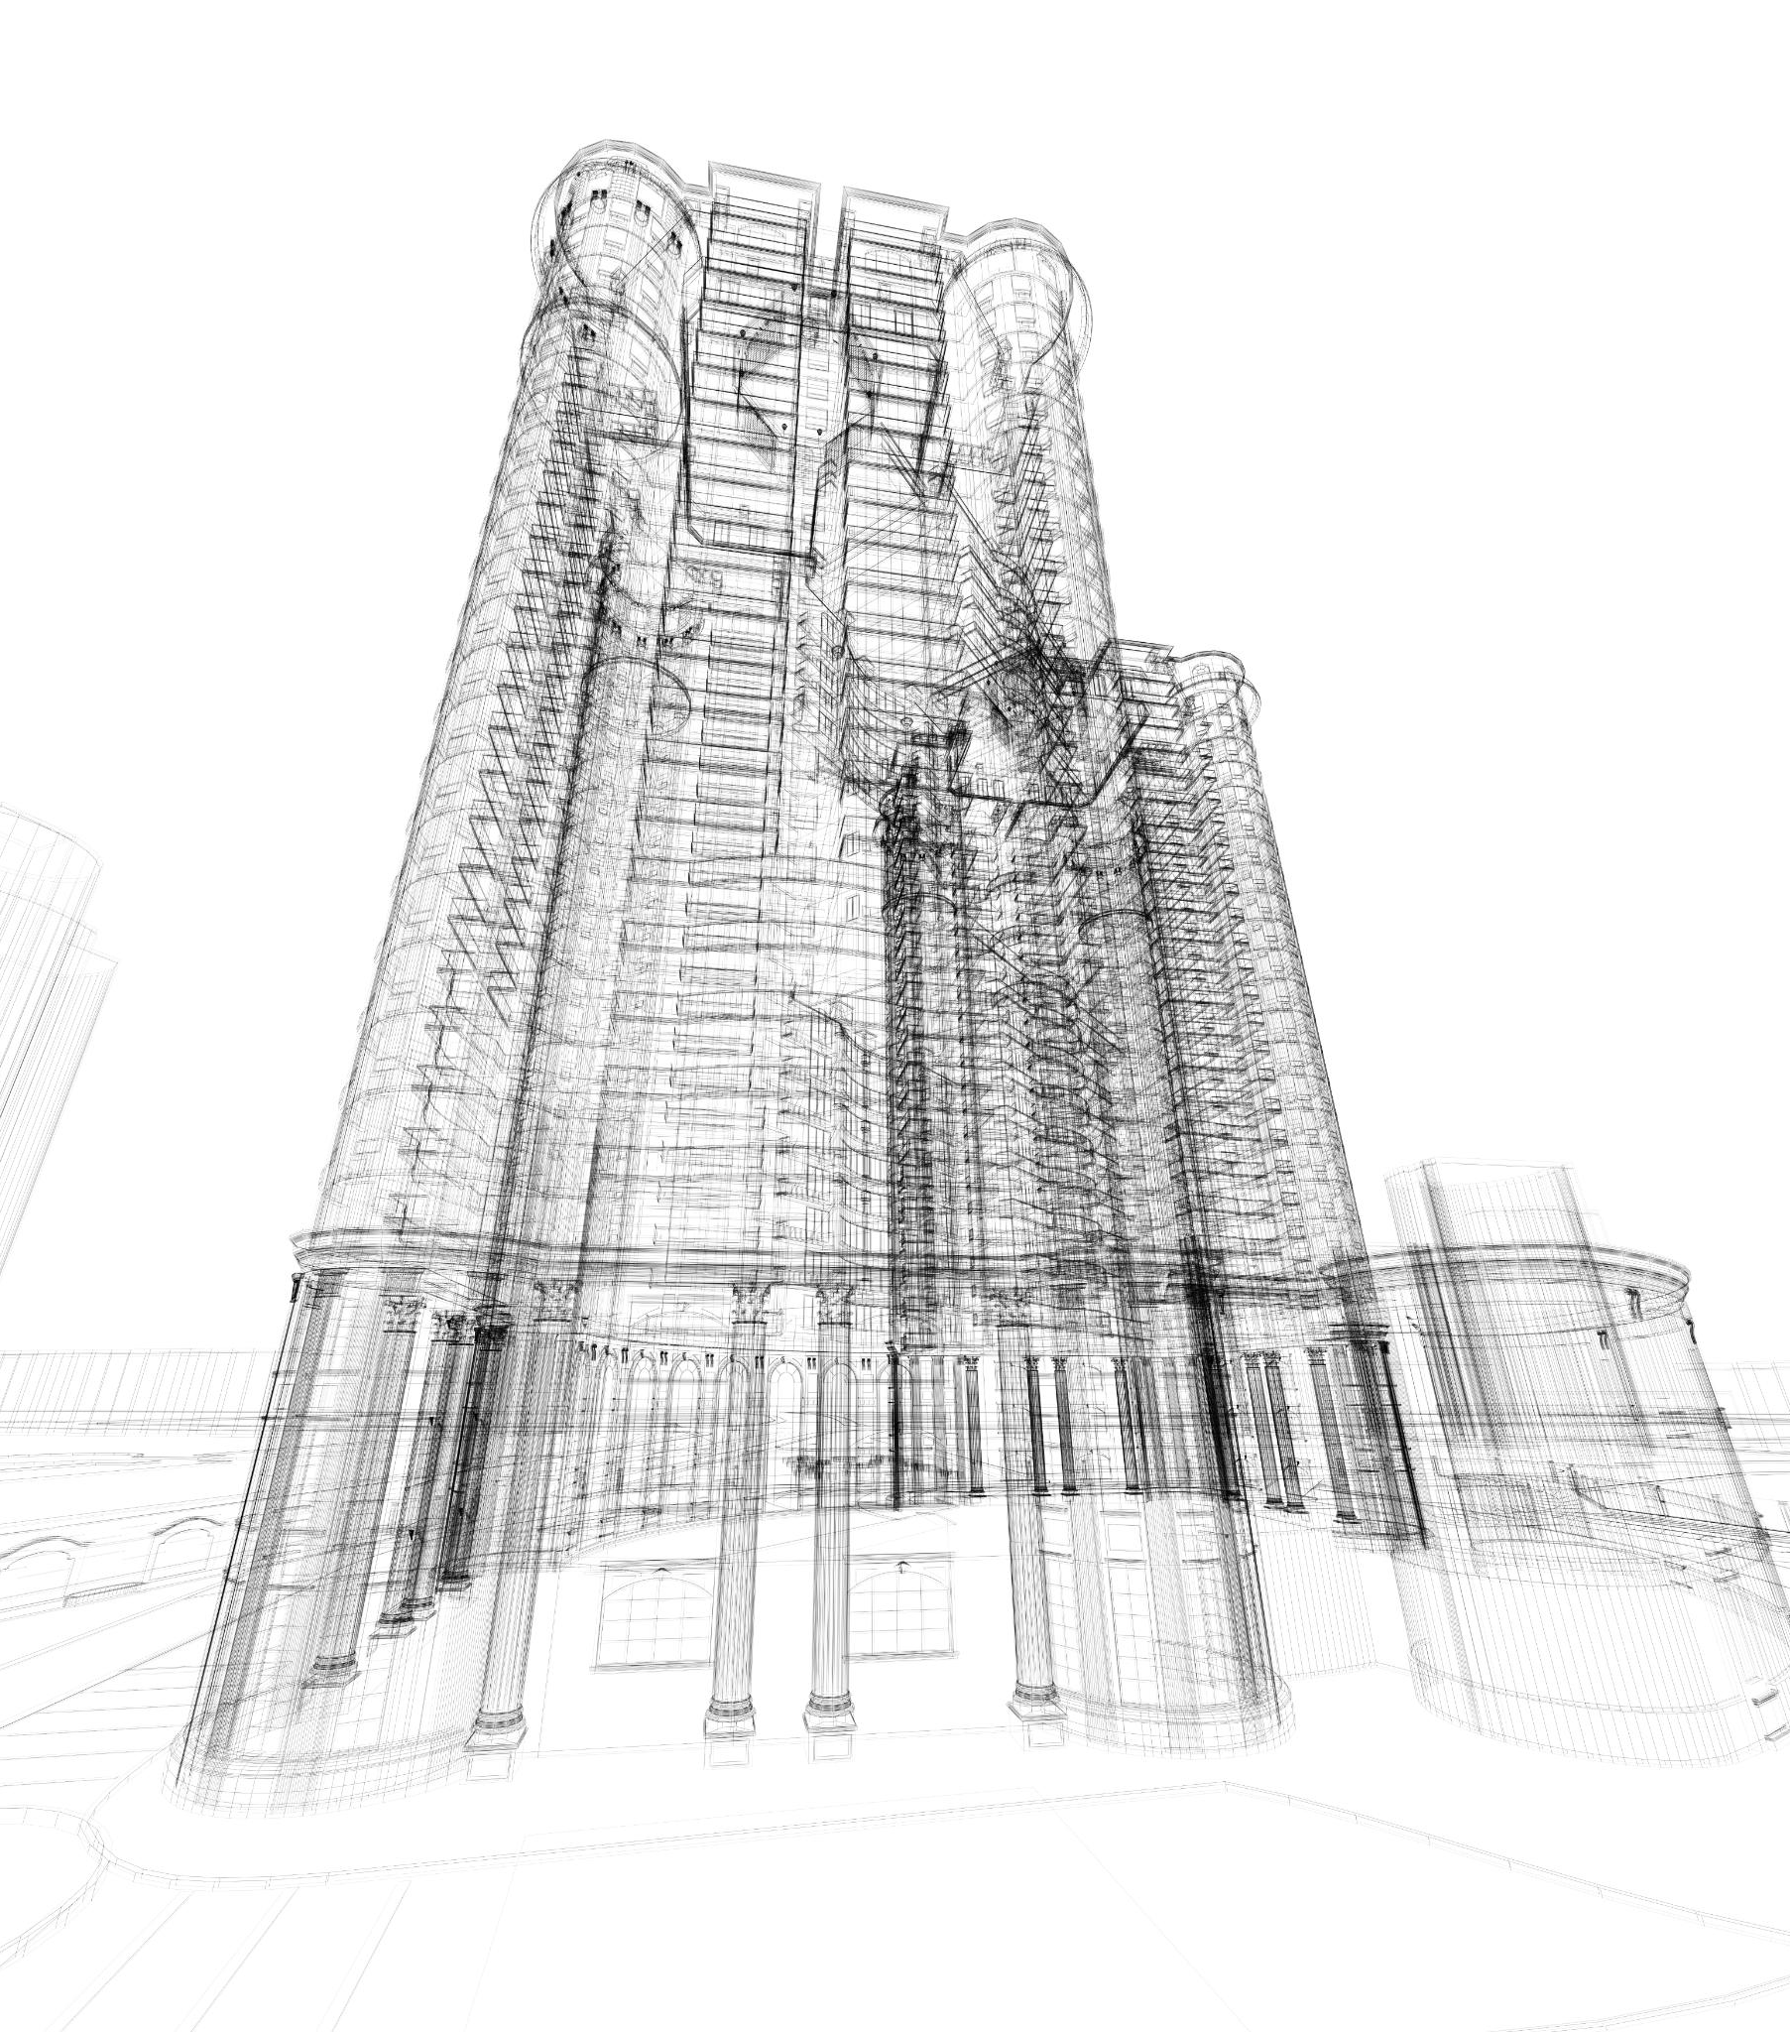
Burj Khalifa: Design and Construction
Innovative Structural Design
The Burj Khalifa's design incorporated innovative structural engineering to support its incredible height, showcasing the advancement in architectural technology.
Construction Techniques
Specialized construction techniques were employed to build the Burj Khalifa, demonstrating the complexity and precision required for such a monumental structure.
Notes:
The Burj Khalifa, the world's tallest building, required innovative structural design and construction techniques to achieve its iconic height. The skyscraper stands as a symbol of human ingenuity and architectural excellence.

Slide 15
Key Concepts and Techniques
Notes:
Civil engineering relies on fundamental concepts and techniques to design and construct safe, sustainable, and cost-effective infrastructure. Understanding structural analysis, materials science, and sustainable practices is essential for modern civil engineers.

Slide 16

Structural Analysis and Design
Behavior of Structural Elements
Structural analysis evaluates how structural elements respond to different loads and conditions, ensuring structural stability and performance.
Design Safety and Efficiency
Design considerations focus on ensuring structures are safe, durable, and efficient in meeting their functional requirements, providing long-term reliability.
Notes:
Structural analysis involves evaluating the behavior and performance of structural elements under various loads and conditions. Design considerations ensure that structures are safe, durable, and efficient in meeting their functional requirements.

Slide 17

Materials Science in Construction
Properties of Construction Materials
Materials science provides essential insights into the properties of construction materials, helping engineers understand how materials behave under different conditions.
Material Selection in Construction
Engineers must carefully select materials based on specific applications and environmental factors to ensure the structural integrity and longevity of construction projects.
Notes:
Materials science plays a critical role in civil engineering by providing insights into the properties and behavior of construction materials. Engineers must select materials that are suitable for specific applications and capable of withstanding environmental factors.

Slide 18

Sustainable Engineering Practices
Green Building
Green building focuses on creating structures that are environmentally responsible and resource-efficient throughout a building's life cycle, from design to construction and operation.
Renewable Energy Integration
Renewable energy integration involves incorporating sustainable energy sources like solar and wind power into building designs to reduce reliance on fossil fuels and lower carbon emissions.
Life Cycle Assessment
Life cycle assessment is a method to evaluate the environmental impacts of a product or service throughout its entire life cycle, from raw material extraction to disposal, aiming to minimize resource consumption and waste generation.
Notes:
Sustainable engineering focuses on designing infrastructure that minimizes environmental impact and maximizes resource efficiency. Concepts like green building, renewable energy integration, and life cycle assessment are essential for creating resilient and eco-friendly structures.

Slide 19
Current Trends and Future Directions
Notes:
The field of civil engineering is constantly evolving to address the challenges of a rapidly changing world. Emerging trends such as smart infrastructure, green engineering, and sustainable practices are shaping the future of the industry.

Slide 20

Smart Infrastructure and Technology Integration
IoT and Sensors
IoT devices and sensors are key components of smart infrastructure, enabling real-time data collection and analysis for optimal system performance.
Data Analytics
Data analytics plays a crucial role in smart infrastructure by processing vast amounts of data to extract valuable insights for informed decision-making.
Notes:
Smart infrastructure leverages technologies like IoT, sensors, and data analytics to enhance the efficiency and performance of infrastructure systems. Integration of digital tools and real-time monitoring enables proactive maintenance and improved decision-making.

Slide 21

Environmental Considerations and Green Engineering
Minimizing Environmental Impact
Green engineering aims to minimize the environmental impact of civil engineering projects by implementing sustainable practices and technologies that reduce pollution and conserve natural resources.
Promoting Sustainability
Green engineering promotes sustainability by incorporating strategies like green building design, renewable energy utilization, and waste reduction into civil engineering projects for a more eco-friendly future.
Notes:
Green engineering focuses on minimizing environmental impact and promoting sustainability in civil engineering projects. Strategies like green building design, renewable energy utilization, and waste reduction are key considerations for future projects.

Slide 22

Future Challenges and Opportunities in Civil Engineering
Resilient Infrastructure Solutions
Civil engineers play a crucial role in developing resilient infrastructure solutions to tackle challenges like climate change, urbanization, and population growth.
Innovation and Collaboration
Embracing innovation and collaboration are key for civil engineers to address future challenges effectively and develop cutting-edge solutions.
Notes:
As the world faces complex challenges such as climate change, urbanization, and population growth, civil engineers have a crucial role in developing resilient infrastructure solutions. Embracing innovation, collaboration, and sustainable practices will be essential in addressing future challenges.

Slide 23
References and Further Learning
Notes:
Civil engineering professionals can enhance their knowledge and skills by exploring key textbooks, publications, and case studies. Engaging with professional organizations and academic resources can provide valuable insights and networking opportunities.

Slide 24

Key Textbooks and Publications
Structural Design
Key textbooks and publications in civil engineering focus on structural design, providing essential knowledge for designing safe and efficient structures.
Construction Management
Textbooks and publications in civil engineering cover construction management, offering insights into project planning, organization, and execution.
Geotechnical Engineering
Key resources in civil engineering include textbooks and publications on geotechnical engineering, focusing on soil mechanics, foundation design, and earth structures.
Transportation Planning
Publications in civil engineering also cover transportation planning, addressing topics such as traffic engineering, urban transportation systems, and sustainable mobility.
Notes:
Key textbooks and publications in civil engineering cover a wide range of topics, including structural design, construction management, geotechnical engineering, and transportation planning. These resources serve as valuable references for both students and professionals.

Slide 25

Professional Organizations and Resources
ASCE - American Society of Civil Engineers
ASCE offers valuable resources, networking opportunities, and continuing education for civil engineers, supporting their professional growth and development.
ICE - Institution of Civil Engineers
ICE provides civil engineers with access to industry insights, networking events, and professional development resources to enhance their careers and expertise.
CIOB - Chartered Institute of Building
CIOB offers civil engineers valuable resources, networking opportunities, and continuing education programs to support their professional development and advancement in the industry.
Notes:
Professional organizations like ASCE, ICE, and CIOB offer valuable resources, networking opportunities, and continuing education for civil engineers. Membership in these organizations can provide access to industry insights and professional development opportunities.

Slide 26

Case Studies and Academic Papers
Real-world Projects Insights
Exploring case studies in civil engineering offers valuable insights into real-world projects, allowing for a deeper understanding of challenges faced and innovative solutions implemented.
Research Trends Analysis
Analyzing academic papers in civil engineering can uncover research trends and advancements in the field, providing inspiration for new ideas and approaches.
Notes:
Exploring case studies and academic papers in civil engineering can provide valuable insights into real-world projects, innovative solutions, and research trends. Analyzing past projects and research findings can enhance understanding and inspire new ideas.

Slide 27
Conclusion
Fundamentals of Civil Engineering
Understanding the fundamental principles of civil engineering is crucial for shaping the infrastructure of the world we live in.
Historical Milestones and Notable Projects
Exploring historical milestones and notable projects in civil engineering provides insights into the evolution of the field and its impact on society.
Current Trends in Civil Engineering
Understanding current trends in civil engineering helps us adapt to new technologies and innovative solutions for sustainable infrastructure development.
Future Directions of Civil Engineering
Exploring the future directions of civil engineering enables us to anticipate challenges, innovate solutions, and create a sustainable and resilient future.
Notes:
Civil engineering is a dynamic and essential field that shapes the world we live in. By understanding its fundamentals, historical milestones, notable projects, key concepts, current trends, and future directions, we gain valuable insights into the impact and potential of civil engineering in creating a sustainable and resilient future.

