Slide 1

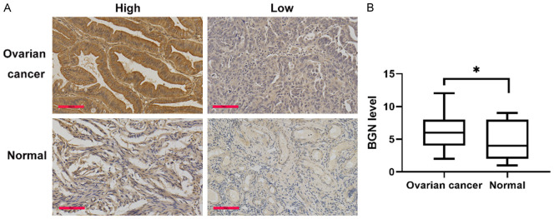
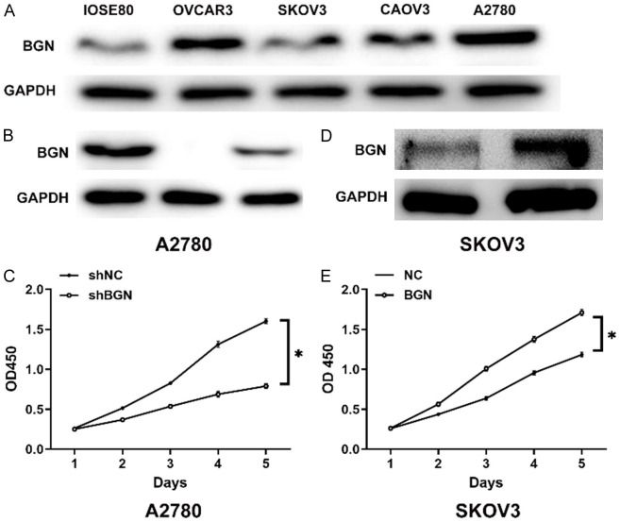
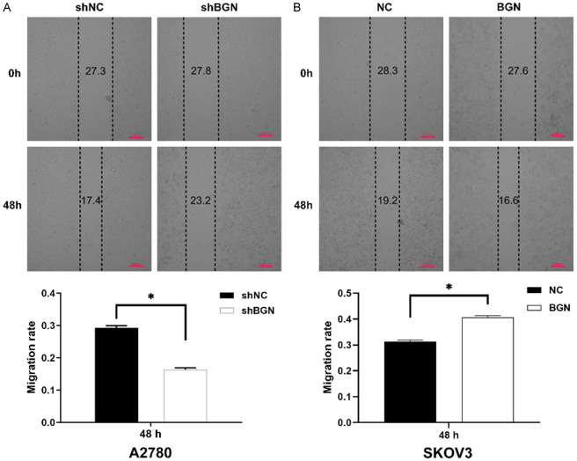
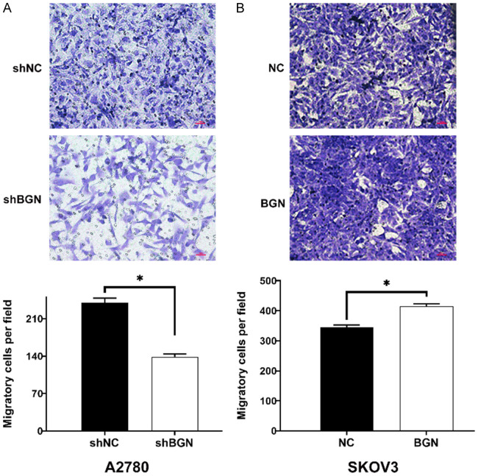

Biglycan promotes proliferation and metastasis of ovarian cancer
Shan-Yu Fang*, Xue-Mei Zhang*, Xin-Ping Chen*
Department of Obstetrics and Gynecology, The First Affiliated Hospital of Nanchang University, Nanchang 330006, Jiangxi, China. *Equal contributors.
INTRODUCTION
Ovarian cancer (OC) is among the most lethal gynecological cancers, largely due to its late detection and high recurrence rates despite surgery and chemotherapy. Biglycan (BGN) is an extracellular matrix proteoglycan that helps maintain tissue structure and regulates key signaling pathways involved in cell behavior. Notably, BGN is overexpressed in several malignancies including endometrial, lung, gastric, and colon cancer indicating its potential contribution to tumor growth and progression.
AIM
BGN expression levels in OC and normal tissues
AIM
The aim of this study was to investigate the expression levels of BGN in ovarian cancer tissues and cells, and to clarify how BGN influences ovarian cancer progression and specifically its effects on tumor cell proliferation, migration, and metastasis. By understanding BGN’s functional role, the study sought to determine whether BGN could serve as a potential biomarker or therapeutic target in ovarian cancer.
RESULTS
Detection of BGN levels in OC and normal ovarian
cells with Western blot analysis
Effects of BGN on wound healing of OC cells
Effects of BGN on migration ability of OC cells, as determined with the transwell assay
CONCLUSIONS
The study demonstrated that BGN expression is significantly higher in ovarian cancer tissues and cell lines compared to normal ovarian tissues. Functional experiments showed that silencing BGN reduced ovarian cancer cell proliferation and migration, while overexpressing BGN enhanced these tumor-promoting behaviors. Together, these findings indicate that BGN actively contributes to ovarian cancer progression and may serve as a potential biomarker and therapeutic target for the disease.
FUTURE DIRECTIONS
Future studies should investigate the molecular mechanisms by which BGN promotes ovarian cancer progression, particularly its involvement in Wnt, MAPK, and other signaling pathways. Larger clinical cohorts are needed to clarify the association between BGN expression and clinicopathological features and patient prognosis. In vivo studies and therapeutic targeting of BGN or its downstream pathways may further establish BGN as a prognostic biomarker and a potential target for ovarian cancer treatment.

