Slide 2
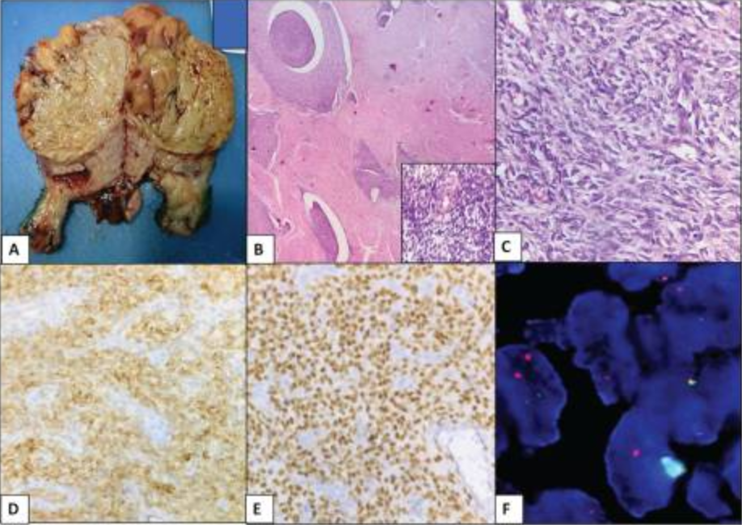
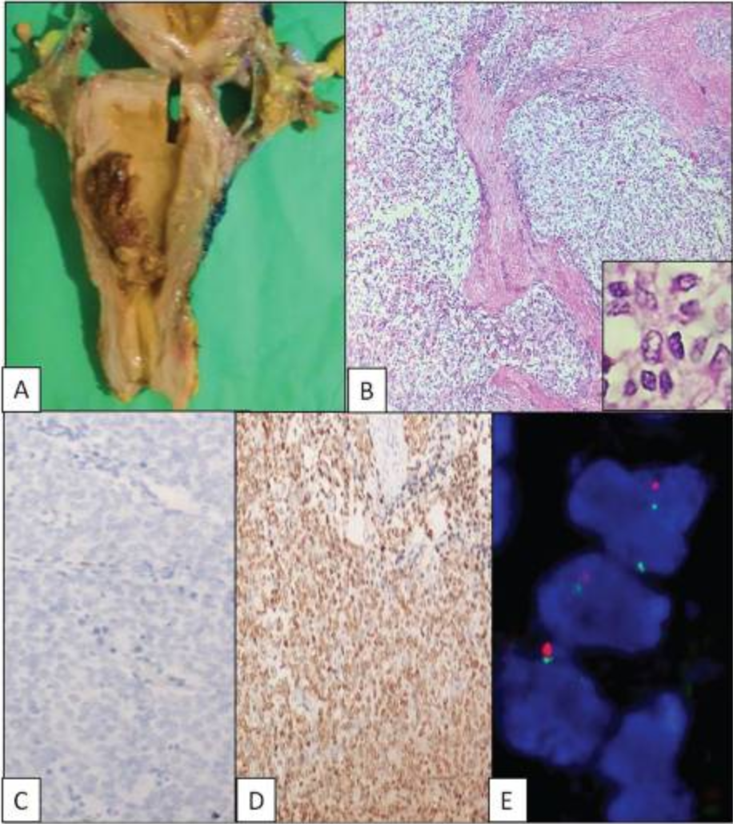
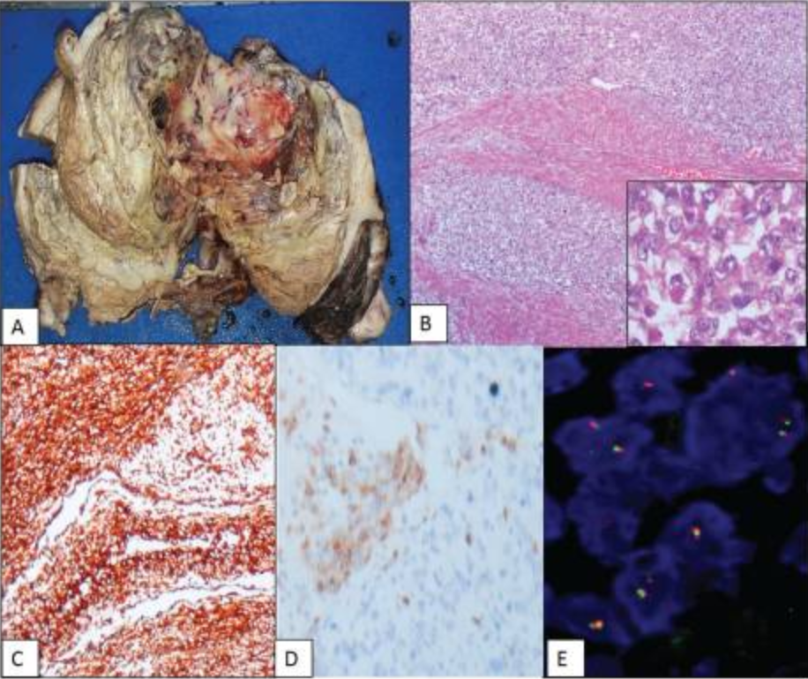
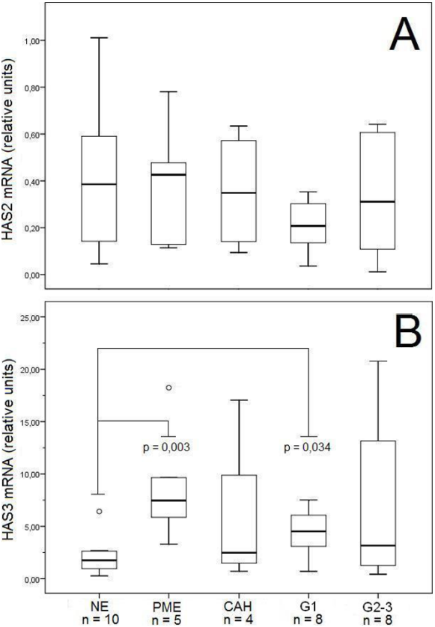
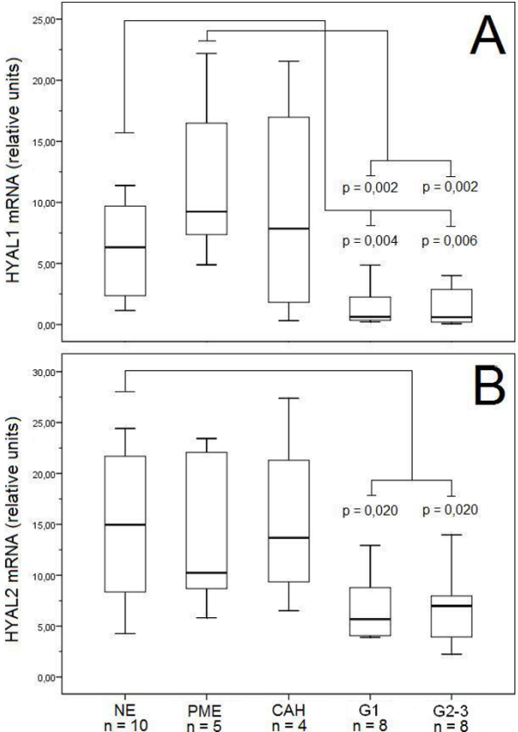
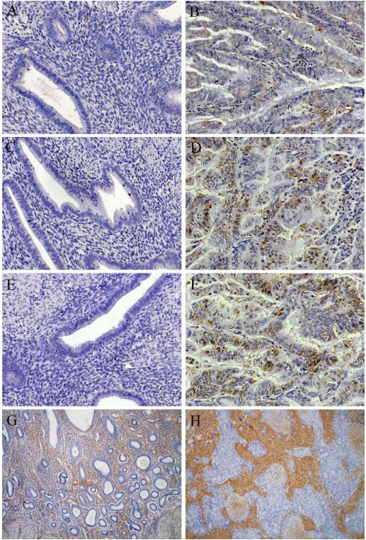
Hyaluronan Synthases (HAS1–3), Hyaluronidases (HYAL1–2), and ECM Alterations in Uterine Tumors: An Immunohistochemical and Molecular Overview
Maria Marmara ¹, Thomas Vrekoussis ², Fanourios Makrygiannakis ^{1,2}, Dragana Nikitovic ¹ and Aikaterini Berdiaki^{* 1}
¹ Department of Histology-Embryology, Medical School, University of Crete, 70013 Heraklion, Greece ² Laboratory of Human Reproduction, Department of Obstetrics and Gynecology, Medical School, University of Crete, 70013 Heraklion, Greece Email: berdiaki@uoc.gr
INTRODUCTION
RESULTS
Rare mesenchymal neoplasms of the endometrium, endometrial stromal
tumors, (ESTs) can range from benign stromal nodules to extremely
aggressive sarcomas. Their variability makes diagnosis, categorization,
and therapy extremely difficult. Uterine tissue architecture and tumor
behavior are significantly shaped by the extracellular matrix (ECM), a
dynamic network of structural and signaling components. Tumor
growth, invasion, and progression in ESTs are actively encouraged by ECM remodeling and changes in its constituent parts. Hyaluronan synthases (HAS1-3) and hyaluronidases (HYAL1,2) control the
amounts of hyaluronan, a key glycosaminoglycan of the ECM accumulates in a number of cancers, including endometrial cancer. The significance of ECM- and hyaluronan related pathways in the pathogenesis of ESTs is highlighted by the dysregulation of these
enzymes, which results in abnormal hyaluronan accumulation and tumor-supportive ECM remodeling.
Low-grade endometrial stromal sarcoma
(LG-ESS)
High-grade endometrial stromal sarcoma (HG-ESS)
Undifferentiated uterine sarcoma
(UUSs)
Figure 1. (A) Gross examination reveals a well-defined yellow-tan tumor. (B–C) H&E sections
displaying homogenous small cells with little
atypia, delicate spiral arterioles, and tongue like infiltration. (D-E) Immunohistochemistry
showing ER positive and diffuse CD10. (F) FISH
showing the t(7;17)(p15;q11.2) rearrangement utilizing the JAZF1–SUZ12 dual-fusion probe.
Figure 2. (A) Gross examination reveals Polypoidal mass. (B) Infiltrative growth with uniform round cells (H&E).
(C–D) Immunohistochemistry showing CD10 negativity and diffuse cyclin D1 positivity.
(E) FISH demonstrating YWHAE-FAM22 t(10;17) translocation.
Figure 3. (A) Gross examination reveals a large intracavitary fleshy polypoidal mass with haemorrhage and necrosis. (B) H&E section demonstrating diffuse myometrial infiltration (×100). (C–D) Immunohistochemistry showing diffuse vimentin positivity and focal CD10 expression (×400). (E) FISH analysis negative for YWHAE–FAM22 rearrangement.
AIM
The aim of this study was to characterize ESTs using immunohistochemical and molecular markers and to examine the expression of hyaluronan synthases (HAS1–3) and hyaluronidases (HYAL1–2) using RT-PCR and correlate these levels with tissue hyaluronan content and HAS1–3 immunoreactivity.
Real – Time PCR
(PR-PCR)
HAS 1-3 immunoreactivity and HA-staining
CONCLUSIONS
Endometrial stromal tumors constitute a rare, small but clinically significant subset of uterine mesenchymal neoplasms (1.8%)
Subclassification of ESTs is essential due to differences in prognosis and management
LG-ESS: CD10 shows high diagnostic performance (sensitivity 100%, specificity 90%), ER/PR demonstrate 80% sensitivity and 100% specificity. Cyclin D1 is highly specific (100%) for YWHAE–FAM22–rearranged HG-ESS
FISH for JAZF1–SUZ12 and YWHAE–FAM22 is a valuable adjunct for accurate ESS grading
HYAL1 and HYAL2 were coexpressed and significantly downregulated in endometrioid endometrial cancer. Reduced HYAL1/2 expression correlated with increased hyaluronan accumulation.
HAS1–3 mRNA levels were not elevated, but HAS1–3 immunoreactivity was increased.
Findings suggest cancer-related alterations in HAS protein turnover rather than transcriptional upregulation
Figure 6. Immunostaining of HAS1 (A,B), HAS2 (C, D), HAS3 (E,F) and HA (G,H) in normal human endometrium (A,C,E,G) and in grade 2 endometrioid endometrial carcinoma tissue sections (B,D,F, H). The brown color (DAB) indicates HAS (A-F) or HA (G,H), and blue color (haematoxylin) indicates nuclei.
Figure 4. HAS 2-3 mRNA expression in human endometrium and its lesions. Relative mRNA levels of A) HAS2 and B) HAS3 in different tissues.
Figure 5. HYAL 1-2 mRNA expression in human endometrium and its lesions. Relative mRNA levels of A) HYAL1 and B) HYAL2 in different tissues.
Transcripts of HAS1 were detected at such a low level that reliable quantitation was not consistently possible.

