Slide 1
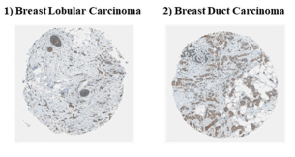
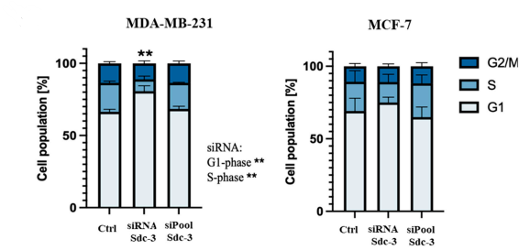
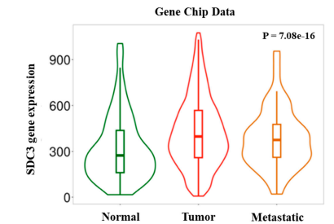
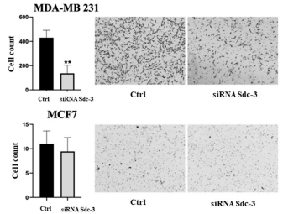
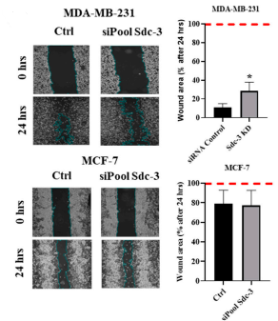
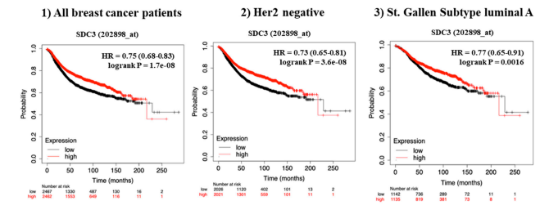
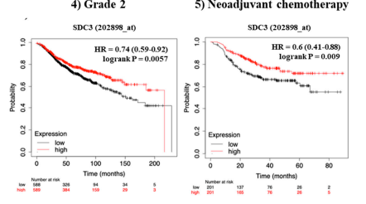
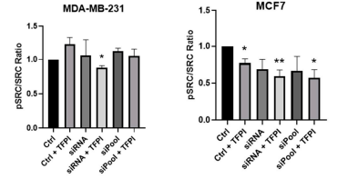
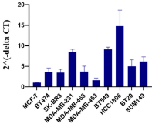
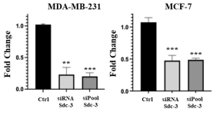
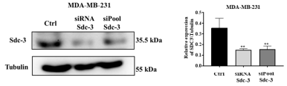
The role of the Cell Surface Heparan Sulfate Proteoglycan Syndecan-3 in Breast cancer Pathophysiology Lena Habenicht 1 , Nourhan Hassan 2,3 , Nancy A. Espinoza-Sànchez 1,4 , Jessica Oyie Sousa Onyeisi 1 , Balázs Gy˝orffy 5 , Lars Hanker 1 , Burkhard Greve 4 and Martin Götte 1,* 1 Department of Gynecology and Obstetrics, Münster University Hospital, Albert-Schweitzer Campus 1, 48149 Münster, Germany; nancyadriana.espinozasanchez@ukmuenster.de (N.A.E.-S.); jessicaoyie.Sousaonyeisi@ukmuenster.de (J.O.S.O.); lars.hanker@ukmuenster.de (L.H.) 2 Center for Molecular Medicine Cologne, University of Cologne, Robert-Koch-Straße 21, 50931 Cologne, Germany; nourhan.hassan@uk-koeln.de 3 Biotechnology Department, Faculty of Science, Cairo University, Giza 12613, Egypt 4 Department of Radiotherapy-Radiooncology, Münster University Hospital, Albert-Schweitzer Campus 1, 48149 Münster, Germany; greveb@uni-muenster.de 5 Department of Bioinformatics, Semmelweis University, T˝uzoltó utca 7-9, 1094 Budapest, Hungary; gyorffy.balazs@med.semmelweis-univ.hu * Correspondence: mgotte@uni-muenster.de
Introduction
Results
With its great biological and clinical heterogeneity, breast cancer continues to be one of the most common and deadly cancers in the world. Recent research identifies the extracellular matrix (ECM) as a crucial regulator of tumor growth in addition to genetic and hormonal factors. Tumor behavior is shaped by proteoglycans, especially heparan sulfate proteoglycans (HSPGs), which alter signaling cascades and cell–matrix interactions. While the involvement of several members of the syndecan family (SDC1, SDC2, and SDC4) in the development of cancer have been identified, nothing is known about the role of syndecan-3 (SDC3) in breast cancer. SDC3 may be an understudied factor in the pathophysiology of breast cancer due to its role in other cancer types and its regulatory effect on cellular signaling.
SDC3 expression in breast cancer histological subtypes by immunohistochemical staining, shows membranous and cytoplasmic staining that is primarily found in tumor cells, and less pronounced in the stroma.
Significant changes in the G1- and S-phase of the cell cycle in MDA-MB-231 cells :G1- phase (80.7% p ≤ 0.01),S-phase (8.2%;
p ≤ 0.01), ,control (G1-phase: 66.4%; S-phase: 20.0%).
SDC3 expression varies across breast cancer progression stages. We see significantly increased SDC3 mRNA levels in primary tumors and metastatic lesions, compared to normal breast tissue
Wound area was significantly increased
after SDC3 knockdown. MCF-7 cells displayed little changes.
The migration of MDA-MB-231 cells was significantly decreased in transwell migration
AIM
SDC3 expression is associated with the relapse-free survival (RFS) of breast cancer patients. Log-rank p values and hazard ratios (HRs; 95% confidence interval in parentheses) are shown
The effect of SDC3 depletion on the potential activation of Src proto-oncogene tyrosine-protein kinase (pSRC), as well as expression of its total form (SRC)
The aim of this study was to investigate the role of syndecan-3 (SDC3) in breast cancer by combining in-silico analyses of public datasets- The Human Protein Atlas, TNM Plot, Kaplan-Meier Plot Analysis- with in-vitro functional studies using two breast cancer cell lines- MCF-7, and MDA-MB-231, to determine how SDC3 depletion affects breast cancer cell behavior, gene expression, and oncogenic signaling pathways.
Relative gene expression of SDC3 was quantified by qRT-PCR in 10 different breast cancer cell lines.
CONCLUSIONS
Our research shows that SDC3 may have an impact on important cancer characteristics linked to breast carcinogenesis and cancer progression. We suggest that SDC3 may influence the behavior of human breast cancer cells by controlling the activity of the proto-oncogene tyrosine-protein kinase Src (SRC) in the context of the TF pathway, as well as other genes involved in important breast cancer signaling pathways. The functional alterations seen with SDC3 depletion may have a mechanistic explanation according to this molecular research.

