Slide 1
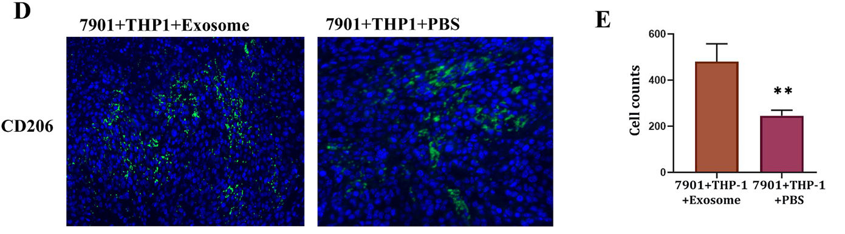
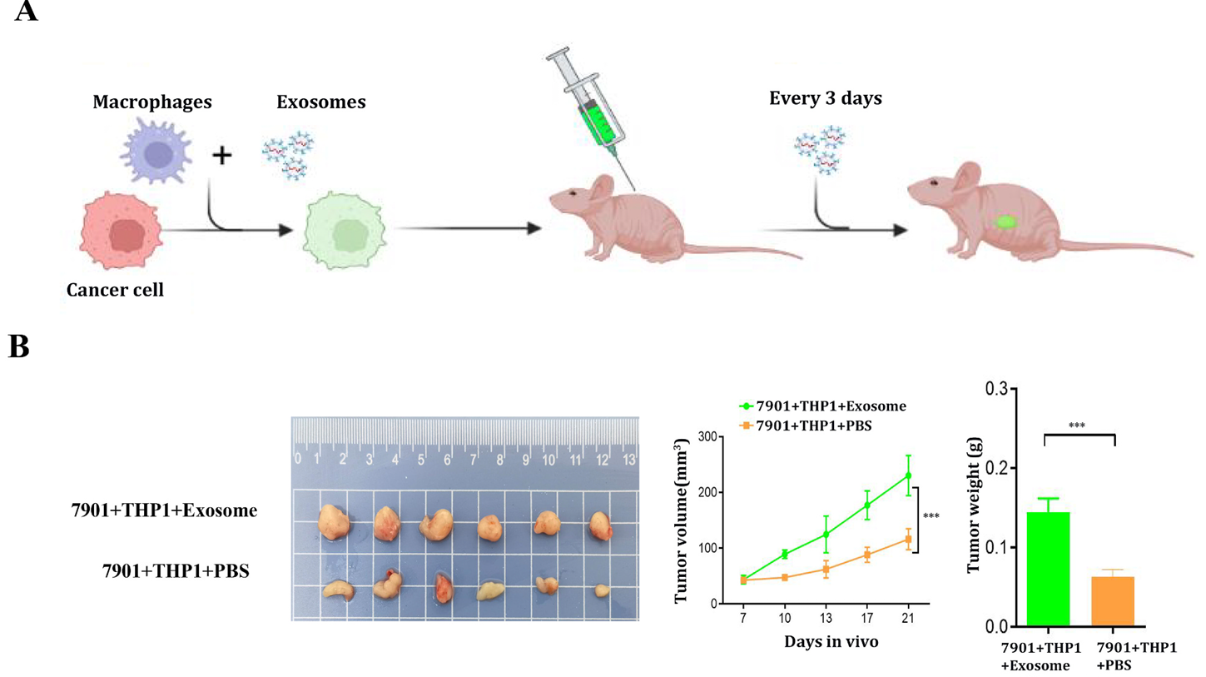
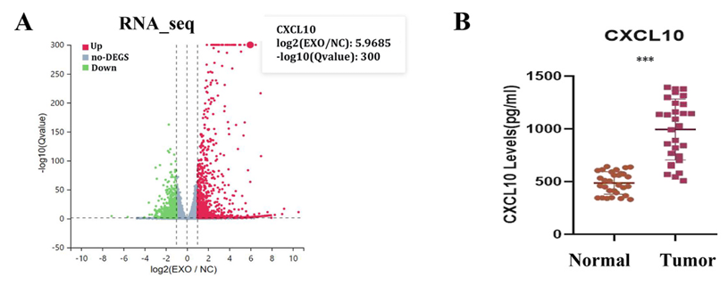
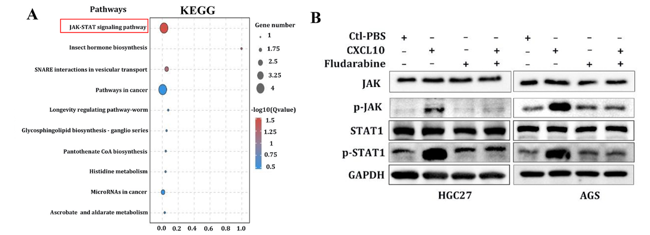
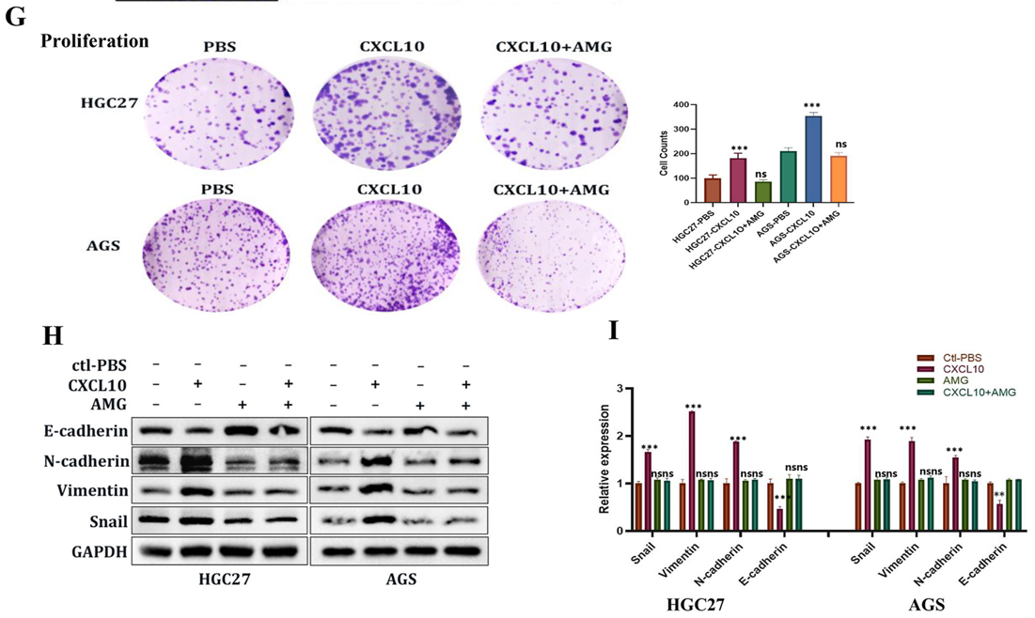
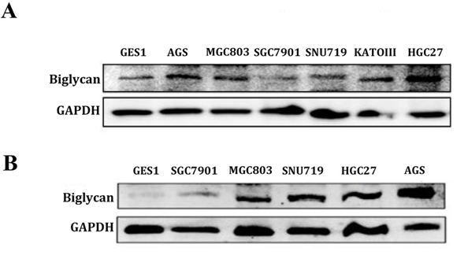
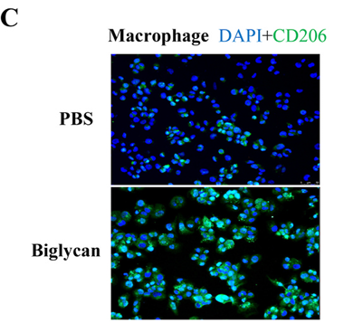
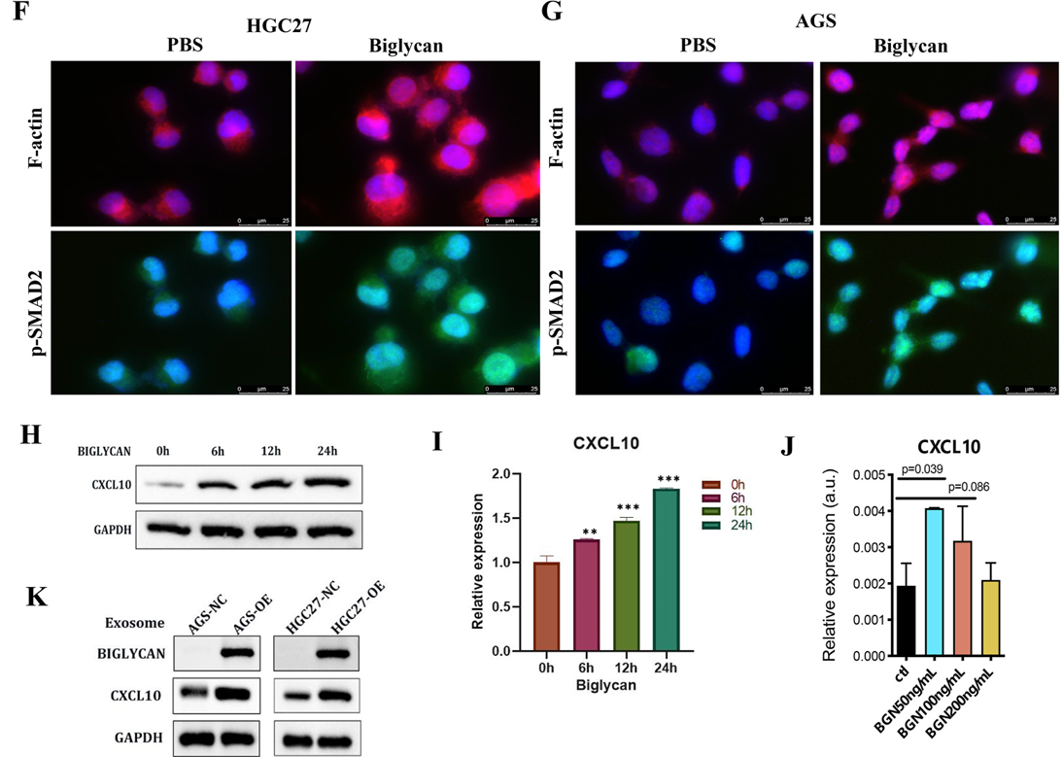
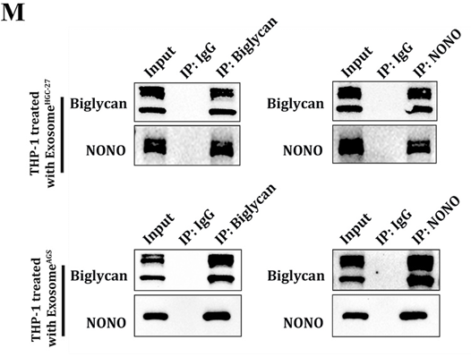
Exosomal Biglycan promotes gastric cancer progression via M2 polarization and CXCL10-mediated JAK/STAT1 activation
Wenchao Li¹˒², Songcheng Yin¹˒³, Hongfa Wei¹˒⁴, Junjie Liu⁵, Changhua Zhang¹˒⁴, Zidan Zhao¹, Mingyu Huo¹, Fuhui Wang¹˒⁴, Liang Qiao⁶
¹ Digestive Diseases Center, The Seventh Affiliated Hospital, Sun Yat-sen University, Shenzhen, China ² Department of Thyroid and Breast Surgery, The Third Affiliated Hospital, Sun Yat-sen University, Guangzhou, China ³ Department of General Surgery, The First Affiliated Hospital of Shantou University Medical College, Shantou, China ⁴ Guangdong Provincial Key Laboratory of Digestive Cancer Research, Shenzhen, China ⁵ Department of Gastric Surgery, The Sixth Affiliated Hospital, Sun Yat-sen University, Guangzhou, China ⁶ Storr Liver Centre, Westmead Institute for Medical Research, University of Sydney, Australia
INTRODUCTION – AIM
Gastric cancer (GC) is often diagnosed at advanced stages, with a 5-year survival rate below 20%. The tumor microenvironment, particularly macrophage polarization toward the M2 phenotype, plays a key role in GC progression and immune envasion. In this study, we investigate the role of GC-derived exosomal Biglycan (BGN) in macrophage reprogramming. We show that exosomal BGN is taken up by macrophages, binds to NONO, induces M2 polarization, and upregulates CXCL10. Elevated CXCL10 activates JAK/STAT1 signaling in GC cells, promoting proliferation, invasion, and metastatic potential.
METHODS
Exosome isolation & validation
Macrophage polarization analysis
Tumor cell functional assays (migration, invasion,
EMT, apoptosis)
In vivo xenograft tumor growth and histological stains
Mechanistic analysis of CXCL10/JAK-STAT signaling
Enhanced M2 macrophage infiltration in tumors in vivo
Exosome-treated macrophages promote tumor growth in vivo
GC-derived exosomes enhance CXCL10 secretion in macrophages to drive tumor progression
CXCL10 promotes GC progression by activating JAK/STAT1 signaling pathway
CXCL10 enhances GC cell proliferation and EMT via CXCR3
Biglycan-rich GC exosomes reprogram macrophages toward M2 phenotype
Exosomal biglycan increases CXCL10 expression in macrophages by binding to NONO
Conclusions
Εxosomal BGN derived from GC cell is delivered to macrophages, where it binds to NONO protein, thereby driving M2 polarization and upregulating CXCL10 expression.
The higher level of CXCL10 released by macrophages stimulated the malignant behavior of GC cells by activating the JAK/STAT1 signaling pathway.
These results suggest that BGN,CXCL10 & CXCR3 may serve as a therapeutic targets for GC patients.

