Slide 1
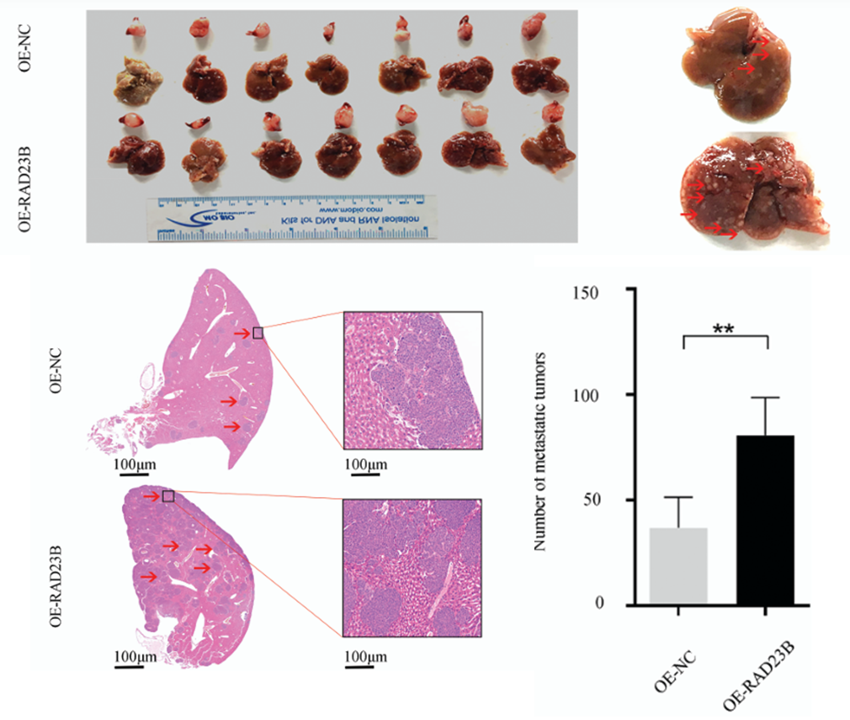
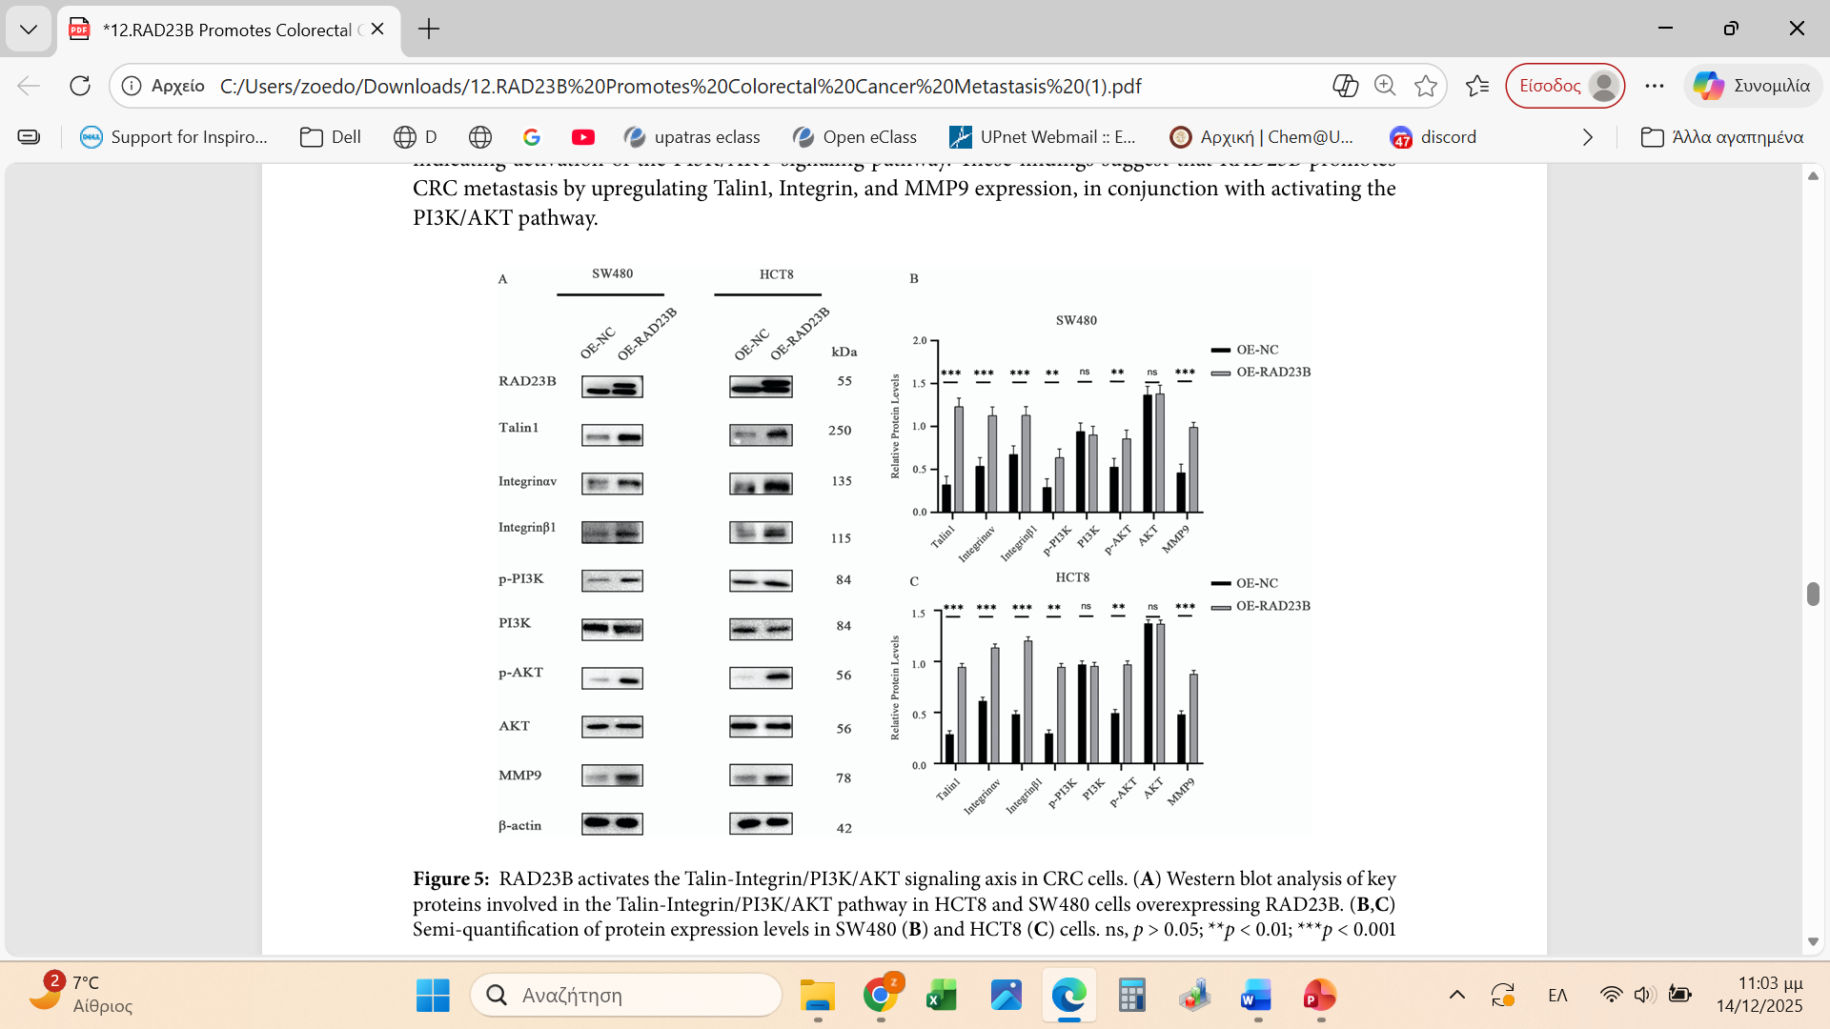
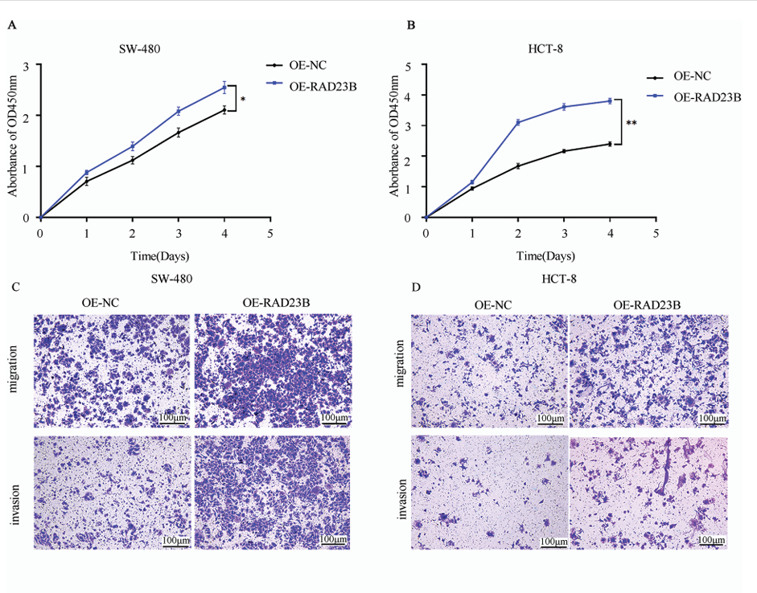
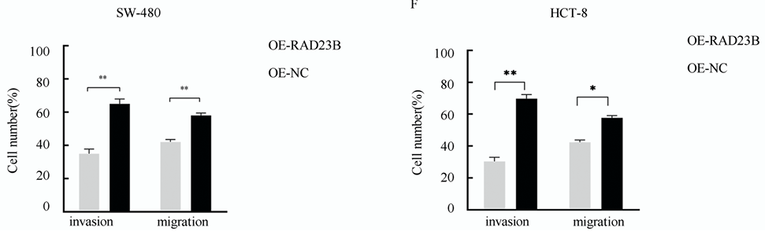
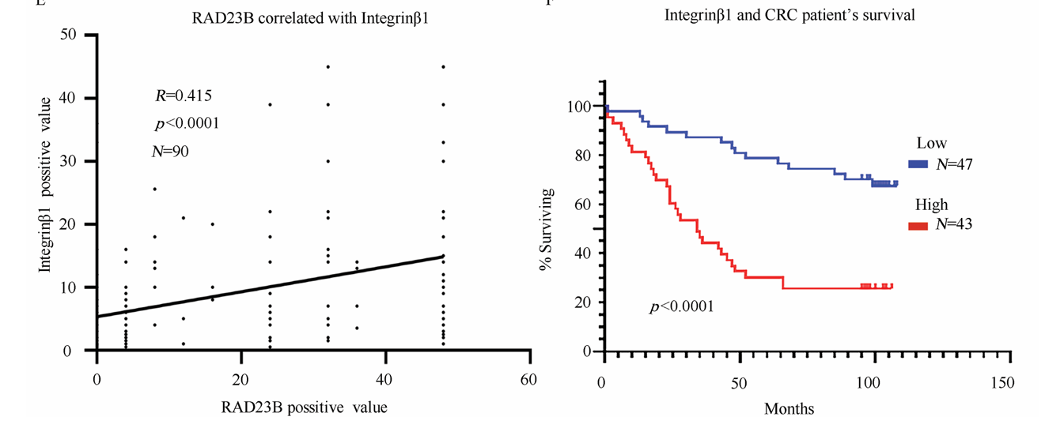
RAD23B Promotes Colorectal Cancer Metastasis via the
Talin1/Integrin/PI3K/AKT/MMP9 Axis
Jun Li ,Yang Chen, Zhijiao Hao, Zhiyong Zhang, Jingyi Fan, Xiao Liu, Xueli Zhao, Hongyan Zhang and Chenpeng Wu
Background
Colorectal cancers (CRCs) are characterized by diffuse infiltration of tumor cells into the regional lymph nodes and metastasis to distant organs, and its highly invasive nature contributes to disease recurrence and poor outcomes. CRC ranks among the foremost causes of cancer-related mortality globally.
Radiation sensitive 23 homolog B (RAD23B), a DNA repair-related protein, modulates several signaling pathways that influence cellular proliferation, migration, and invasion.
RAD23B overexpression promotes CRC metastasis in vivo
Aim
This study aimed to clarify the role of RAD23B in CRC metastasis and elucidate the underlying molecular mechanisms by which it regulates tumor cell migration, invasion, and metastasis through the Talin1/Integrin β1/PI3K/AKT/matrix metalloproteinase 9 (MMP9) signaling axis.
RAD23B activates the Talin-Integrin/PI3K/AKT signaling axis in CRC cells.
RAD23B overexpression promotes proliferation, migration, and invasion of CRC cells
RAD23B and Integrin β1 are highly expressed in CRC tissues and are linked with poor patient survival.
Highlights
RAD23B promotes metastasis in CRC via a defined molecular mechanism.
Interactions within the Talin1/Integrin/PI3K/AKT/MMP9 axis were confirmed.
RAD23B and Integrin β1 expression predict CRC metastatic risk and prognosis.
Reference provided for RAD23B inhibitors and related targeted therapies.

