Slide 1

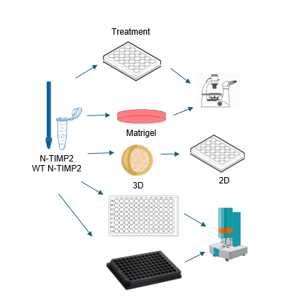
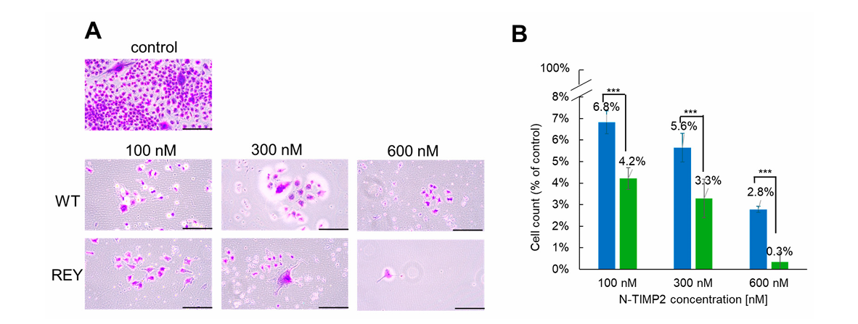
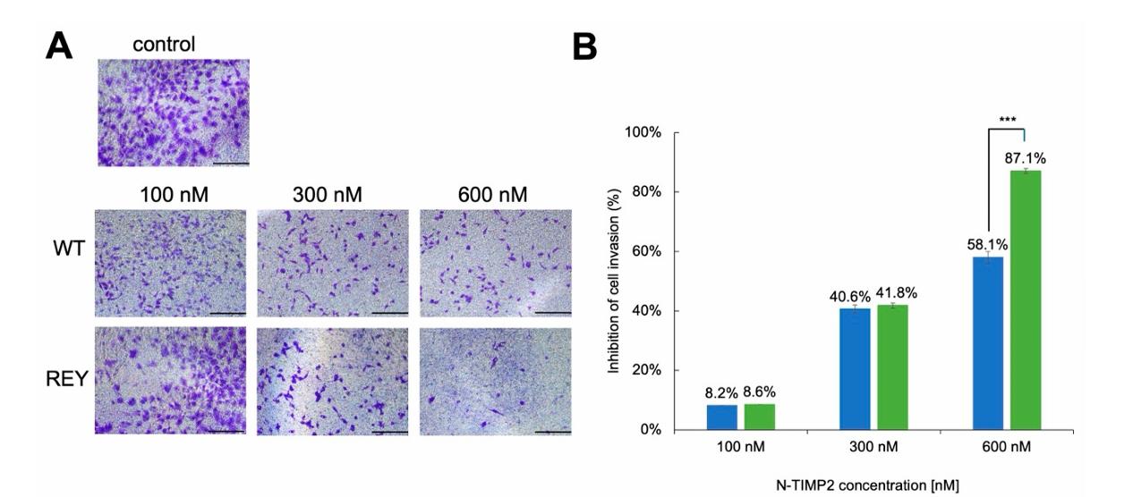
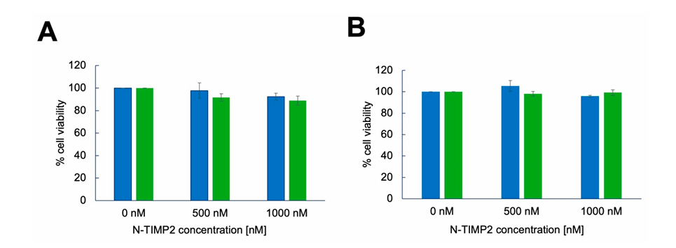
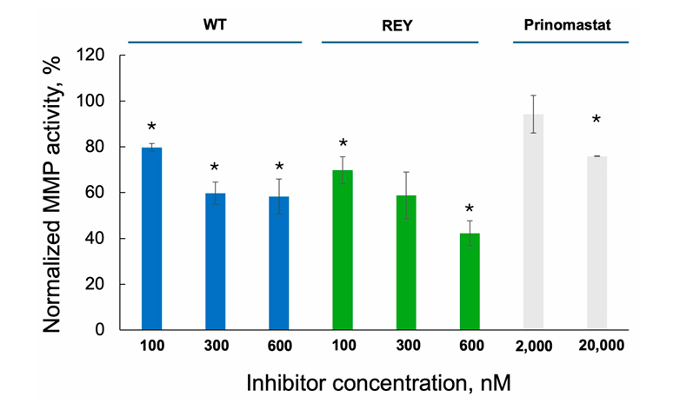
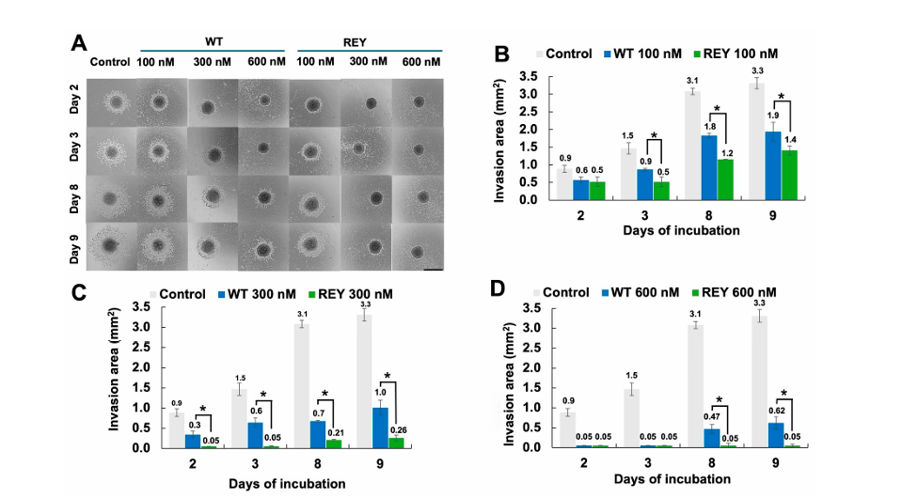
Engineered N-TIMP2 variant specifically targeting MMP-9 exhibits potent anti-glioblastoma activity
Mark Feldman, Naama Rotenberg, Julia M. Shifman
Department of Biological Chemistry, The Alexander Silberman Institute of Life Sciences, The Hebrew University of Jerusalem, Jerusalem
Background
Experimental workflow
Glioblastoma is the most common and lethal form of primary brain cancer that originates in glial cells. A major challenge in glioblastoma treatment is the ability of the aggressive tumor cells to invade surrounding healthy tissues, resist apoptosis, promote angiogenesis, and escape the immune response. These processes are closely linked to the activity of specific enzymes, matrix metalloproteinases (MMPs), that degrade the extracellular matrix (ECM). In particular, MMP-9 has been implicated in glioblastoma progression, recurrence, and treatment resistance, making it an ideal molecule to be targered in order to inhibit the aggressiveness of glioblastoma cancer cells. An attractive strategy for specific MMP inhibition takes advantage of small endogenous proteins, tissue inhibitors of metalloproteinases (TIMPs).
Aim
The main goal of this study is to examine the ability of N-TIMP2 (REY), an engineered variant of the N-terminal domainof TIMP2, to inhibit various pro-cancer processes in adult GB U251 cells using multiple in vitro assays and compare its inhibitory potency to that of WT N-TIMP2.
Cell Survival/Proliferation
Results
Cell Invasion
Cytotoxicity
Enzymatic Activity
Spheroid Spread
N-TIMP2 (REY) and WT N-TIMP2 inhibit the MMP-9 and decrease the cell proliferation, invasion and spreading of spheroids.
N-TIMP2 (REY) inhibition is dose depended, more effective and specific than WT N-TIMP2 for MMP-9.
Future perspectives
Test the activity of N-TIMP2 in additional glioblastoma cells and prioritize the long-term efficacy and safety in in vivo glioblastoma studies.
Develop advanced delivery systems for the N-TIMP2 variant.
Conclusions
Acknowledgments
We acknowledge Ruty Shai (Sheba Medical Center) for providing the GB U251 cell line

