Slide 1

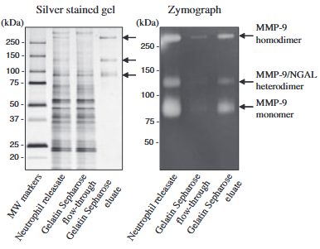
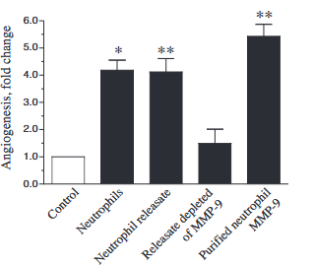
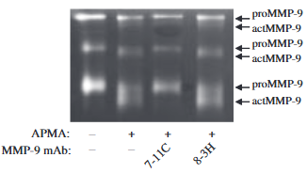
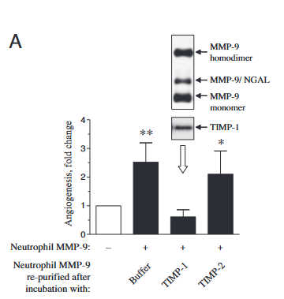
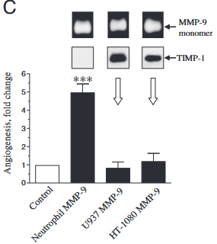
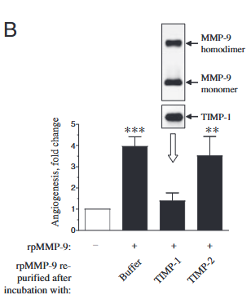
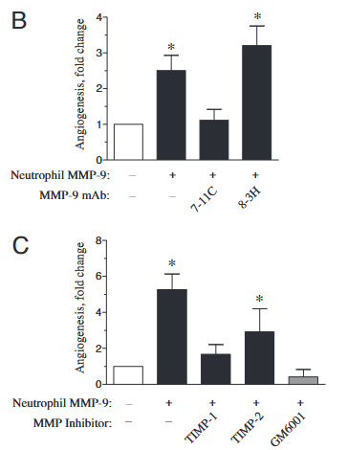
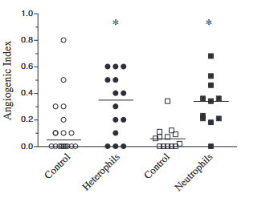
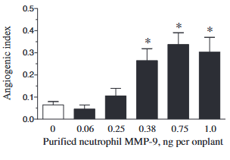
Human neutrophils uniquely release TIMP-free MMP-9 to provide a potent catalytic stimulator of angiogenesis
Veronica C. Ardi, Tatyana A. Kupriyanova, Elena I. Deryugina, James P. Quigley
Department of Cell Biology, The Scripps Research Institute, 10550 Torrey Pines Road, La Jolla, CA 92037
Introduction
C D
(C)Puriﬁcation of neutrophil MMP-9 (D) MMP-9 is the major angiogenic
moiety in neutrophil re-leasate
(2) (3)
(2) Angiogenesis induced by neutrophil MMP-9 involves (3) TIMP-1-free proMMP-9 is required for the
activation οf MMP-9 zymogen and proteolytic activity of induction of angiogenesis.
the activated MMP-9 enzyme.
Matrix metalloproteinase-9 (MMP-9) induces an angiogenic switch that is critical for tumor progression. Among MMP-9–expressing cells in the tumor microenvironment, inflammatory neutrophils are a major source of this protease. Using a modified angiogenesis model, we show that human neutrophils and their granule contents strongly induce angiogenesis. We further demonstrate that neutrophils release a uniquely potent, TIMP-free form of proMMP-9 that requires enzymatic activation to promote angiogenesis. In contrast, MMP-9 complexed with its inhibitor TIMP-1 lacks angiogenic activity. That the high angiogenic potency of neutrophil proMMP-9 is associated with its unique TIMP free status was confirmed when a generated and purified stoichiometric complex of neutrophil proMMP-9 with TIMP-1 failed to induce angiogenesis. These findings identify neutrophils as a specialized source of catalytically active MMP-9 that directly drives angiogenesis.
Aim
The present study aims to determine if neutrophil-derived MMP-9 directly drives angiogenesis and to define the mechanistic reasons of its pro-angiogenic activity. Particular emphasis was given on the role of TIMP-free proMMP-9 and its catalytic activation at the angiogenic site.
Results
(1)
A B
(1) Angiogenic response in collagen onplants: (A) comparison of angiogenesis induced by different cell types (human neutrophils vs heterophils vs control), and (B) dose-dependent increase in angiogenesis with increasing concentrations of purified neutrophil MMP-9.
Conclusions
Neutrophils are a dominant pro-angiogenic source of MMP-9, inducing angiogenesis more effectively than other MMP-9–expressing cell types.
Neutrophil-derived MMP-9 is released in TIMP-free form, giving it high catalytic and angiogenic potency.
Binding of MMP-9 to TIMP-1 abolishes angiogenic activity, showing that MMP-9 bioavailability, not expression alone, controls the angiogenic switch.

