Slide 1
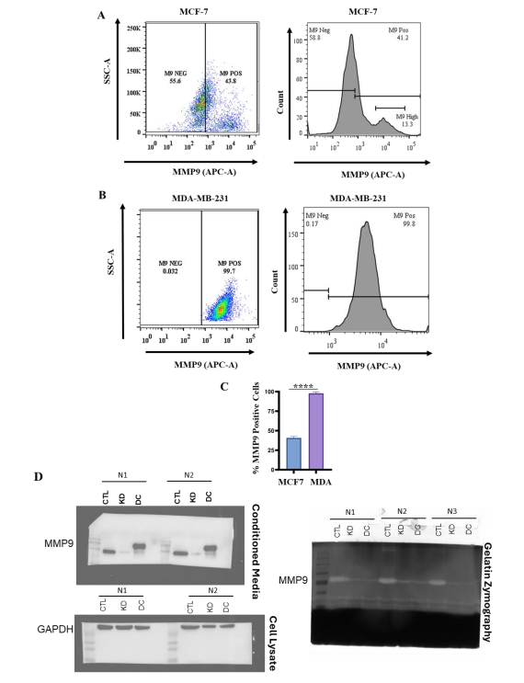
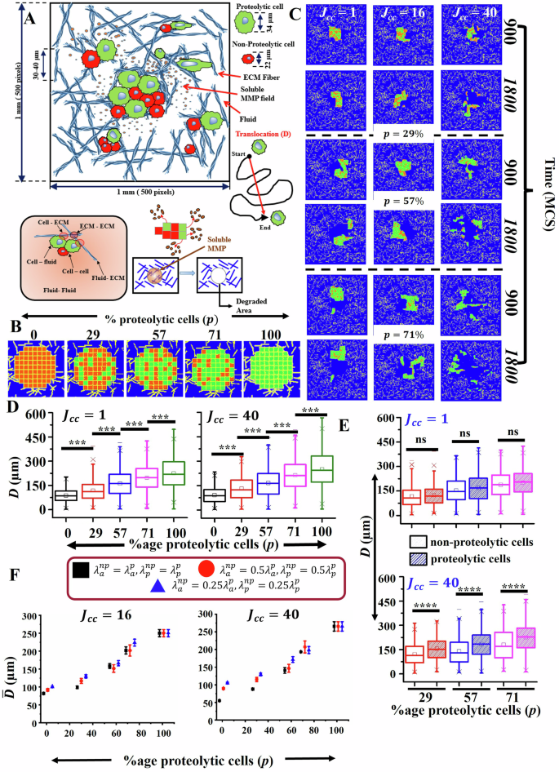
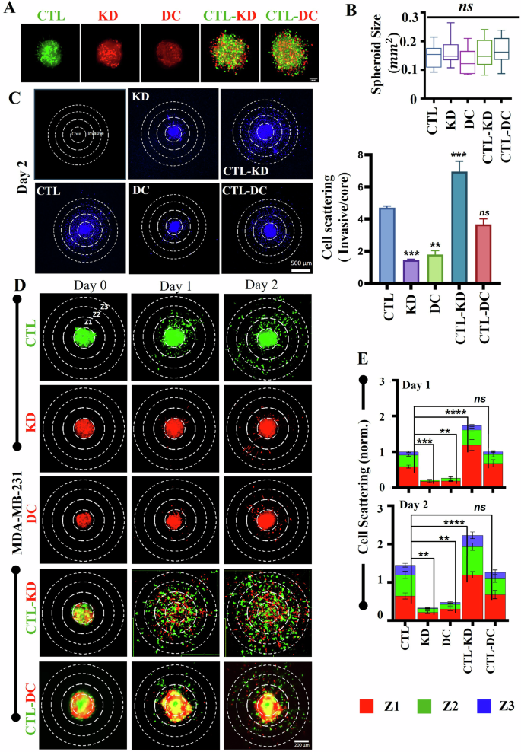
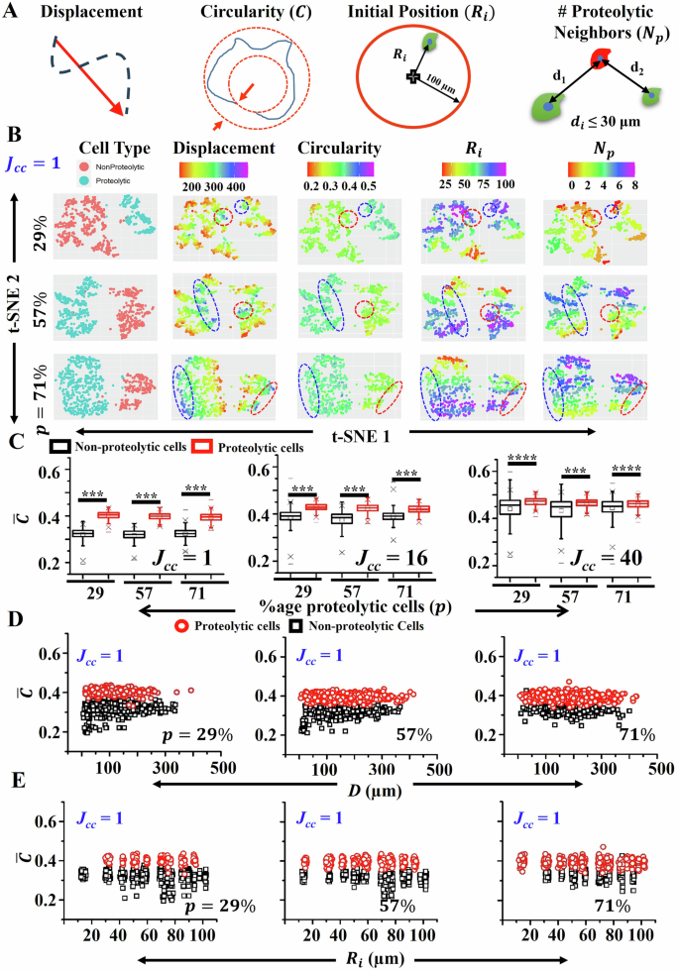
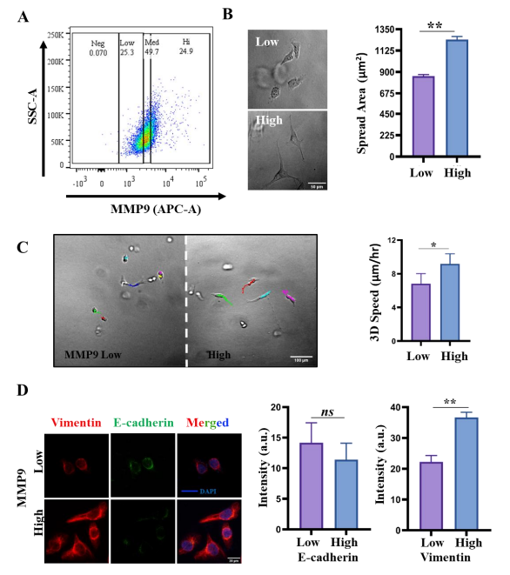
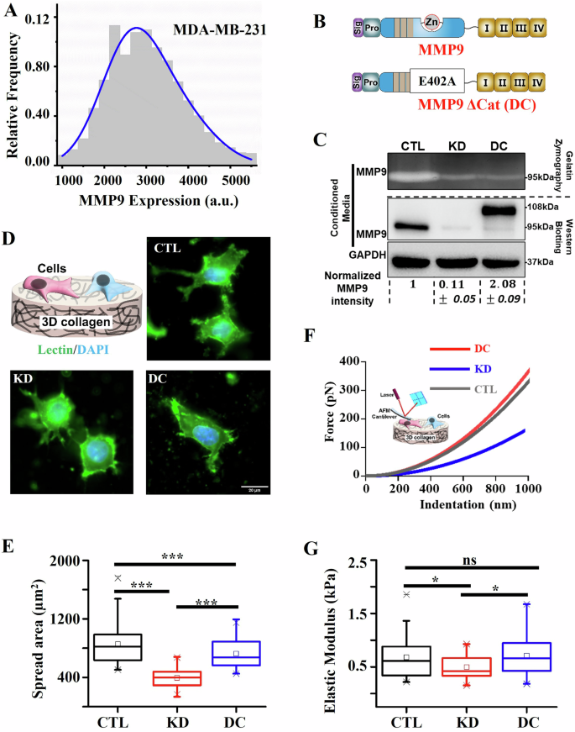
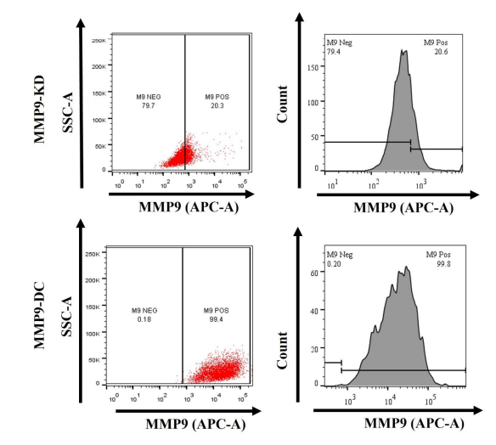
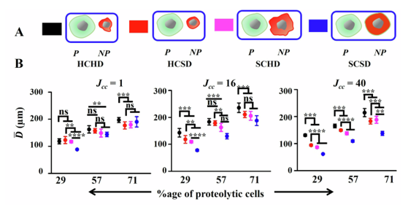
MMP9 shapes cell mechanics to enable collective invasion in cancer
Asadullah, Sarbajeet Dutta, Sumon Kumar Saha, Anisha Karmakar, Nikita Sharma, Sudikshaa Vijayakumar & Shamik Sen
Systems Biology and Applications
Introduction
2. Evaluation of MMP9 heterogeneity in noninvasive MCF-7 and invasive MDA-MB-231 cells
5. Computational model of cancer invasion by a phenotypically and functionally heterogeneous cell cluster
8. 3D invasiveness of homospheroids and heterospheroids
Tumor heterogeneity drives metastasis, with genetically and phenotypically distinct subpopulations cooperating to invade and colonize distant tissues.
Invasion requires ECM remodeling, primarily mediated by matrix metalloproteinases (MMPs). Collagen degradation is sequential: MMP14 initiates cleavage, followed by gelatinases MMP2 and MMP9. MMP9, synthesized as inactive pro-MMP9, is activated by multiple signaling pathways and is critical for aggressive cancer cell invasion.
Cooperative invasion occurs when proteolytically active cells lead less invasive subpopulations, a process dependent on MMP9. Inhibition of MMP9 alters cell/nuclear mechanics, reducing invasion potential.
Conclusions
Aim
Differential MMP9 expression generates subpopulations with distinct biophysical properties that cooperate to promote collective invasion. Proteolytic cells lead the collective invasion by degrading the ECM, while non-proteolytic cells migrate by deforming and following paths created by neighboring proteolytic cells. The efficiency of collective invasion critically depends on both the ratio of proteolytic cells and the biophysical differences between subpopulations. Loss of heterogeneity reduces invasiveness. Invasion is maximized when non-proteolytic cells remain smaller and softer than proteolytic cells. The combination of functional and biophysical traits reveals mechanisms of tumor progression and highlights potential therapeutic targets based on cellular heterogeneity.
Despite evidence of cooperative invasion in heterogeneous tumors, it remains unclear how variability in cancer cell biophysical properties influences this process. This study addresses this gap by investigating how differential MMP9 expression modulates the biophysical characteristics of breast cancer cells, potentially shaping their invasive and metastatic behavior.
6. Parameters involved in co-operative collective migration
3. Characterization of MMP9 high and MMP9 low MDA-MB-231 cells
Results
1. Effect of MMP9 perturbations on cell spreading and cell stiffness of MDA-MB-231 breast cancer cells.
4. Assessment of MMP9 heterogeneity in KD and DC cells
Future Directions
Modulation of MMP9 expression by tumor microenvironment changes.
Investigating the impact of MMP9 expression in other cancer types.
Developing therapeutic strategies beyond simple MMP9 inhibition.
Designing drugs aimed at reducing intratumoral heterogeneity.
Exploring and pharmacologically targeting collective invasion.
7. Invasiveness of proteolytically heterogeneous cell cluster for different combinations of cell size and deformability

