Slide 1

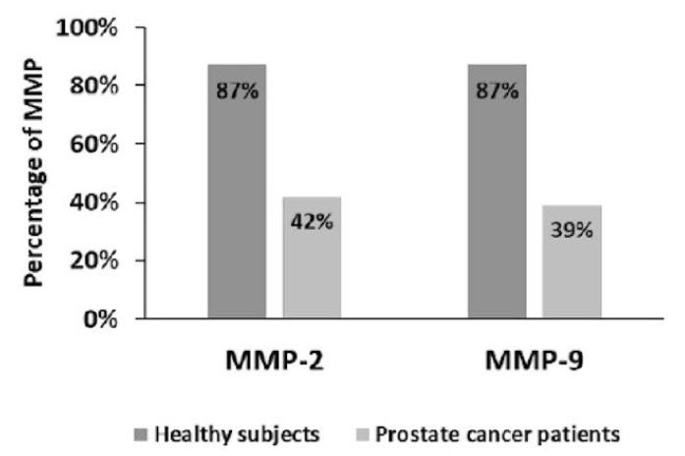
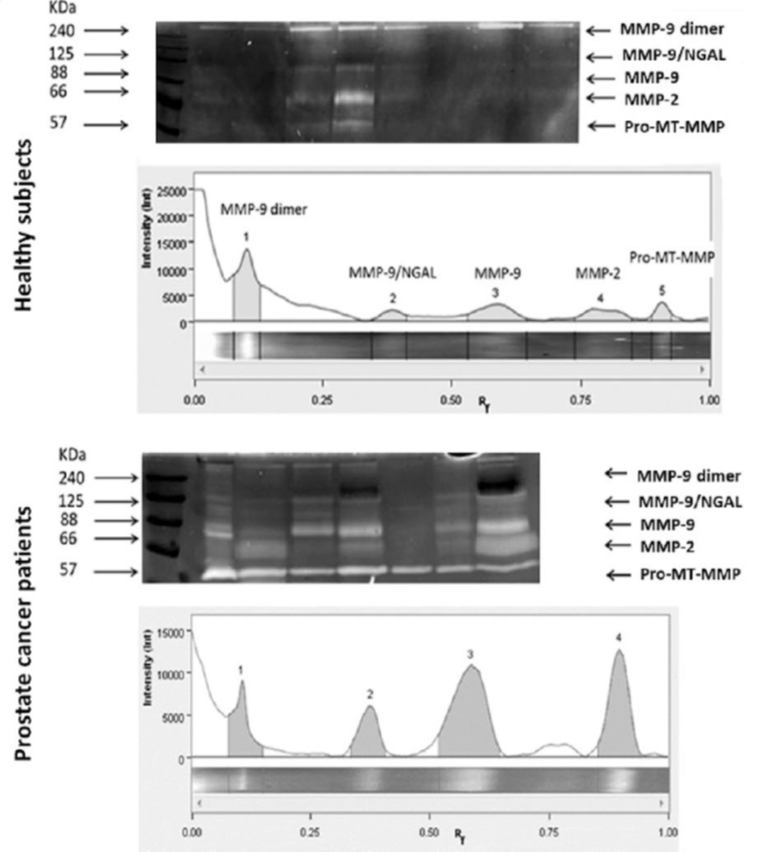

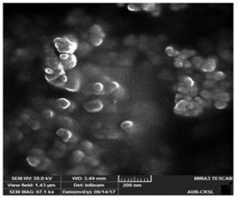
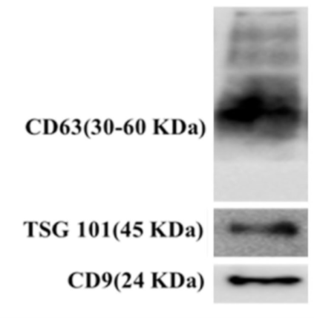
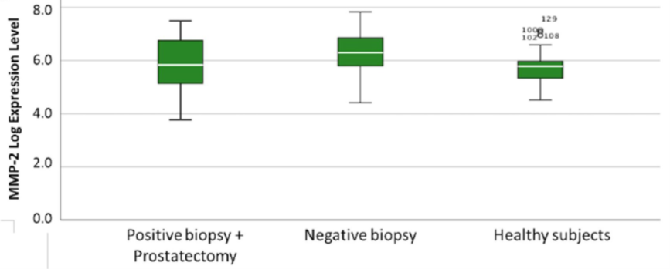
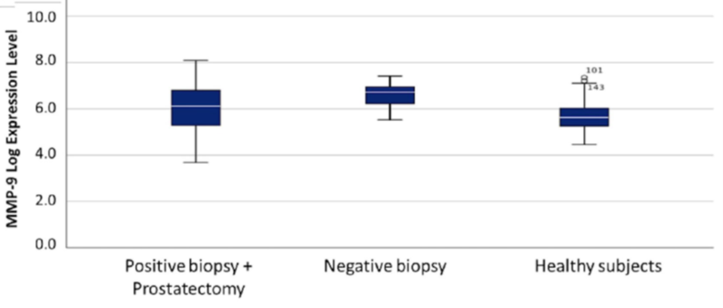
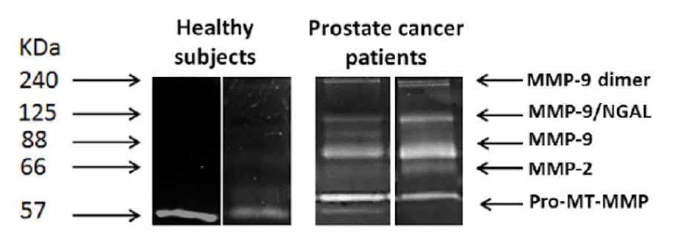
The role of urine derived exosome metalloproteinases as biomarkers for prostate cancer detection may be confounded by non-malignant prostatic inflammation
Jad Najdi, Layal Hajjar1, Ola Hadadeh, Talar Telvizian, Christelle Dagher, Albert El Hajj, Wassim Abou-Kheir, Deborah Mukherji, Marwan El-Sabban
Introduction- Aim
3. Urinary MMP-2 and MMP-9 were mapped in isolated exosomes.
Metalloproteinases (MMPs) are promising diagnostic and prognostic biomarkers for prostate cancer (PCa). This study explored the association between urinary exosome MMP levels and the incidence of prostate cancer.
Study Participants
American University Medical Center (2015-2019)
Patients: 147
Groups: patients with negative biopsy: 21
patients with positive biopsy/before prostatectomy: 78
healthy patients (control): 48
Figure 4: The expression of MMP-9 and MMP-2 in urine exosomes from healthy subjects and PCa patients. (
Study Design
Urine collection
↓
Exosomes purification from urine
↓
Exosomes characterization by scanning electron microscopy
Immunoblot analysis of exosomes
Metalloproteinases activity detection by gelatin zymography
Results
Statistical analysis
1. Proves that the membrane-bound vesicles detected by SEM are exosomes.
Figure 5: Gelatinase species in urine of healthy subjects (upper panel) and PCa patients (lower panel)
4. Distribution of MMP expression in population subsets.
Figure 1: An electron micrograph of urine exosomes
Figure 2: The expression of exosome-specific biomarkers (TSG-101, CD9, and CD63)
Figure 6: MMP-2 expression in urine exosomes among patients with positive biopsy, negative biopsy, and healthy subjects.
2. Gelatinase activity in urine of patients with PCa.
Figure 3: Zymograms of MMPs in urine samples from healthy and PCa patients
Figure 7: MMP-9 expression in urine exosomes among patients with positive biopsy, negative biopsy and healthy subjects.
Conclusions
Future studies should include control groups with non-malignant prostatic inflammatory disease
An increase in MMP-2 expression is associated with increased probability of negative biopsy..
An increase in MMP-9 expression is associated with increased odds of being diagnosed with Pca.
MMP-2 and MMP-9 urinary expression use as biomarkers for PCa should be evaluated with caution. (Multiple confounding variables can affect their level of expression)
Increased urine MMP levels could indicate the need for prostate biopsy.

