Slide 1
Explainable Artificial Intelligence
Concepts, Taxonomies, Opportunities and Challenges
Ονοματεπώνυμο: Βασιλικοπούλου Καλλιόπη
Μεταπτυχιακό Πρόγραμμα: ΔΠΜΣ-ΣΜΗΝ
Μάθημα: Ανάλυση και Διαχείριση Μεγάλων και Πολυδιάστατων Δεδομένων

Slide 2
Explainability in AI (XAI)
Why is it needed?
What does it mean?
What are the goals?
How to obtain it?

Slide 3
Why is XAI needed?
ML models are getting bigger and bigger
Humans can no longer understand how they make predictions
Humans can no longer trust these predictions
Increasing demand for Explainability

Slide 4
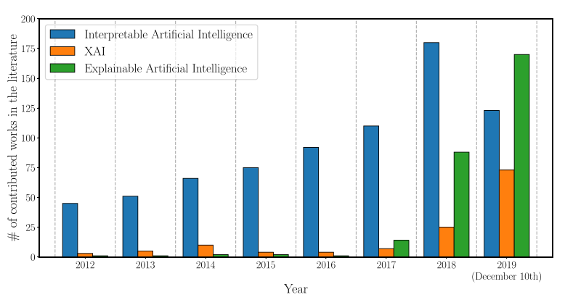
The increasing demand for Explainability
Publications with keywords like:
Interpretable AI
XAI
Explainable AI
are increasing every year

Slide 5
What are the goals of XAI?
Trustworthiness: we can trust the model’s predictions
Causality: we understand why an input caused a prediction
Transferability: we can re-use the model for other tasks
Informativeness: the model informs us what problem it learns to solve
Confidence: we are confident about the model’s predictions
Fairness: the model makes unbiased predictions
Accessibility: we can improve old and develop new ML algorithms
Interactivity: we can tweak the model’s hyperparameters
Privacy awareness: our personal data should remain private

Slide 6
What does XAI mean?
XAI Terminology

Slide 7
XAI Terminology: The problem
Many new terms arise
Disagreement on the vocabulary
Need for a universal vocabulary
XAI is a new field in Artificial Intelligence

Slide 8
XAI Terminology: The XAI terms
Interpretability: Does the model’s decision-making process make sense?
Explainability: How can a model’s decision be explained?
Understandability: Can a certain audience understand the model’s decision-making process?
Transparency: How clearly can I see the model’s inner thinking?
Comprehensibility: Can the model show what it learned from its training?

Slide 9
Transparency
How clearly can I see the model’s inner thinking?
1. Transparent Models:
Simulatable
Decomposable
Algorithmically Transparent
2. Opaque (black-box) Models

Slide 10
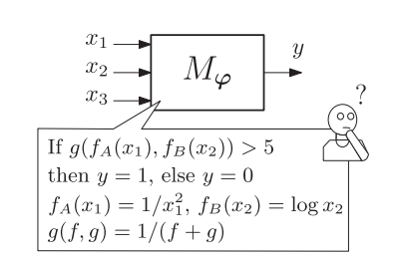
Transparency: Simulatable Models
A human can mentally follow the entire prediction making process
Simple and small ML models

Slide 11
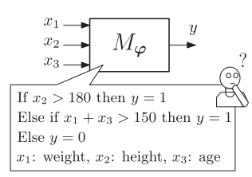
Transparency: Decomposable models
Simple but large ML models
Model is too large for humans to follow the prediction process
Each part of the model:
inputs x,
weights w,
functions f(x,w)
is humanly understandable

Slide 12
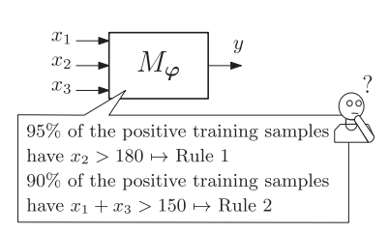
Transparency: Algorithmically transparent models
Models with more complex calculations
Can be interpretable with the assistance of mathematic tools

Slide 13
Transparency

Slide 14
Interpretability vs Explainability
Interpretability:
Passive property (inherent in the model itself)
All transparent models are interpretable
Explainability (or post-hoc explainability):
Active property (requires external tools or techniques)
All black-box models need to be explained to become understandable to humans

Slide 15
Understandability
Understandability
Model Understandability
Human Understandability
Interpretability Explainability
Target audience

Slide 16
Model Classification by Transparency
Transparent Models
Black-box Shallow Models
Black-box DL Models

Slide 17
Transparent Models
Linear/Logistic Regression
Decision Trees
K - Nearest Neighbours
Rule Based Learners
General Additive Models
Bayesian Models

Slide 18
Black-box Shallow Models
Tree Ensembles
SVMs

Slide 19
Black-box DL Models
DNNs
CNNs
RNNs

Slide 20
Explainability Techniques
Text explanations: Use text to describe the model’s behavior
Visualizations: Use visuals to describe the model’s behavior
Local explanations: Explain the model’s behavior on a small part of the feature space
Explanations by example: Use a set of examples that represent the model’s behavior
Explanations by simplification: Use a simpler model to explain the black-box model
Feature relevance: Show how each input feature affected the prediction

Slide 21
Explainability Techniques Classification
Model-agnostic techniques: designed for application to ML models of any kind
Model specific techniques: designed for a specific ML model

Slide 22
Model-agnostic techniques
Popular Techniques:
Explanation by simplification
Feature relevance explanation
Visual explanation

Slide 23
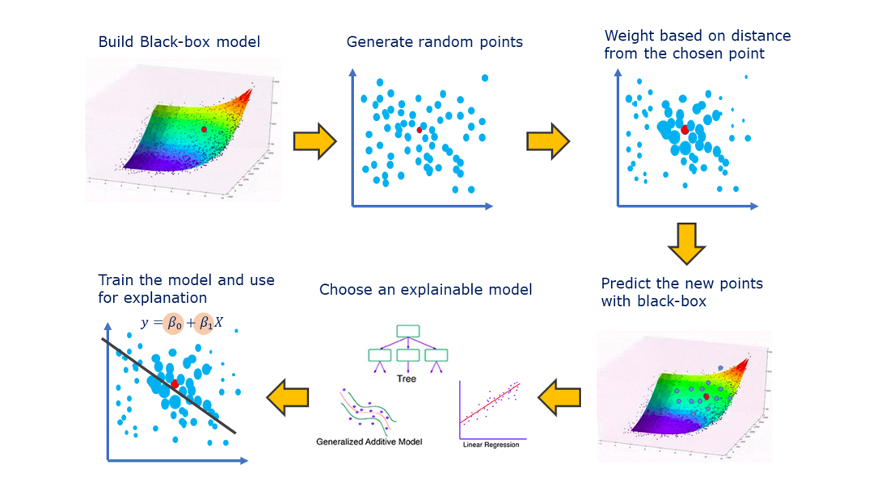
LIME: Model-Agnostic Explanation By Simplification
Creates an interpretable linear model and uses it to explain the black-box model’s behavior

Slide 24
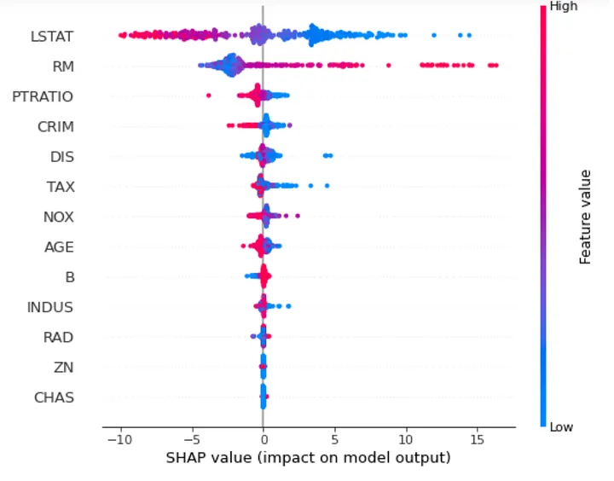
SHAP: Model-Agnostic Feature Relevance Explanation
Calculates how much each input feature affects the model’s predictions

Slide 25
Model-Agnostic Visual Explanations
Less common technique for post-hoc explainability
Usually used along with feature relevance techniques

Slide 26
Model specific techniques
Explainability in shallow ML models
Explainability in DL models

Slide 27
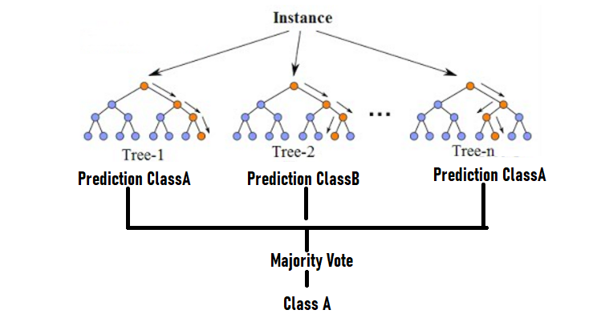
Tree Ensembles: Model Specific techniques
Tree Ensembles: Combinations of Decision Trees (e.g. Random Forest)
Popular Explainability Techniques:
Explanation by simplification
Feature Relevance

Slide 28
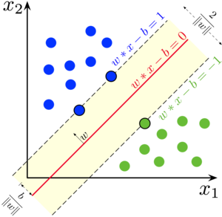
SVMs: Model Specific techniques
SVMs: Support Vector Machines
Popular Explainability Techniques:
Explanation by simplification
Local explanations
Visualizations
Explanations by example

Slide 29
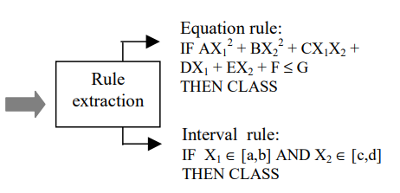
SVMs: Rule-Based Explanation By Simplification

Slide 30
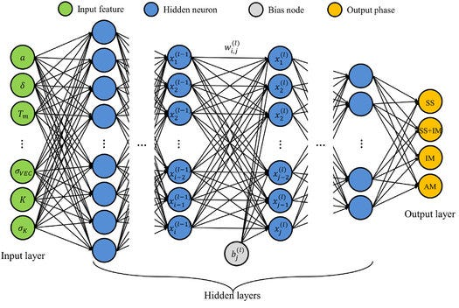
DNNs: Model Specific Techniques
DNN: Dense Neural Network
Most used explanation techniques:
local explanations
feature relevance

Slide 31
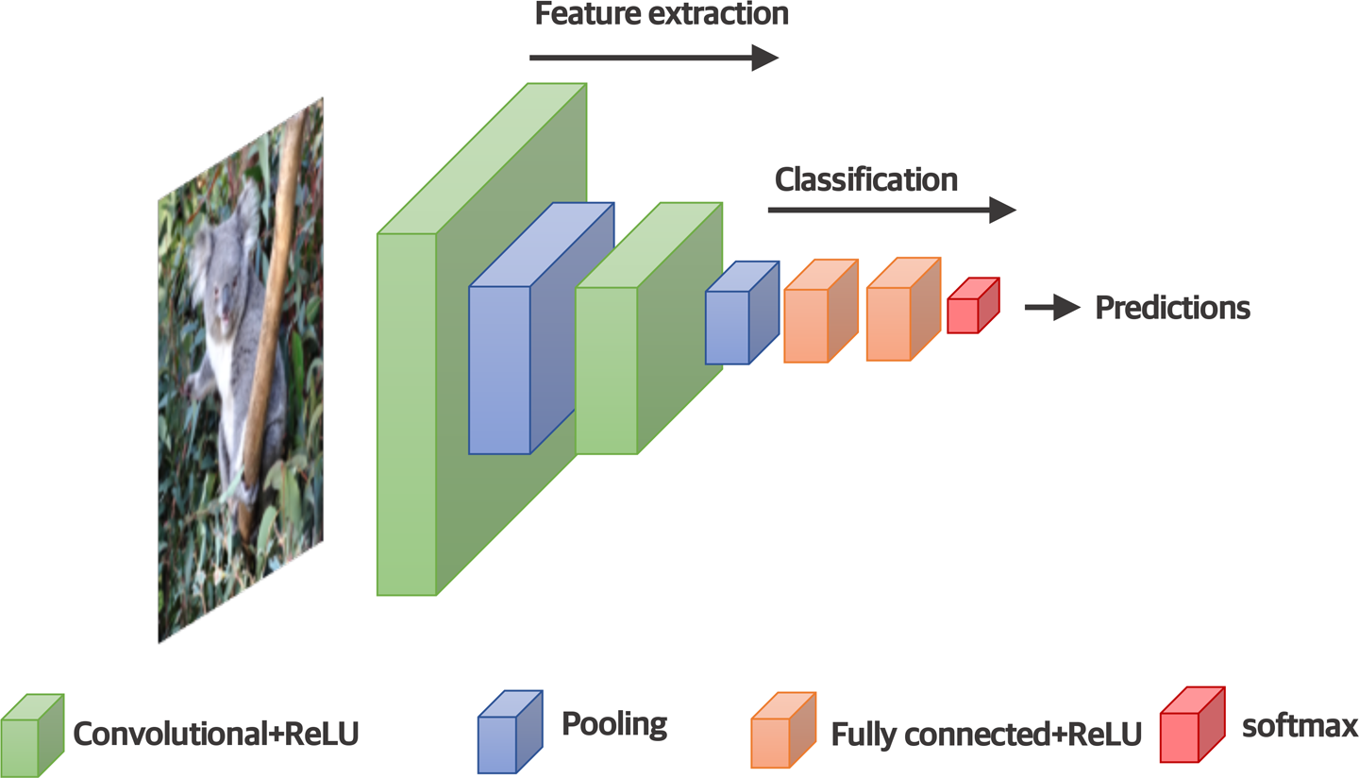
CNNs: Model Specific Techniques
CNN: Convolutional Neural Network
Easier to explain due to human’s ability to understand visual data
CNN explainability approaches:
Detect the input features that were crucial for the prediction
Understand what the intermediate layers see

Slide 32
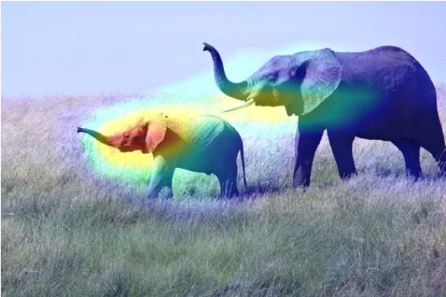
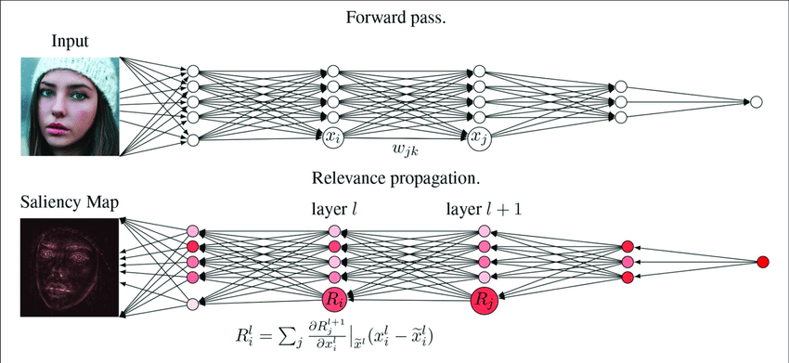
CNNs: Detect the input features that affected the prediction
Saliency maps
Class Activations (Grad-CAM)

Slide 33
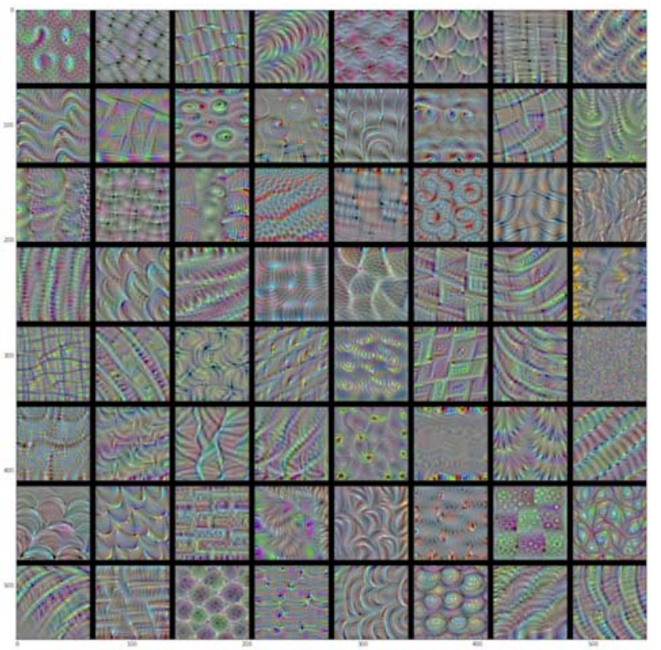
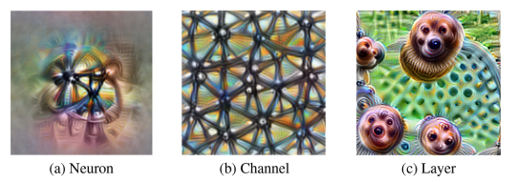
CNNs: Understand what the intermediate layers see
Display what patterns the model has learned:
in neuron level
in channel level
in layer level
Depending on the visualization goal
VGG16: Channel patterns for layer block4_conv1

Slide 34
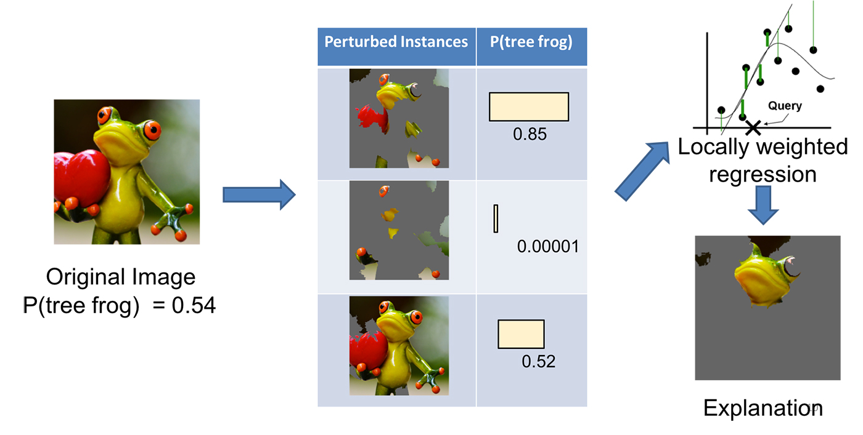
LIME for CNNs
Split the input image to superpixels
Mask some of the superpixels
Use CNN to make predictions on the perturbed images
Explain its behavior via a linear model

Slide 35
RNNs: Model Specific Techniques
RNN: Recurrent Neural Network
Best for NLP and time-series processing tasks
RNN explainability approaches:
Understanding what a RNN model has learned (feature relevance)
Modifying RNN architectures (local explanations)

Slide 36
RNNs: Understanding what a RNN model has learned
LRP to RNNs
Visualization based on finite horizon n-grams
Interpretable mimic learning

Slide 37
RNNs: Modifying RNN architectures
RETAIN (REverse Time Attention)
RNN based on SISTA
HMM and RNN

Slide 38
Hybrid transparent and black-box models
Enrich black-box model knowledge with humanly understandable knowledge
Results in both:
Improved performance
and
Improved explainability

Slide 39
XAI research opportunities
Optimal balance between interpretability and performance
Need for a unified XAI concepts
XAI and Security
Setting guidelines for ensuring interpretable AI models

Slide 40
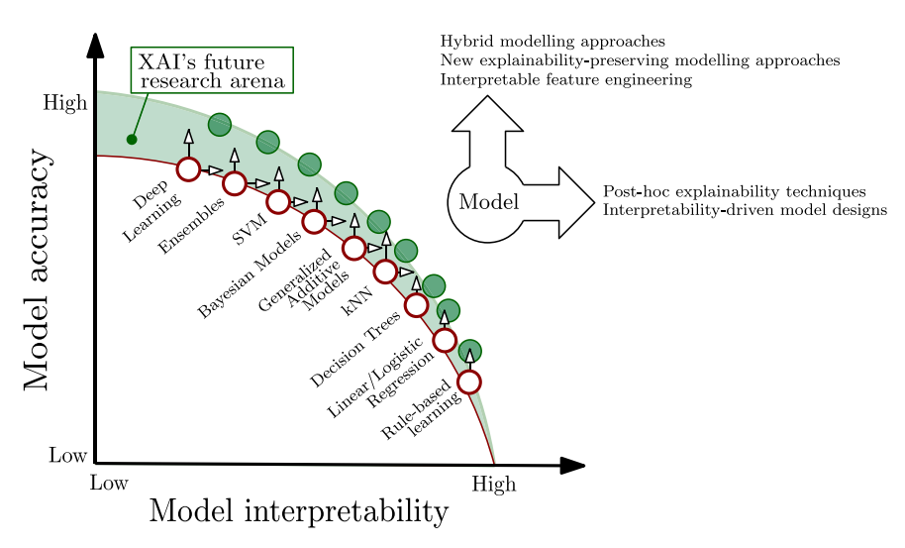
Interpretability vs Performance
“All models that are more complex are more accurate”, but not all
When they do:
XAI has helped improve this ratio
Research Opportunity: Use XAI to invert or at least cancel the slope
More Complexity
More Performance
Less Interpretability

Slide 41
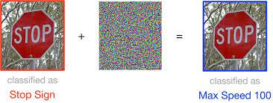
XAI and AI security
XAI techniques can reveal the model’s knowledge to the public
Security Issues:
Stealing model’s functionality
Adversarial attacks
Research opportunity:
Detect model’s adversarial vulnerabilities
Harden the model against them

Slide 42
Guidelines for ensuring interpretable AI models
Research Opportunity: Set universal guidelines for ensuring interpretable AI models
Suggested Guideline:
When aiming for interpretability, take the audience into account
More interpretable models should have priority
When a black-box model is chosen, use XAI tools for explainability
Rethink interpretability in terms of the individual human

Slide 43
The AI Principles
Suggested AI Principles:
Fairness and Integrity
Transparency and Explainability
Human-centric AI
Privacy and Security
AI Principles published by the European Commission:
Human agency and oversight
Technical robustness and safety
Privacy and data governance
Transparency, diversity, non-discrimination and fairness
Societal and environmental well-being
Accountability

Slide 44
XAI and Fairness
AI systems tend to unintentionally make unfair decisions
XAI can find correlations between sensitive features and predictions

Slide 45
XAI and Accountability
Accountability: A human or organization can ensure the proper functioning of the AI system
XAI tools can make it easier to:
Understand the model’s thought process
Show whether an AI system is responsible for errors or unfair outcomes

Slide 46
Data Fusion
- What is it?
Techniques that combine information from different sources for calculating predictions
- Why is it important?
- Proven improvement of the ML models’ performance

Slide 47
Levels of Data Fusion
Data-Level Fusion: Combine raw data from multiple sources
Model-Level Fusion: Combines outputs from multiple AI models to make a final decision
Knowledge-Level Fusion: Combine knowledge or rules from multiple systems to create better understanding

Slide 48
Data Fusion and Explainability
XAI tools: experts in finding correlations between predictions and input features
Data fusion techniques: Combine multiple info from different sources
Data fusion and XAI: Gives access to combined info – threat for data Privacy
Data Privacy Threat !
Data Fusion Techniques: Combine multiple info
XAI Tools: Reveal model’s learned knowledge

Slide 49
Implementing responsible AI principles in organizations
Goal: Turn AI principles into actionable steps within the organizations
Suggested methodology:
Set AI principles
Awareness and training on AI system potential issues
Define Responsibilities for monitoring AI systems

Slide 50
Thank you !!!

