Slide 1
Sensor Data Storage Performance: SQL or NoSQL, Physical or Virtual
Foivos chalantzoukas - 1066579

Slide 2
What is the problem
The growing usage of sensors leads to increasing amounts of data output
Efficient storage and processing of this data becomes key
SQL and NoSQL systems offer different benefits – CAP Theorem for shared data systems (Consistency, Availability, Tolerance to Network Partitions)
Physical and virtual machines behave differently
Which is the most efficient solution?

Slide 3
Why is it important?
Common applications for sensors:
Energy grid monitoring,
Physical anomaly detection
Internet of Things
Smart homes
Large amounts of data in these applications – Need for scalability and solid performance

Slide 4
Main Idea
Compare the performance of three different open-source database systems
PostgreSQL:
SQL database from 1995
Complies with the ACID principle (Atomicity, Consistency, Isolation, Durability)
Transactional
Cassandra:
NoSQL database from 2008
Horizontally scalable
Uses eventual consistency
MongoDB:
NoSQL database from 2007
Manages BSON (Binary JSON documents)
Strong query language – supports JavaScript and RegEx
See how virtualization affects their performance

Slide 5
Test setup
Four operations were tested
Single write (insert a single entry)
Single read (read a single entry)
Multiple writes (insert 1000 entries)
Multiple reads (read 1000 entries)
Minimal set of columns used for the data
Client – Server setup with a dedicated network
Identical physical and virtual setups
Tests are separated into single client and multi client

Slide 6
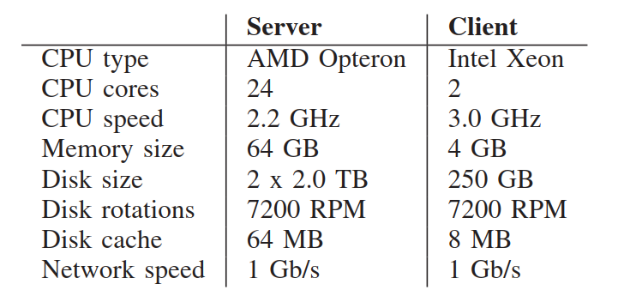
Hardware specifications

Slide 7
Software specifications

Slide 8
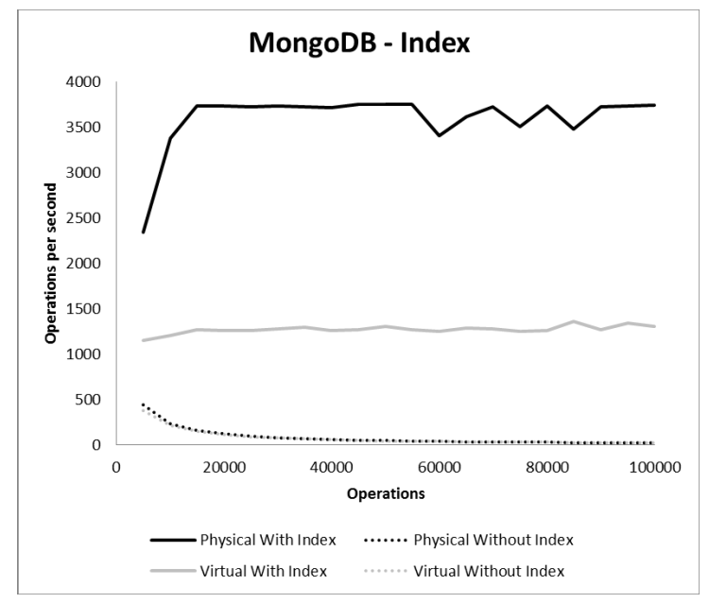
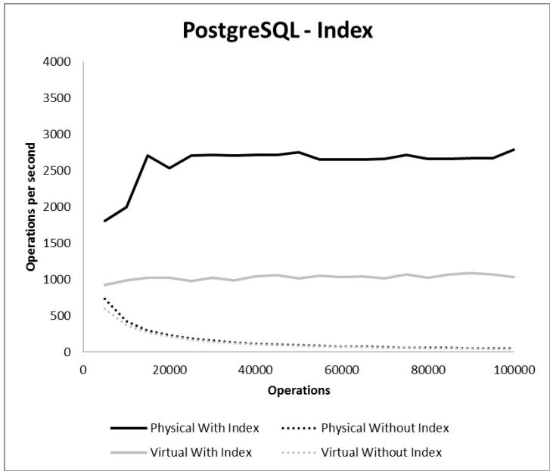
The effect of indexes (in reading data)

Slide 9
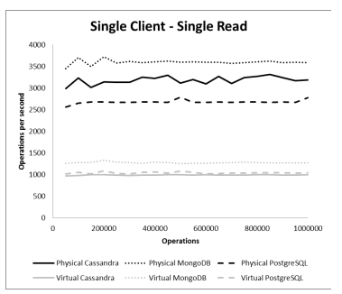
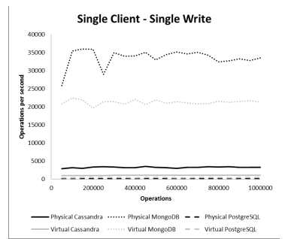
Single client – single read/write

Slide 10
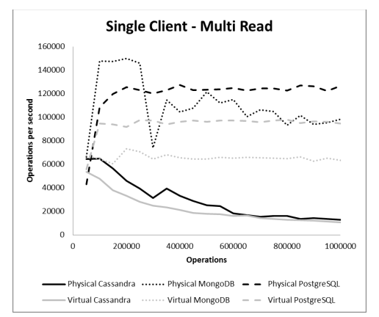
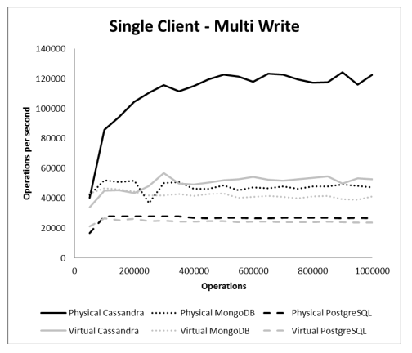
Single client – multi read/write

Slide 11
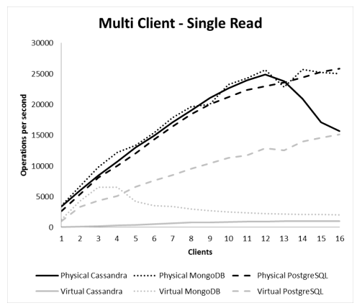
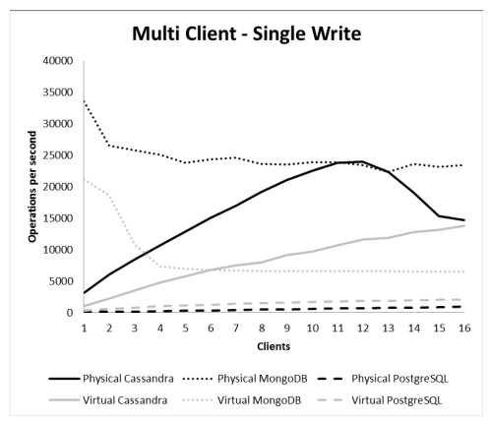
Multi client – single read/write

Slide 12
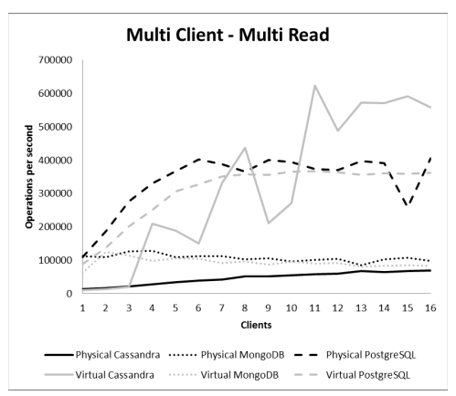
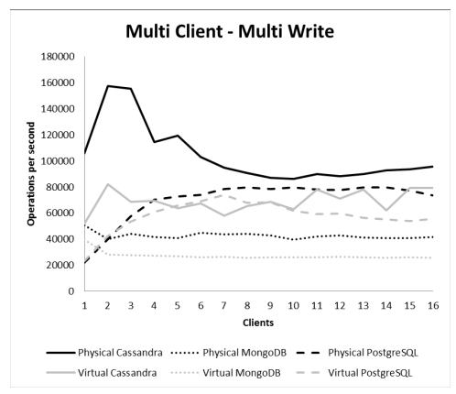
Multi client – multi read/write

Slide 13
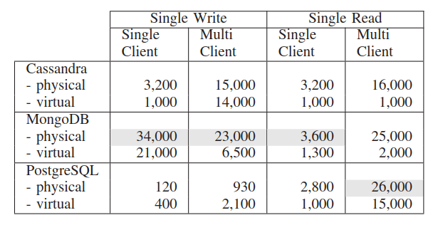
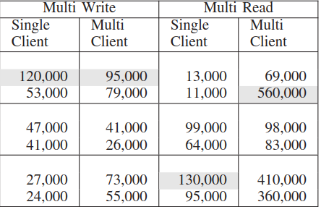
Results summary
Single operations per second (grey is the highest)

Slide 14
Methods compared with each other
PostgreSQL:
Limited effect from virtualization (sometimes positive)
Takes advantage of multiple clients
Especially good at multiple reads
Supports flexible queries
Cassandra:
Strong multi-write performance
Heavily affected from virtualization (mostly negatively)
Optimal for horizontal scaling
MongoDB:
Good single-write performance
Affected from virtualization less than Cassandra
Optimal for small to medium datasets

Slide 15
Drawbacks of each method
PostgreSQL:
Slow write performance
Poor horizontal scalability
Cassandra:
Heavily affected from virtualization
Medium read performance
MongoDB:
Moderately impacted from virtualization
Inefficient in multiple client setups

Slide 16
Possible improvements
Utilize distributed setups to take advantage of the way Cassandra was developed for scalability
Configure the virtualization settings to maybe improve performance
Explore hybrid databases to leverage the strengths of both SQL and NoSQL DBs
Adopt cloud solutions to explore their performance

Slide 17
Conclusions
No clear winner – each database has its own benefits and drawbacks
MongoDB ideal when write performance is needed
PostgreSQL optimal when read performance is important
Cassandra more efficient in large and distributed systems
The impact of virtualization varies – Virtual Machine Monitor (VMM) caching plays key part
Select a Database (SQL or NoSQL, physical or virtual) depending on the application context

Slide 18
References
J. S. van der Veen, B. van der Waaij, and R. J. Meijer, “Sensor Data Storage Performance: SQL or NoSQL, Physical or Virtual,” IEEE Fifth International Conference on Cloud Computing, 2012.

