Slide 1
Speech Recognition Using Deep Neural Networks: A Systematic Review Presentation
Theodoros Chatzimichail
1067538

Slide 2
Introduction to Deep Learning in Speech Applications
Based on 174 papers from 2006 to 2018 we writes explore the rapid evolution of speech recognition due to Deep Learning.
Its performance is detailed in diverse speech-related tasks such as emotion recognition, speaker identification, and noise-robust recognition.

Slide 3
Speech Signals Categories
Speech recognition, which gives information about the content of speech signals.
Speaker recognition that carries information about the speaker identity.
Emotion recognition, which delivers information about the speaker's emotional state.
Health recognition, which offers information on the patient's health status.
Language recognition, that yields information of the spoken language.
Accent recognition, which produces information about the speaker accent.
Age recognition that supplies information about the speaker age.
Gender recognition, which carries information about the speaker gender.

Slide 4
Related Work of Past Approaches
Gaussian Mixture Models: In unsupervised learning, a Gaussian mixture model is a soft clustering strategy that indicates the likelihood that a certain data point is part of a cluster. With k ∈ {1,…,K} denoting the number of clusters in a data collection, it is made up of multiple Gaussians.
Hidden Markov Models: A statistical model that describes a system of hidden states and observation of those hidden states. The states are not directly observed instead we observe probabilistically generated symbols.

Slide 5
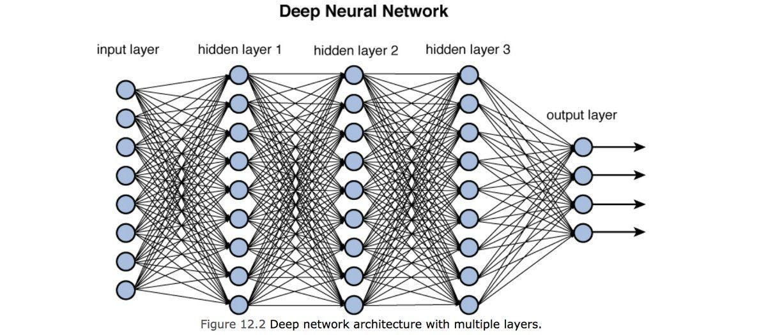
Advancements in Neural Networks
Why Neural Networks?
Convolutions in NNs have a linear basis (the operation of convolution with weights), but at each step a non-linear operation (ReLU or other) is inserted.
$$z\left[n\right]=bias+\sum_{k=0}^{n}{feature\left[k\right] weight[k]}$$
As a result, CNNs overcome the limitation of the previous techniques in non-linear functions, and they have significantly improved speech recognition.
Deep Learning can be described as a machine learning that is based on algorithms that learn from multiple of levels in order to provide a model that represents complex relations among data.

Slide 6
Types of training
Supervised training: The network is trained using labeled data, where each input sample is associated with a corresponding output label or target. It learns by minimizing the difference between its predictions and the ground truth labels.
Unsupervised training: The network is trained on data without explicit labels or targets. The goal is to uncover patterns, structures, or representations in the data.
Semi-supervised training: The network combines aspects of supervised and unsupervised training. It utilizes a small amount of labeled data alongside a large amount of unlabeled data to improve learning efficiency and accuracy.

Slide 7
Methodology System Literature Review
The main goal of is to identify and examine articles that implement deep neural networks in the area of speech. The examination performed based on the following phases:
Planning Phase
Research Questions
Research Strategy
Study Selection
Quality Assessment rules
Data Extraction Strategy
Conducting Phase
Reporting Phase

Slide 8
Research Questions
RQ1: What are the different types of papers that were included in the study?
RQ2: What are the different types of speech identified in the research papers?
RQ3: What are the different types of database used to test and train the algorithm in each paper?
RQ4: What are the different database languages identified in the research papers?
RQ5:Whattypeofenvironmentwasusedtoconductthe study?
RQ6: How were features extracted from speech?
RQ7: What type of evaluation technique was used in the research papers?
RQ8: What types of deep neural network models have been used

Slide 9
Search Strategy
Search Terms
The research questions were used to identify the main search terms.
New terms were identified based on published papers and books.
Boolean operators were used in order to limit the search results by combining keywords
Survey Resources
Google Scholar
IEEE Explorer
Science Direct
ResearchGate
Springer
Search Phases

Slide 10
Study Selection Filtration Steps
Removing all duplicate research papers that were obtained from different digital libraries. 19151 VOLUME 7, 2019 A. B. Nassif et al.: Speech Recognition Using Deep Neural Networks: A Systematic Review
Applying inclusion/exclusion criteria to ensure only relevant papers are included in this review.
Removing review papers from the list of papers. It is important to note that these identified review papers were used to conduct a comparison with our review.
Applying the quality assessment in order to include papers with the highest quality which give the best answers to the raised research questions.

Slide 11
Study Selection Inclusion/Exclusion Criteria
Inclusion criteria:
Include papers that use deep neural networks in the area of speech.
Include papers that use deep learning in the area of speech.
Exclusion criteria:
Exclude papers that use deep neural networks in an area other than speech.
Exclude papers that are related to speech but do not use deep neural networks.
Exclude papers with no clear publication information.

Slide 12
Quality Assessment Rules
Applying quality assessment rules was the final step used to identify the final list of papers included in this review paper.
QAR1:Is the paper well organized?
QAR 2: Are the research objectives identified clearly in the paper?
QAR3: Is there sufficient background information provided in the paper?
QAR 4: Is the specific area of speech used clearly defined?
QAR5:Does the paper include practical experimentations?
QAR 6: Is the conducted experiment suitable and acceptable?
QAR7:Is the data set used clearly identified?
QAR 8: Are the results of the conducted experiments clearly identified and reported?
QAR 9: Are the methods used to analyze the results appropriate?
QAR10: Overall, is the paper considered useful?

Slide 13
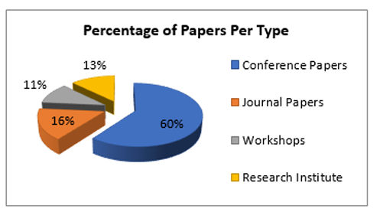
Results
Research Question 1: Types of Papers

Slide 14
Results
Research Question 2: Types of Speech Applications
Specific Area in Speech Recognition | Count of Papers | Percentage [%]
Automatic (ASR) | 14 | 10.2
Large | 27 | 19.7
Low Resource | 4 | 2.9
Multilingual | 4 | 2.9
Noise Robust | 20 | 14.6
Phone Recognition | 6 | 4.4
Sequence Classification | 4 | 2.9
Speaker Adaptation | 8 | 5.8
Speaker Recognition | 18 | 13.1
Speech Separation | 5 | 3.6
Other | 27 | 19.7

Slide 15
Results
Research Question 3: Databases used
Type of Databases | Count | Usage Percentage [%] | Databases
Publicly Available | 147 | 84 | TIMIT, Aurora 4, Switchboard Hub5
Private | 27 | 16 | -

Slide 16
Results
Research Question 4: Languages used
Languages | Count | Usage Percentage [%]
English | 148 | 85
Chinese | 2 | 1
Italian | 2 | 1
French | 2 | 1
Japanese | 1 | 1
South African | 1 | 1
Multiple Languages | 15 | 9
Other | 3 | 2

Slide 17
Results
Research Question 5: Testing Environments
Environments | Count | Percentage [%]
Noisy Environment | 47 | 27
Emotional Speech | 3 | 2
Neutual | 124 | 71

Slide 18
Results
Research Question 6: Feature Extraction Techniques
Extraction Techniques | Percentage [%]
Mel-frequency cepstral coefficients (MFCCs) | 69.5
Linear discriminant analysis (LDA) | 10
HLDA | 5
Short Time Fourier Transform (STFT) | 2
Other | 13.5

Slide 19
Results
Research Question 7: Feature Evaluation Techniques
Evaluation Technique | Count | Percentage [%]
Label Error Rate(LER) | 2 | 1
Phone Error Rate (PER) | 17 | 11
World Error Rate (WER) | 87 | 56
Error Rate | 17 | 11
Accuracy | 17 | 11
dB SIR Gain | 3 | 2
Phoneme classification Performance | 2 | 1
Other | 29 | 19

Slide 20
Results
Research Question 8: Types of DNN Models
Standalone Model Name | Count | Percentage [%]
Deep Neural Network | 67 | 38
Deep Belief Network | 15 | 8.6
Convolutional Neural Network | 26 | 15
Recurrent Neural Network | 15 | 8.6
Deep Maxout Network | 3 | 1.72
Deep Convex Network | 3 | 1.72
Deep Stacking Network | 1 | 0.57
Deep Tensor Network | 1 | 0.57
Autoencoder | 1 | 0.57
Hybrid Model Name | Count | Percentage [%]
DNN-HMM | 21 | 12
DBN-HMM | 15 | 8.6
DMN -HMM | 2 | 1.15
DNN- GMM | 1 | 0.57
CNN-RNN | 1 | 0.57
CNN- HMM | 1 | 0.57
RNN- HMM | 1 | 0.57

Slide 21
Conclusions
The thorough statistical analysis concludes:
The primary language was English in mostly natural noisy environments.
The predominant efficiency metric was the word error rate (WER).
Most Researchers use the MFCCs as a feature extraction for speech signals.
The 75% of DNN were standalone and only the 25% were hybrid.
Authors are encouraged to use hybrid models because they achieve better results.
The Recurrent Neural Networks remain uncharted with untapped potential.

