Slide 1

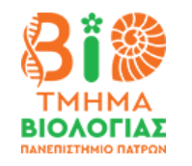
University of Patras, Biology department Applied ecology and Environment Management MSc Environmental Planning and Management of Natural Areas Exam Work Kovács Boglárka Zsuzsanna 10. 02. 2026, Patras

Slide 2
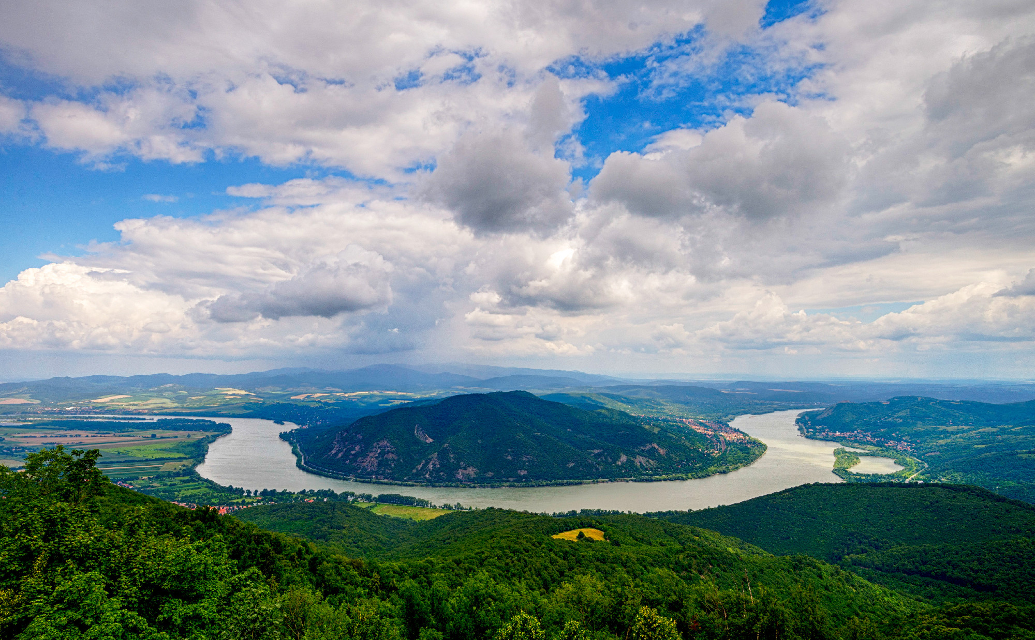
Natura 2000 framework Hungary

Slide 3
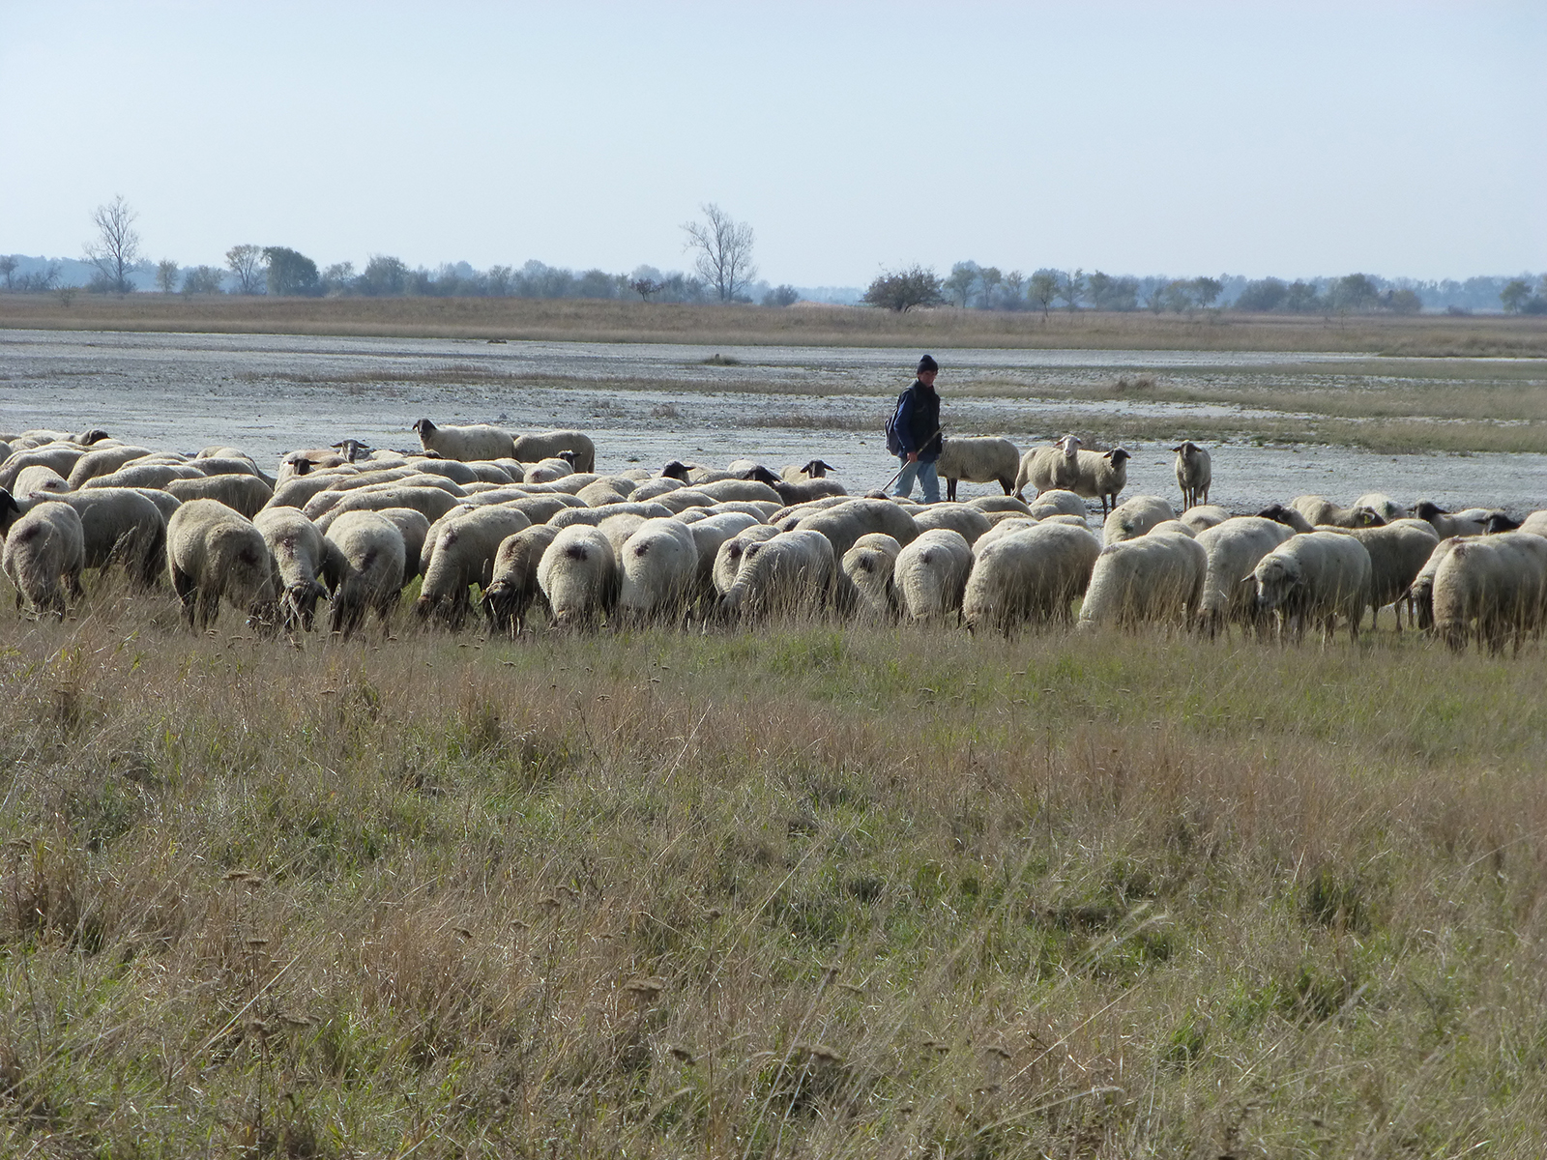
Content
1. Pannonian region
2. Natura 2000 in Hungary
3. Management model
4. Evaluation indicators
5. Effectiveness
Notes:
The study is aimed to draft the Natura 2000 network in Hungary, its management model, evaluation indicators and effectiveness of protected area management.

Slide 4
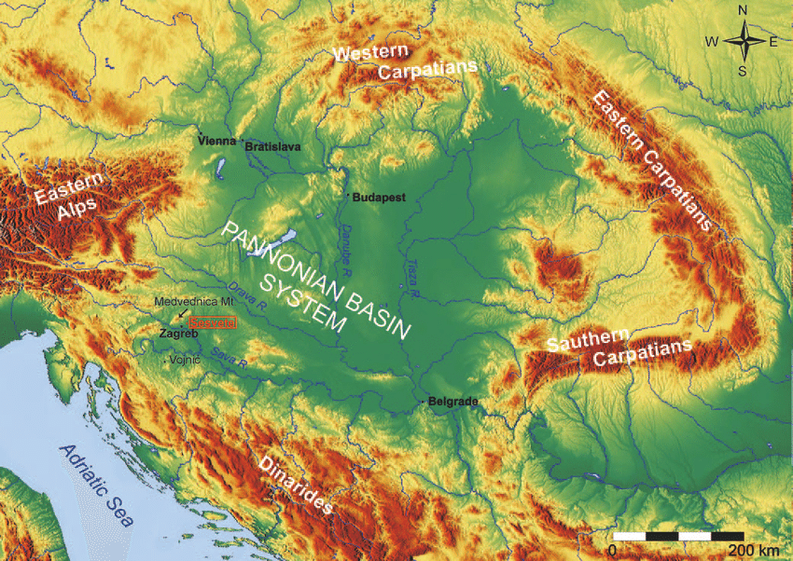
The Pannonian Region
INFLUENCED by
Low-intensity grazing and agriculture
Water presence
one of the largest continuous grassland in Central Europe
Signature habitat:
the PUSZTA
Great Hungarian Plain
Little Hungarian Plain
Dráva Plain
Signature species:
Grey cattle
Racka sheep
Mangalica pig
Notes:
Hungary is a landlocked country with 93,000 km² terrestrial area. Hungary is situated in the Pannonian region, surrounded by 7 countries, with most of its territory characterized by agricultural grasslands and rivers. A significant portion of the Pannonian biogeographical habitat is in Hungary’s national territory; like steppe-like grasslands, wetlands and Illyrian sessile oak-hornbeam forests. The puszta- plain grassland- is a Pannonian signature habitat. The great plain takes up 75% of all Hungarian territory, but the little plain and the dráva plain are equally important.

Slide 5
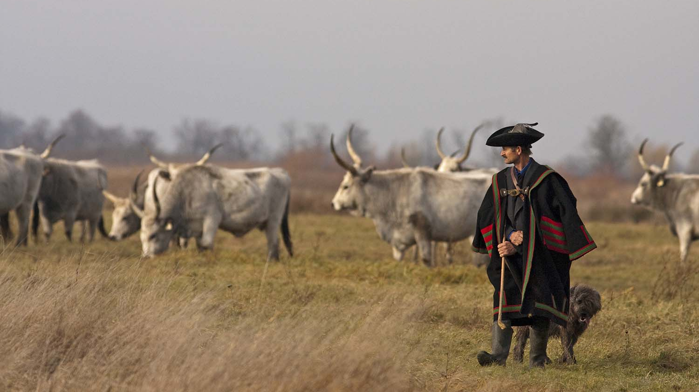
Grey cattle with traditional shepred
At Hortobágy UNESCO World Heritage Site

Slide 6
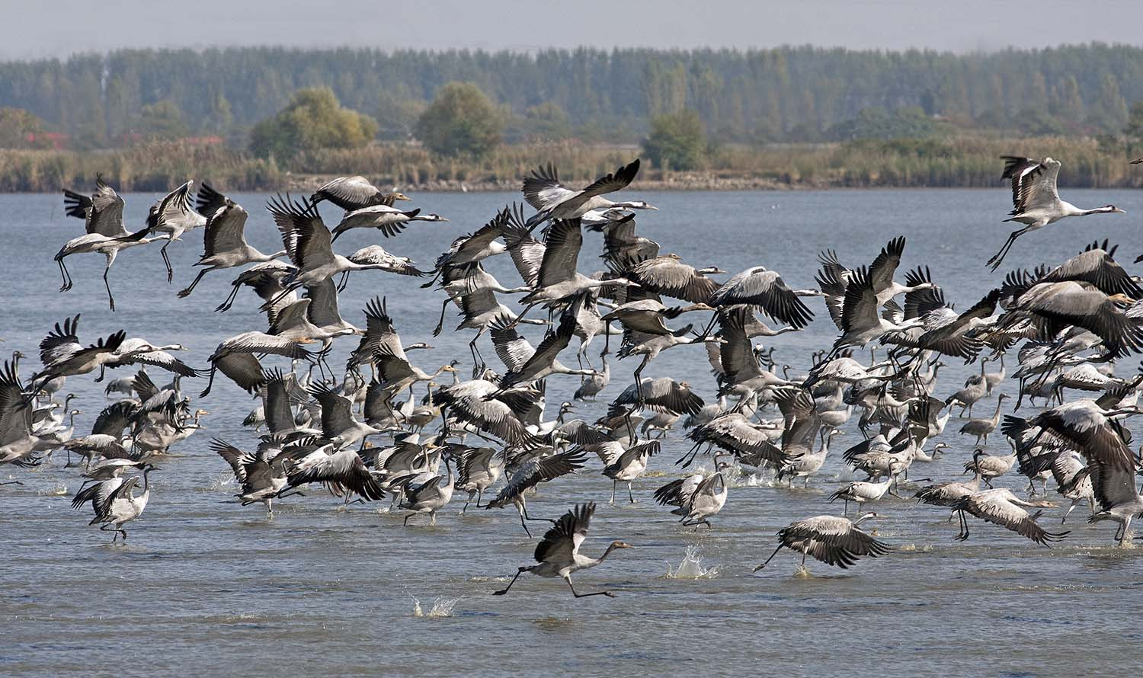
Common Crane (Grus grus)
At Hortobágy UNESCO World Heritage Site

Slide 7
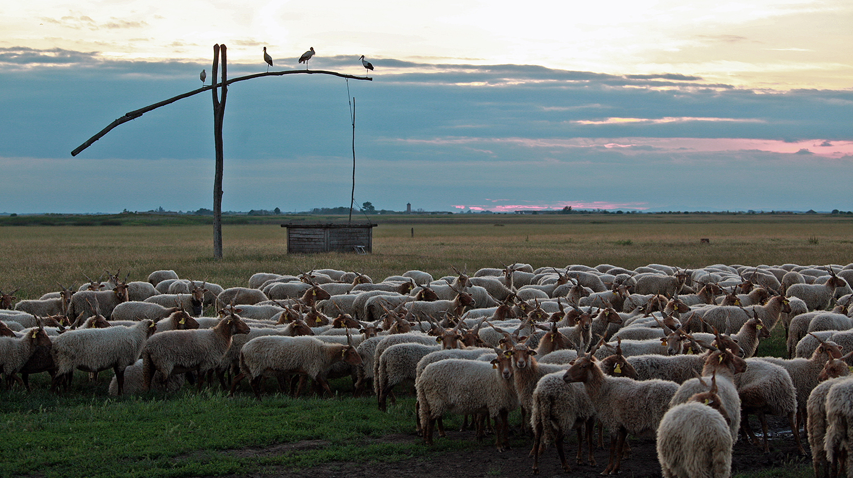
Racka sheep with traditional well
At Hortobágy UNESCO World Heritage Site

Slide 8
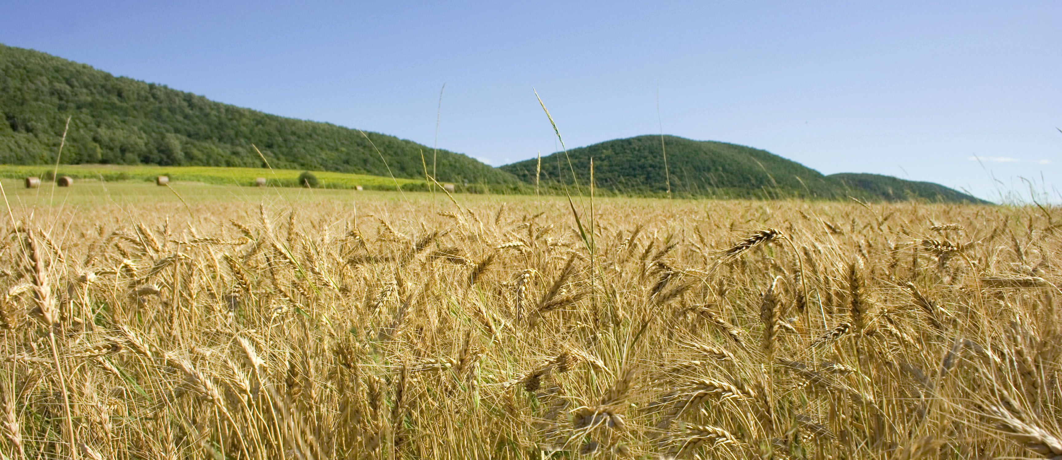
Agricultural area
53% of national territory
>45% of protected areas
Historically: sustainable
Industrialization:
profit orientation
Notes:
Our lands have been cultivated and used by low-intensity grazing livestock keeping through many centuries. Agricultural lands take up more than half of the country’s territory: 49,000 km².

Slide 9
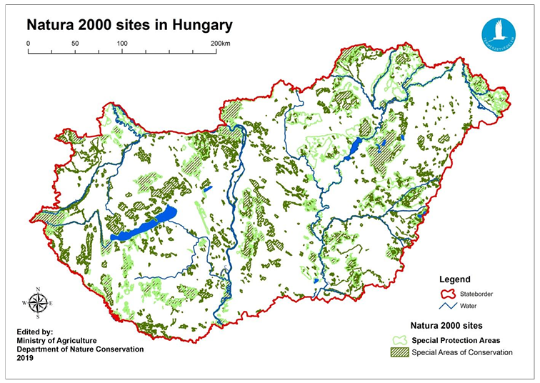
Natura 2000 areas
525 NATURA 2000 sites
479 SAC – 56 SAP
21.4% of national territory
≈ 19,900 km²
Notes:
22.24% of Hungary’s national territory is under protection, and 21.4% is NATURA 2000 designated area. Covering 19,900 km² on 525 sites, out of which 479 Special Area of Conservation and 56 Special Areas of Protection of Bird Habitats.

Slide 10
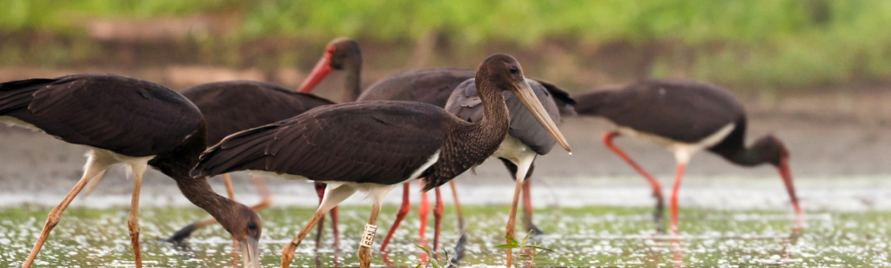
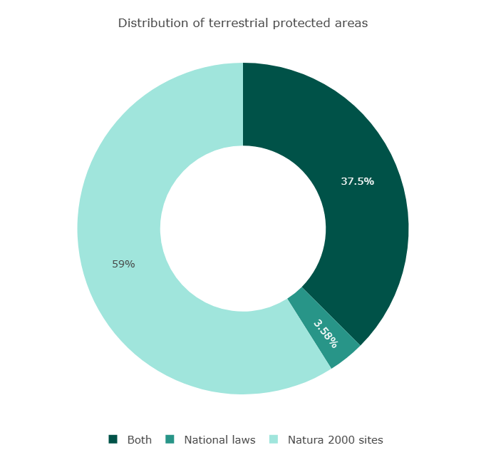
Natura 2000 in Hungary
Habitat type | Natura 2000 (%) | Area (km²)
Grasslands | 25 | 5,000
Forests | 45 | 8,995
Wetlands | 12 | 2,430
Agroecosystems | >45 | overlapping
Notes:
Protected areas cover diverse habitats nationwide: grasslands, forests and wetlands. Protected areas consist of more than 45% of agroecosystems. See table for mor information. National protected areas are mostly under dual protection- being Natura 2000 areas too- with around 3.58% under just national protection. See graph for distribution of terrestrial protected areas.

Slide 11
Legal Framework
European Union’s
Habitats Directive (92/43/EEC) and
Birds Directive (79/409/EEC), later (2009/147/EEC)
Act LIII of 1996 on nature conservation
275/2004. (X.8.) Government Decree
Modifications:
201/2006 (X.2.) Government Decree
266/2008 (XI. 6.) Government Decree
Land parcels and maps:
14/2010 Ministerial Decree
Protect endangered species & habitats
Preserve biodiversity
Notes:
Legal framework of nature conservation in Hungary is based on the most important instruments of the European Union: The Habitats Directive and the Wild birds Directives. The goal of the Natura 2000 network is to protect significant endangered plant and animal species and habitat types at the community level, and through this to preserve biological diversity and ensure its long-term survival. Hungarian law incorporates the European objectives in its 1996 nature conservation Act and the 275/2004 Government Gazette (later modified in 2006 and 2008) on Natura 2000 legal framework, with marker species and habitats listed in the Annexes. Land parcel numbers and maps of all sites are stated in the 14/2010 Ministerial Decree.

Slide 12
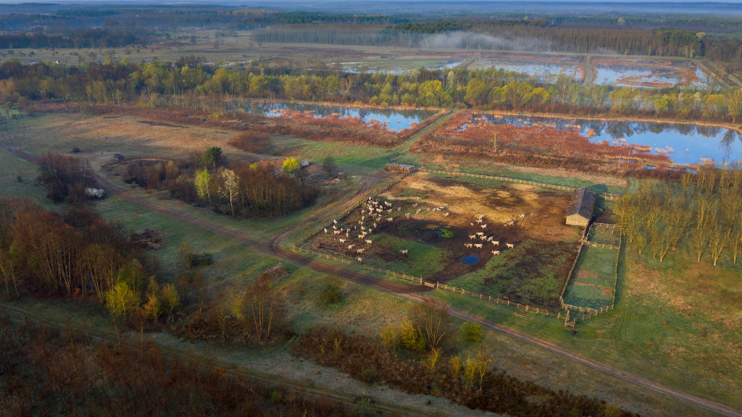
Management model
Notes:
Management model is a Centralized Authority- Decentralized Management complex system, to ensure accountability.

Slide 13
Central Authority Decentralized management Permitting and Enforcement
Legal body | Tasks
Ministry of Agriculture Deputy Minister of State for Nature Conservation | Legislation Evaluate management Supervision
National Park directorates (19) | Monitoring Public authority Scientific, etc.
County “Green” authorities National nature conservation authorities | Permitting Limiting, Banning Impact assessment
Notes:
The Ministry of Agriculture with the leading Deputy Minister of State for Nature Conservation provides legislative oversight, strategic coordination, central monitoring and financial coordination along with data keeping of natural resources, nature protection areas, and conservation goals. 3 main areas of work: To set the Law enforcement practice. To Summarize and evaluate management and prepare the sectors legislation. To practice professional supervision on management bodies.
The 19 National Park Directorates are management bodies, responsible for the monitoring of administrative offences and practicing public authority by running the Nature Protection Service. Operation areas are detached and together they cover the whole country’s territory, however it is not identical to the national parks protected core territory. Around 3,000 km² of Natura 2000 areas are under direct state management by NPs, the remaining 17,000 km² are in mixed ownership, by contractual management of private landholders.
“Green” county or regional authorities practice permitting and law enforcement. They are responsible for all legal procedures involving natural resources and areas, except for those concerning more than one county’s nature conservation authority. Communication among National Park Directorates (management bodies) and county environmental departments is prioritized by regular thematic meetings to harmonize decisions. National Park Directorates and county green authorities are assigned by Government Decree 625/2022, Annex II.

Slide 14
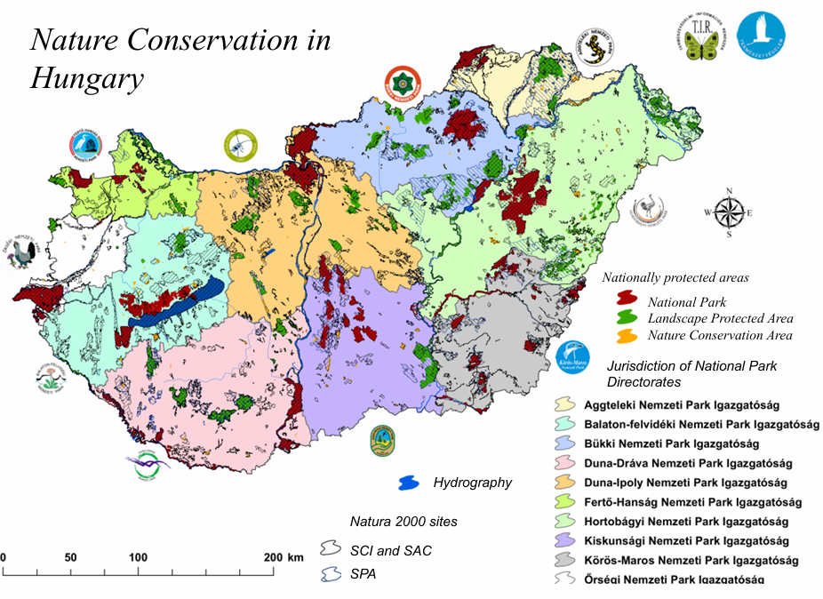

Slide 15
Management planning
NAME | PUBLISHED | CONCERNS
PRIORITIZED ACTION FRAMEWORK | 2014-2020 2021-2027 | Priority conservation & Restoration measures Specific actions required
NATIONAL BIODIVERSITY STRATEGY | 2023-2030 | Environmental Management plan Strategic areas: Reducing threats to biodiversity Sustainable use of biodiversity and benefit-sharing Tools and solutions supporting implementation
GUIDELINES | 2013 | For management plan production
CONSERVATION OBJECTIVES & PRIORITIES | 2013 2018 | For all Natura 2000 sites
MANAGEMENT PLANS | up to date 89% | For 525 Natura 2000 sites specifically
2013
CONSERVATION OBJECTIVES AND PRIORITIES
GUIDELINES
2023
SITE SPECIFIC MANAGEMENT PLANS >89%
Notes:
Hungary’s Natura 2000 strategy focuses on an integrated management, by balancing economic, social, and conservation goals through sustainable farming, habitat restoration, and monitoring. Conservation objectives and priorities were incorporated into the Management Plan production according to Guidelines, by the 10 National Park Directorates. Management planning involves site specific management plans for 525 Natura 2000 sites; of which 470, 89% was complete in 2023.
The Prioritized Action Framework identifies priority conservation and restoration measures, detailing the specific actions required. Legislative and management framework, among financial planning of Natura 2000 areas and offer a comprehensive evaluation of Hungarian Nature conservation sites management efforts and conservation status. National Biodiversity Strategy 2030 is an all-inclusive environmental management plan, containing 3 main strategic areas, 19 objectives and 335 measures.

Slide 16
Financing
INTEGRATED APPROACH
National Park Directorates rely on self-generated revenue
Notes:
Financial needs of environment conservation in Hungary are covered by domestic public-, European Union and other international or private funding. According to the integrated approach, natura 2000 is driven primarily by EU funds, with only 15% national contributions. NPDs rely greatly on self-generated revenue, mostly from environmentally friendly farming and ecotourism.

Slide 17
MONITORING
HUNGARIAN BIODIVERSITY MONITORING SYSTEM (HBMS)
Citizen participation
Country wide
VADONLESŐ VOLUNTEER program
OTHER MONITORING SYSTEMS | SERVICE
NATIONAL HABITAT CLASSIFICATION SYSTEM (NHCS) | HABITAT MAPPING
NATIONAL FORESTS DATABASE (NDF) | FOREST MONITORING
FOREST PROTECTION MEASURING AND OBSERVATION SYSTEM (FMOS) | FOREST MONITORING WITH WIDE RANGE ECOSYSTEM HEALTH ASSESSMENTS
COPERNICUS LAND MONITORING SERVICE (CLMS) | SPECIALIZED HABITAT MAPPING
Notes:
Monitoring is mainly practiced by the Hungarian Biodiversity Monitoring System, a national program launched in 2001. The HBMS is structured for regional coordination, by national Parks, involving central advisory committee and expert groups for effective management. Civil participation has a great place in HBMS, programs like the VADONLESŐ have gained country wide recognition, moving many layers of society simultaneously.

Slide 18
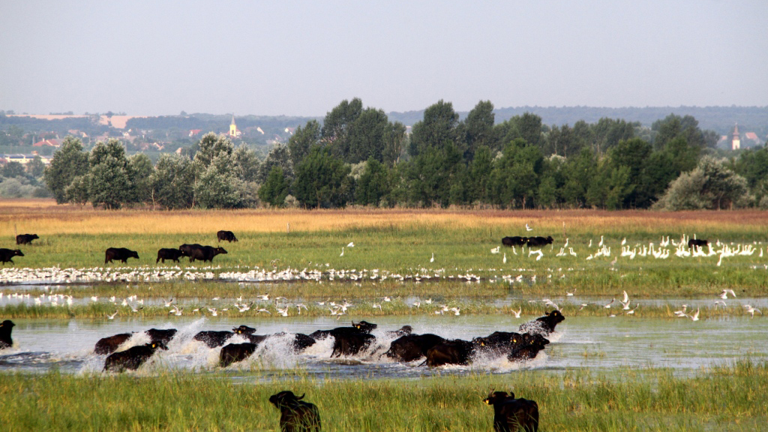
Evaluation indicators -Conservation status-
Buffalo grazing in wetland habitat
Csíkvarsa, Vértes National Park

Slide 19
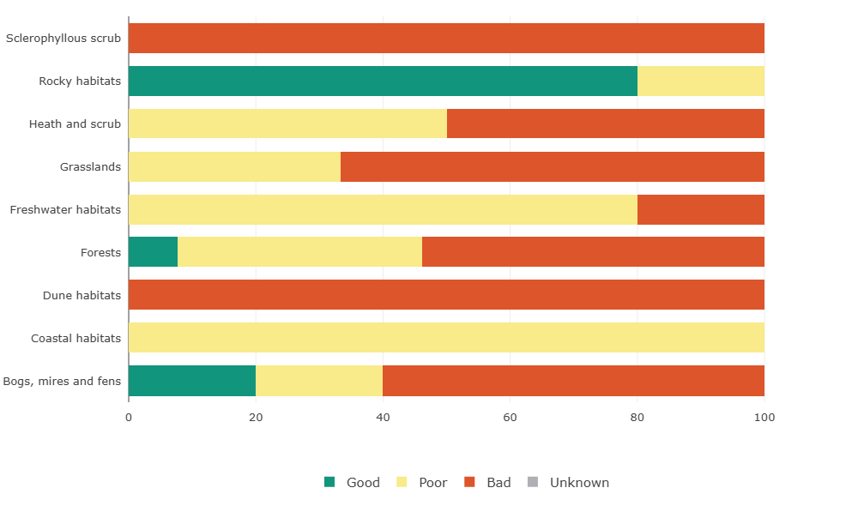
Habitats Conservation status Assessment
45 habitat types:
Forest, Grassland >>
HABITAT | THREATS
Grasslands | Lack of mowing/ grazing Agriculture
Water dependent habitats | Agriculture Change in land use Drought
Forests | Forest management
Notes:
Conservation Status Assessments are reported according to Article 12 (Birds) and 17 (Habitats). In Hungary 45 unique habitat types are present, in the 9 categories (forests, bogs mires fens, coastal, dunes, freshwater, grassland, heath scrub, rocky and sclerophyllous scrub). Grasslands, Forests and Water dependent habitats are high priority conservation areas, due to severe threats of agriculture, forestry, change in land use, abandonment, lack of mowing and climate change. Habitat specific conservation status varies dramatically; Rocky habitats are generally in good conservation status while Dune habitats, Sclerophyllous scrubs, Grasslands, Forests and water dependent habitats (like Bogs, mires and fens) are in mostly bad condition. Poor conservation status describes Coastal habitats, Freshwater habitats and Heath and scrub habitats. See Figure.

Slide 20
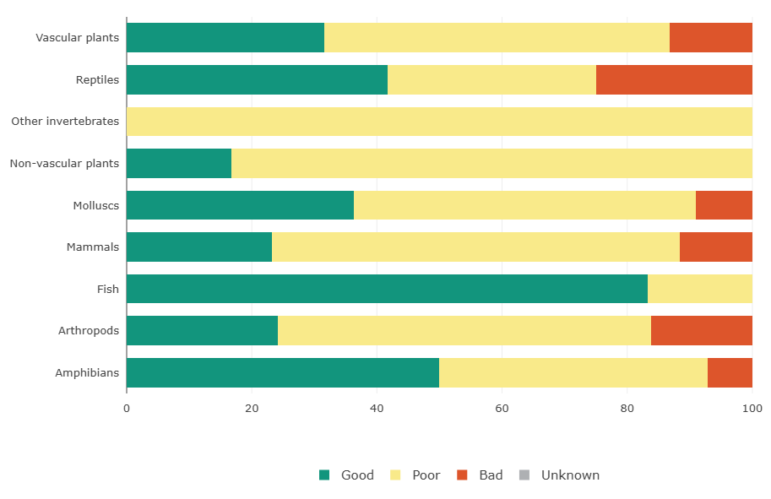
Species conservation status Assessment
INCREASE OR STABLE POPULATION
51% breeding bird species
21% wintering bird species
SPECIES | NUMBER
PLANTS | 733
ANIMALS | 1178
FUNGI | 58
LICHENS | 17
ANT’S NESTS | 6
Notes:
Regarding Species conservation, numerous species of community interest in the Pannonian biogeographical region cannot be found in other EU member states whatsoever, only in Hungary. In Hungary 733 plants and 1178 animals are protected, of which 87 plant and 185 animal species are strictly. 58 mushrooms, 17 lichens and 6 nest-building ant species are also under legal protection. See table for protected species numbers in Hungary. Bird species show an increasing or stable population conservation status trends, concerning 51% of migrating breeding and 21% of wintering species. Invertebrates, Mammals and Arthropods are mostly in poor conservation status, while Reptile Fish and Amphibian species are in mostly good condition. See Figure for conservation status assessment of Hungarian species categories within the natura 2000 framework.

Slide 21
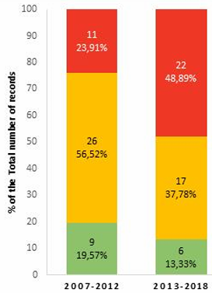
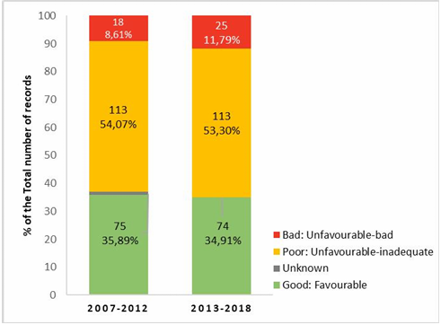
Recent Trends in Conservation Status
conservation status trend
Species >>> Habitats
Habitats conservation status
2007-2018
Species conservation status
2007-2018
Notes:
Good conservation status of protected habitats seems to have a decreasing trend, between 2007 and 2018, similarly, to protected species. The share of habitats in bad conservation status increased to 48.89%, and the share of assessments for species in bad conservation status also increased to 11.79%. The main pressure comes from agriculture, natural processes and climate change, and ‘extraction and cultivation of biological living resources’ (including illegal killing and poaching).

Slide 22
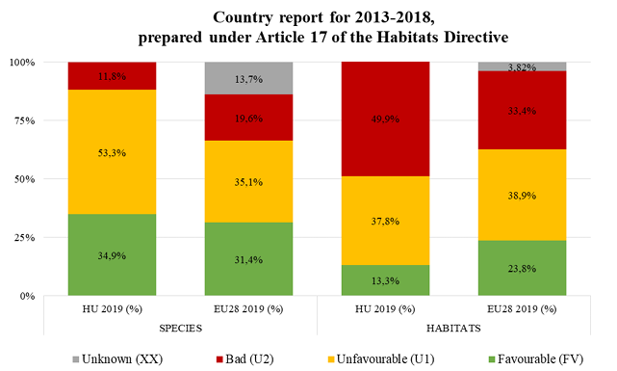
Notes:
Comparison of conservation status at European Member State level indicates that Hungary is generally just above average in species and just below average in habitats conservation. See figure for percentages of good-poor and bad status.

Slide 23
European Comparison
 | Grasslands |  |  | Forests |  |  | Wetlands
CONSERVATION STATUS | Good | Poor | Bad | Good | Poor | Bad | Status
HUNGARY | - | ~40% | ~60% | <10% | 40% | >50% | Poor or bad DETERIORATING
EUROPEAN AVERAGE | <15% | >33% | >50% | <15% | 55% | 31% | Poor or bad DETERIORATING
EU TREND
Notes:
Summarizing the Nature protection efficiency of habitats and species in Hungary is just around the EU level, with a negative highlight on forests and grasslands, which are deteriorating. See Table for this.

Slide 24
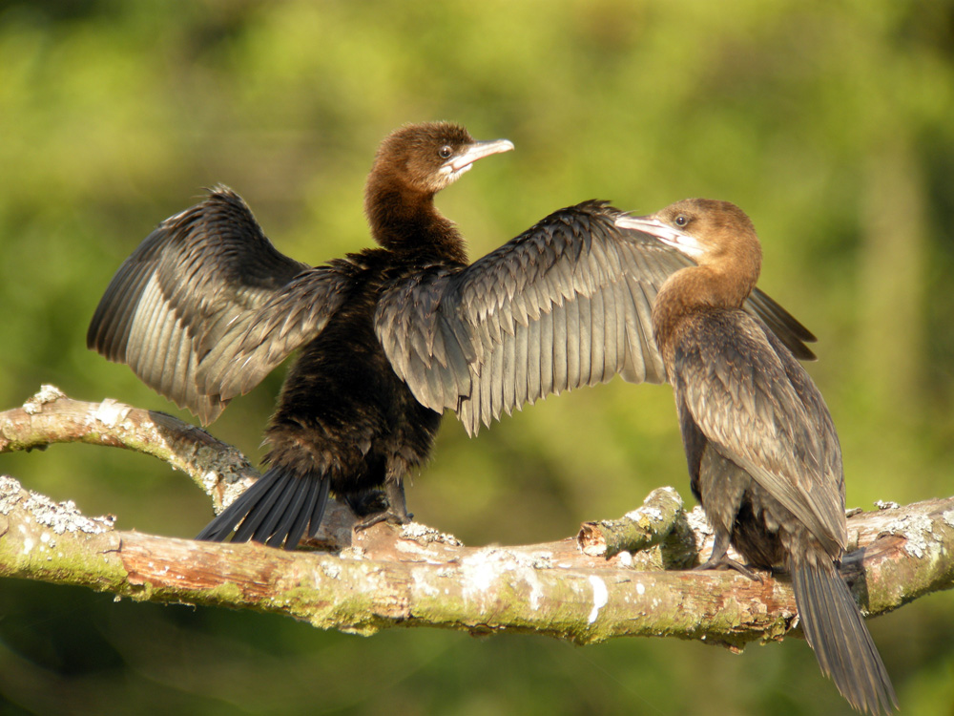
Effectiveness in Protection Management
~ EU level
DETERIORATING forests and grasslands
Reasons:
overoptimistic biodiversity target
lacking legally binding obligations from EU
Private owners in contractual management Lack legal obligations
Great cormorant (Phalacrocorax carbo)
Notes:
There seem to be many reasons beyond effectiveness of implementation, like The biodiversity target itself might be overoptimistic; The EU-Member States lack legally binding obligations and lastly Private owners in contractual management of Natura 2000 lands lack legal obligations towards conservation goals.

Slide 25
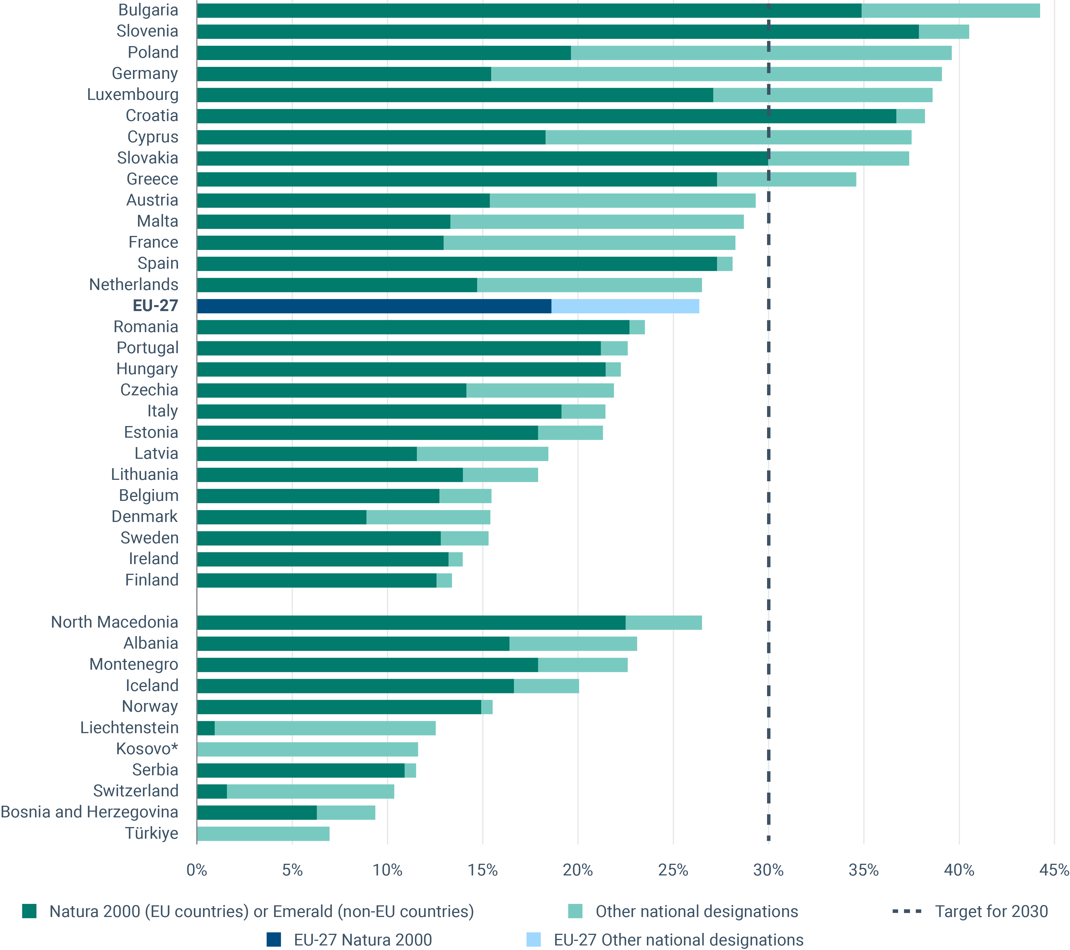
Future prospectives
COMPONENTS FOR SUCCESS
sufficient financial resources
supportive regulatory environment
Notes:
Crucial components of Biodiversity Conservation are sufficient financial resources and a supportive regulatory environment at central and regional administrative levels. In Hungary, the adequate administrative structure is present, however lack of EU level obligatory legislation, insufficient financial resources and contractual management in private ownership of Natura 2000 areas cause irreversible damage.

Slide 26
citations
National Biodiversity Strategy for 2030
Brussels, 8.9.2022, COMMISSION STAFF WORKING DOCUMENT, Environmental Implementation Review 2022, Country Report – HUNGARY
Demeter András (2002) Natura 2000 – European network for natural values conservation, HUNGARY AND THE NATURA 2000 – I., ÖKO Rt. Budapest
Government Decree 275/2004. (X. 8.) on European Sites of Community Importance nature conservation areas.
Government Decree 625/2022. (XII. 30.) on designation of nature conservation authorities and directorates
Ministry of Agriculture (2013), A PRIORITISED ACTION FRAMEWORK (PAF) FOR NATURA 2000, For the EU Multiannual Financing Period 2014-2020, HUNGARY
Ministry of Agriculture (2021), A prioritized action framework (PAF) for Natura 2000, for the EU Multiannual financing period 2021-2027, Hungary
Kerstin Sundseth (2009) Natura 2000 in the Pannonian Region, European Commission Environment Directorate General, DOI: 10.2779/79432
National Summary for Article 17- Hungary (2007-2012)
Article 17 web tool

Slide 27
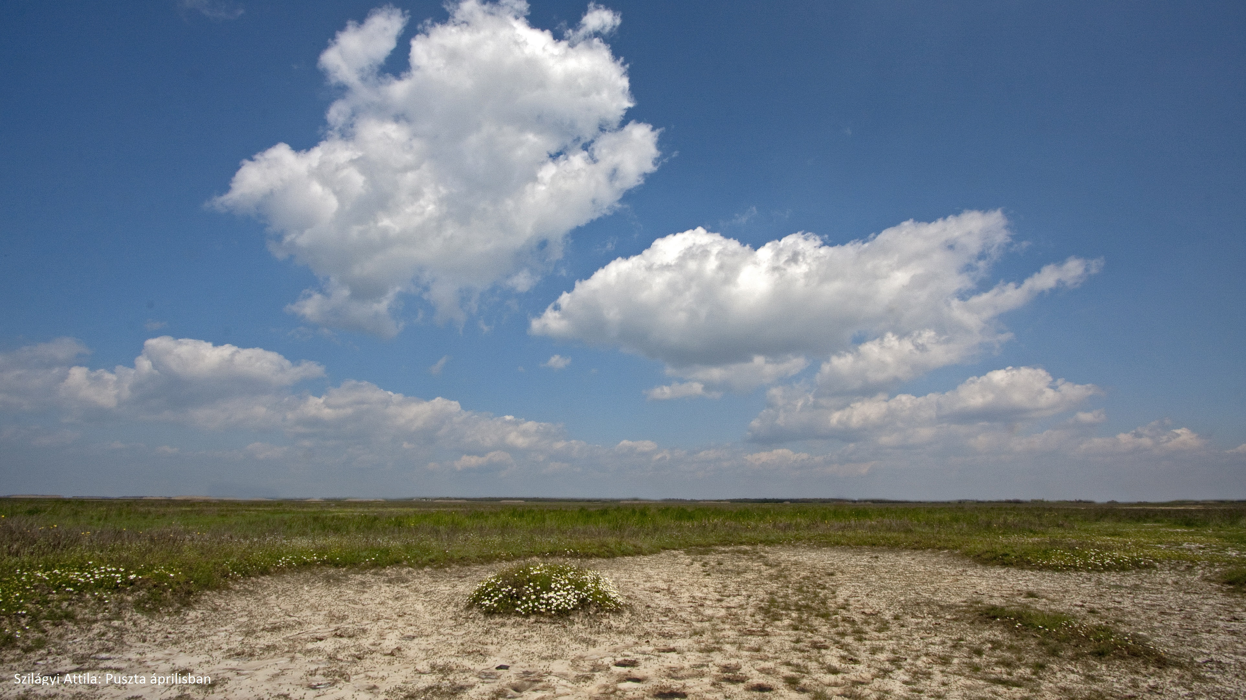
Websites
https://vilagorokseg.e-epites.hu/
https://gyepgazdalkodas.hu/
https://www.hungarikum.hu/

Slide 28
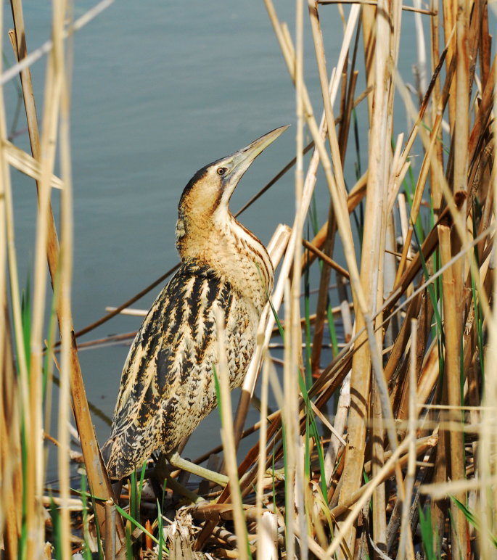
Thank you
Boglárka Zsuzsanna Kovács
Eurasian bittern (Botaurus stellaris)
Notes:
Eurasian bittern (Botaurus stellaris)

