Slide 1
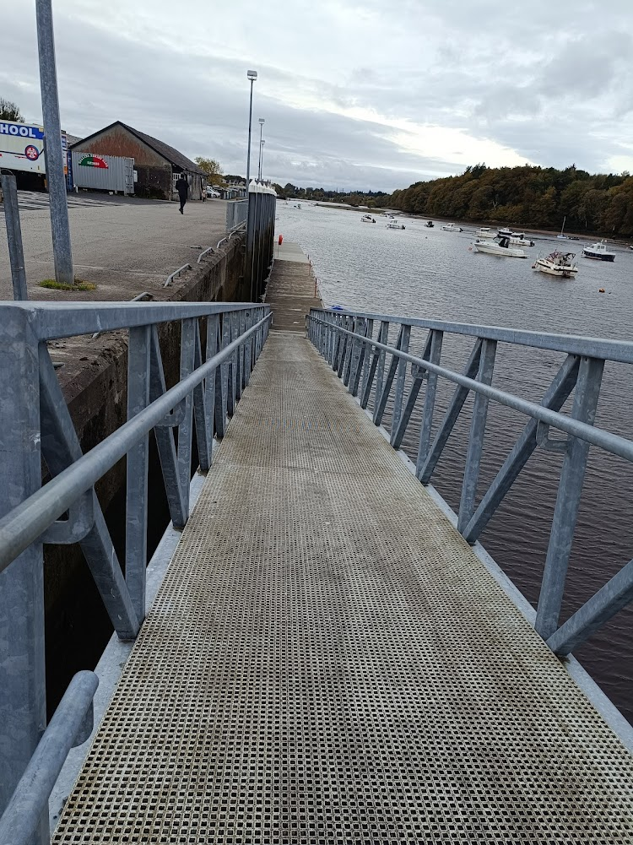
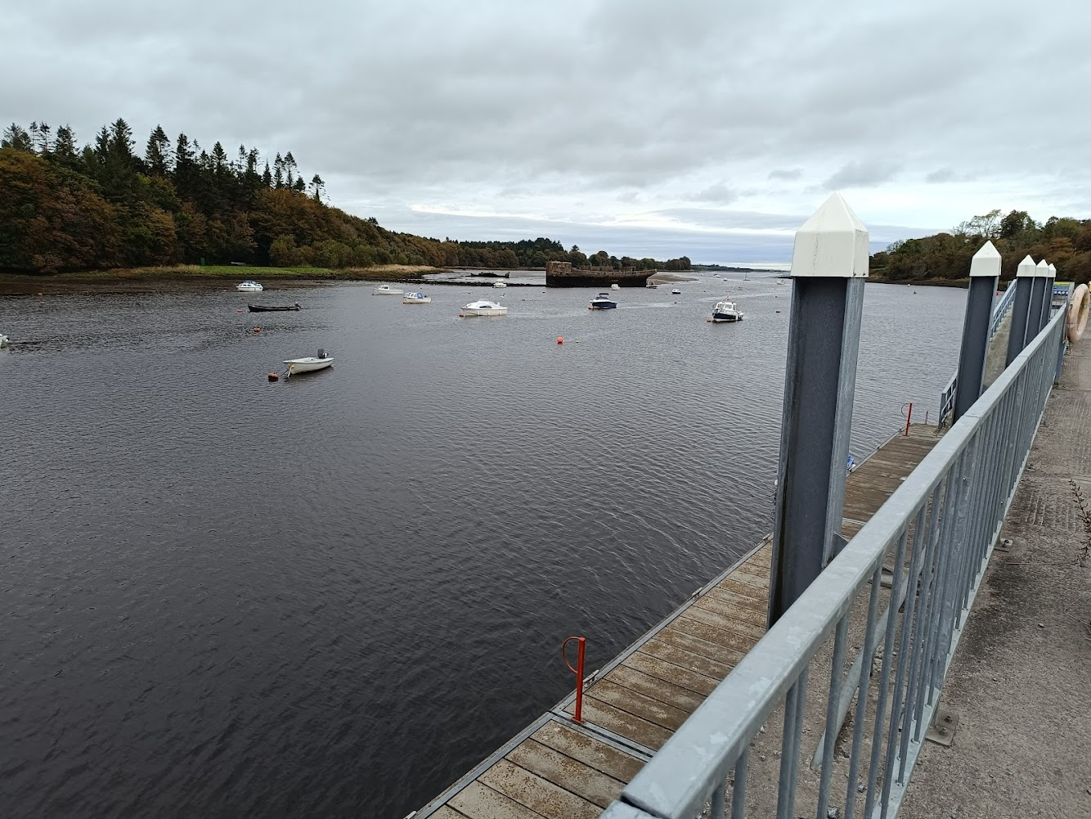
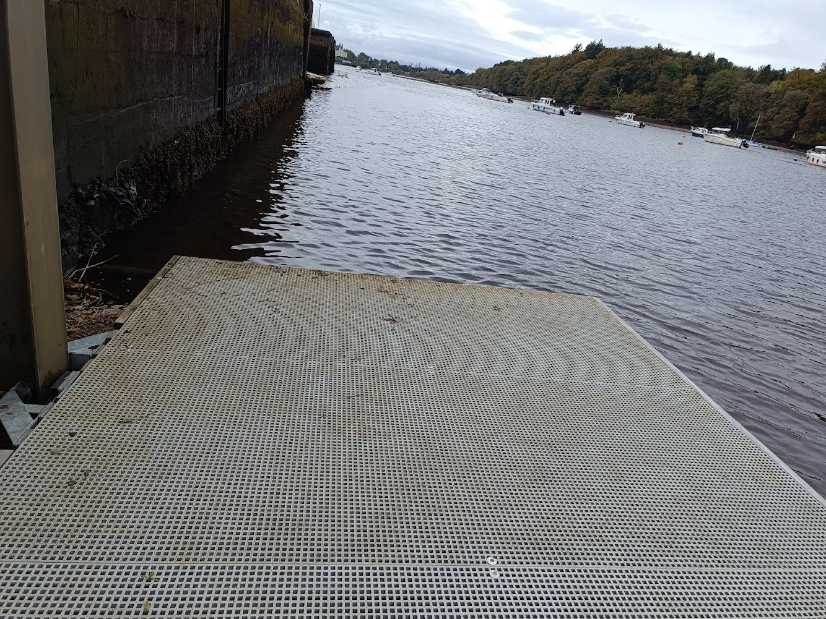
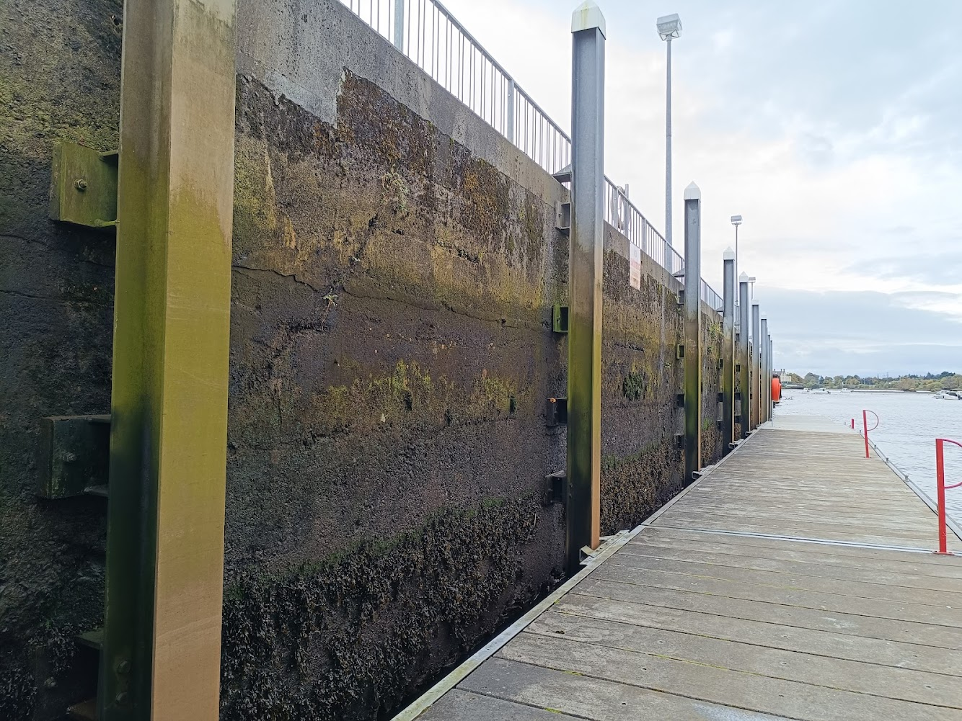
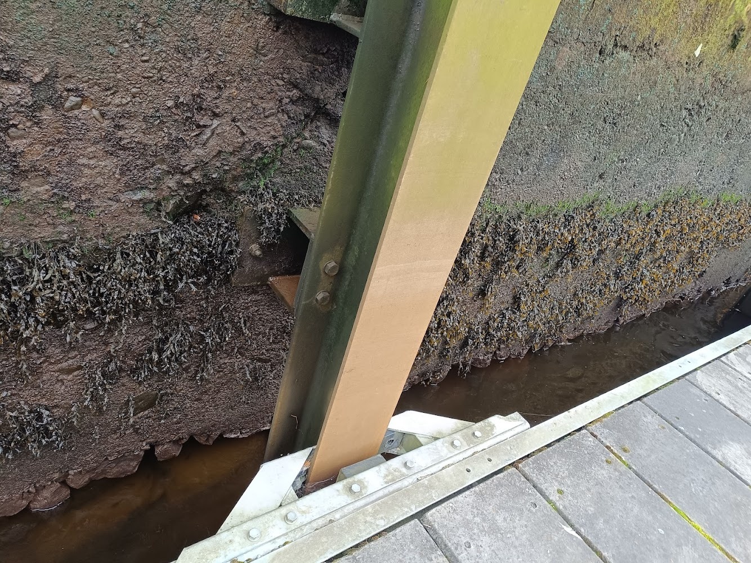
HeritACT SOLUTIONS –BALLINA Small Pavllion Site selection Options
Katherine A. Liapi, Sine Eleusis, Eleusis, March 19, 2024

Slide 2
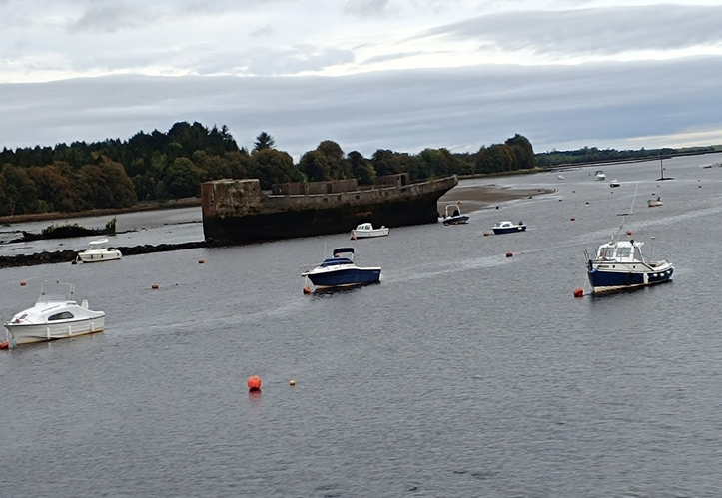
HeritACT SOLUTIONS –BALLINA ProjectSite selection Options
Katherine A. Liapi, Sine Eleusis, Eleusis, March 19, 2024

Slide 3
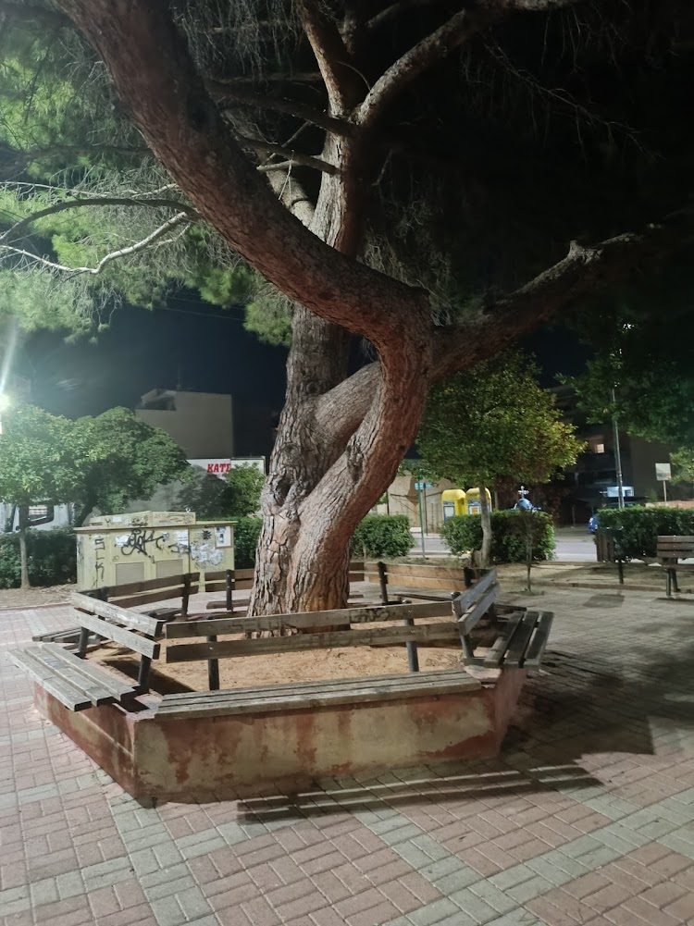
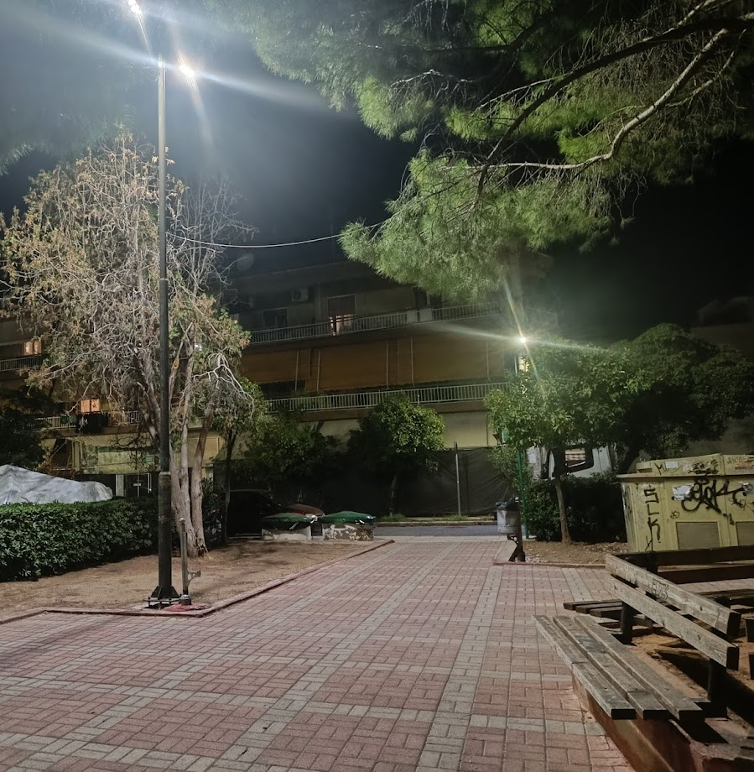
HeritACT SOLUTIONS –ELEUSIS Parasite Pavilion Site selection Options
Katherine A. Liapi, Sine Eleusis, Eleusis, March 19, 2024

Slide 4
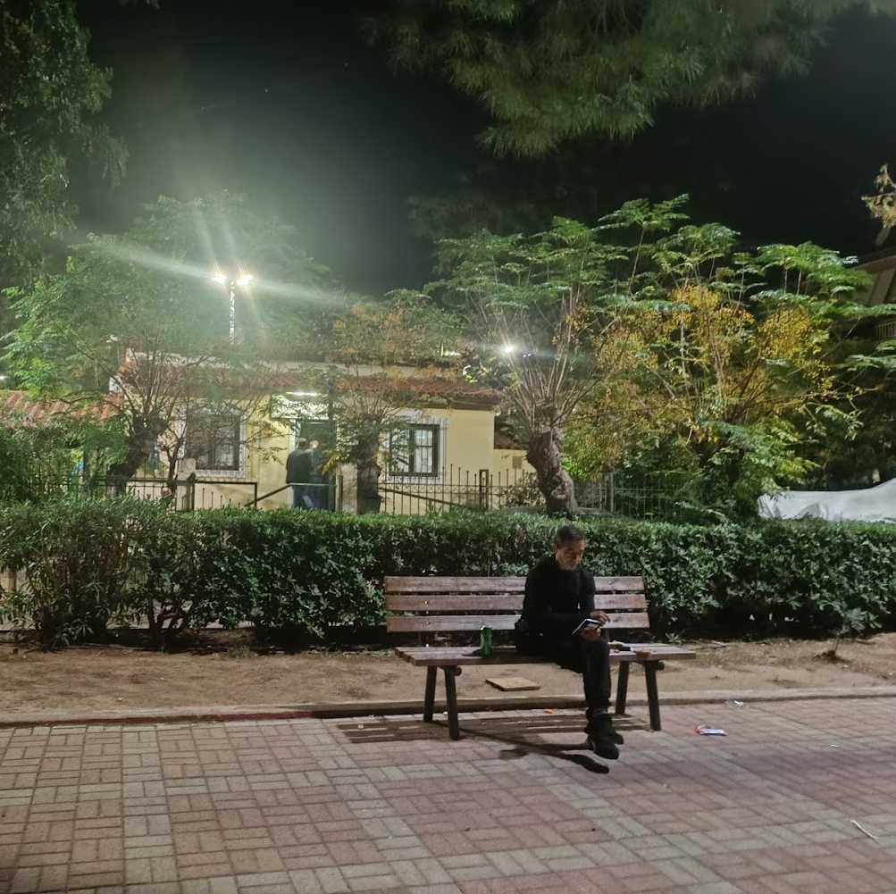
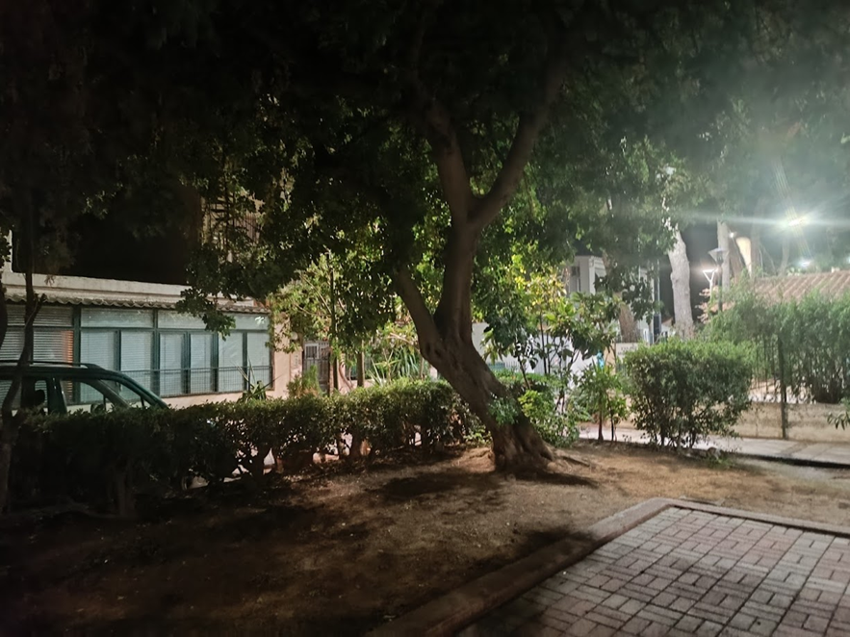
HeritACT SOLUTIONS –ELEUSIS Parasite Pavilion Site selection Options
Katherine A. Liapi, Sine Eleusis, Eleusis, March 19, 2024

Slide 5
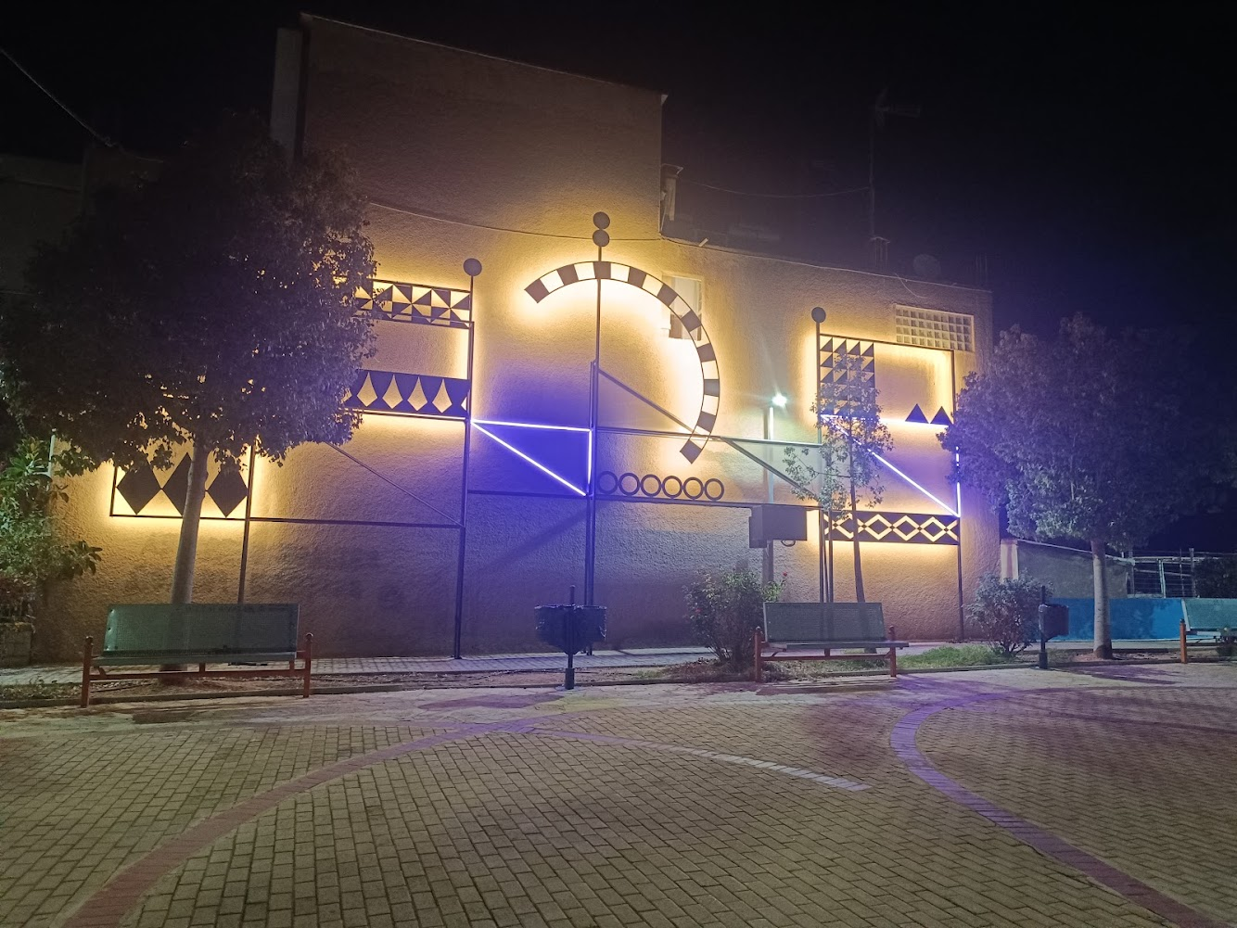
HeritACT SOLUTIONS –ELEUSIS Parasite Pavilion Site selection Options
Katherine A. Liapi, Sine Eleusis, Eleusis, March 19, 2024

Slide 6
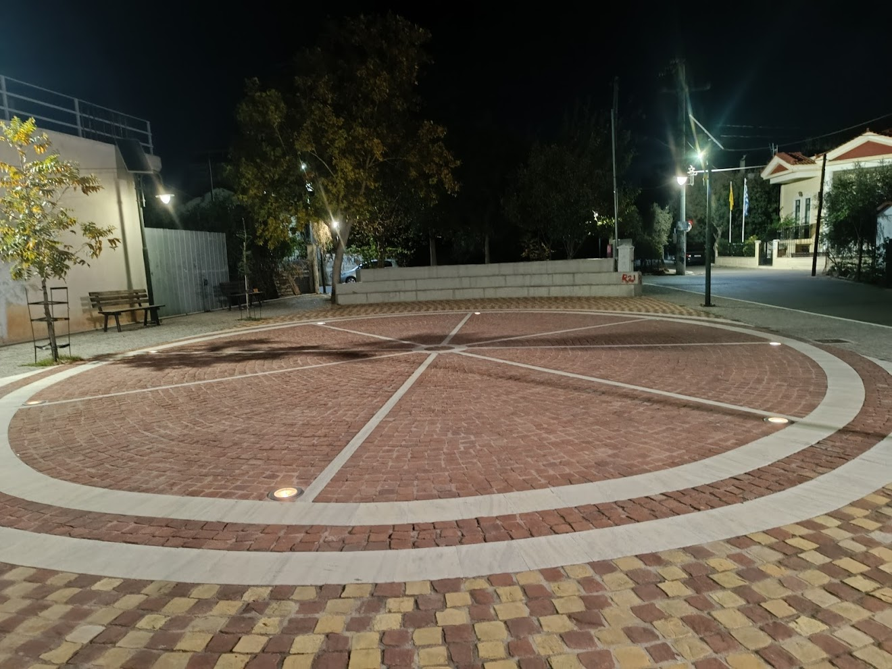
HeritACT SOLUTIONS –ELEUSIS Parasite Pavilion Site selection Options
Katherine A. Liapi, Sine Eleusis, Eleusis, March 19, 2024

Slide 7
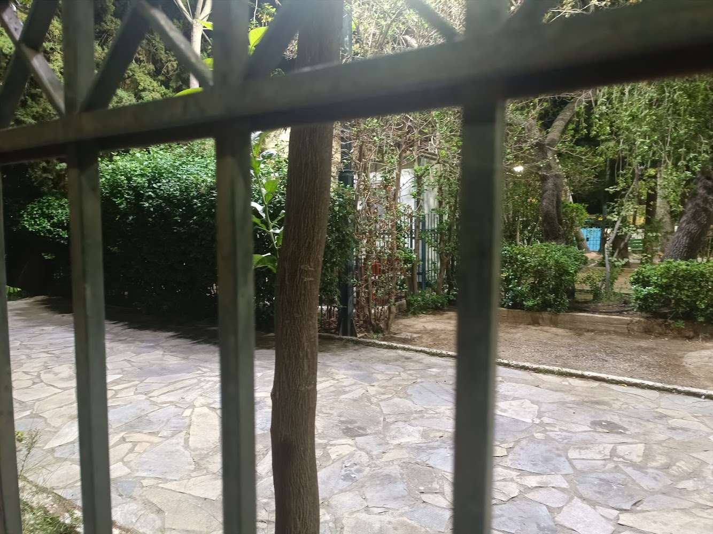
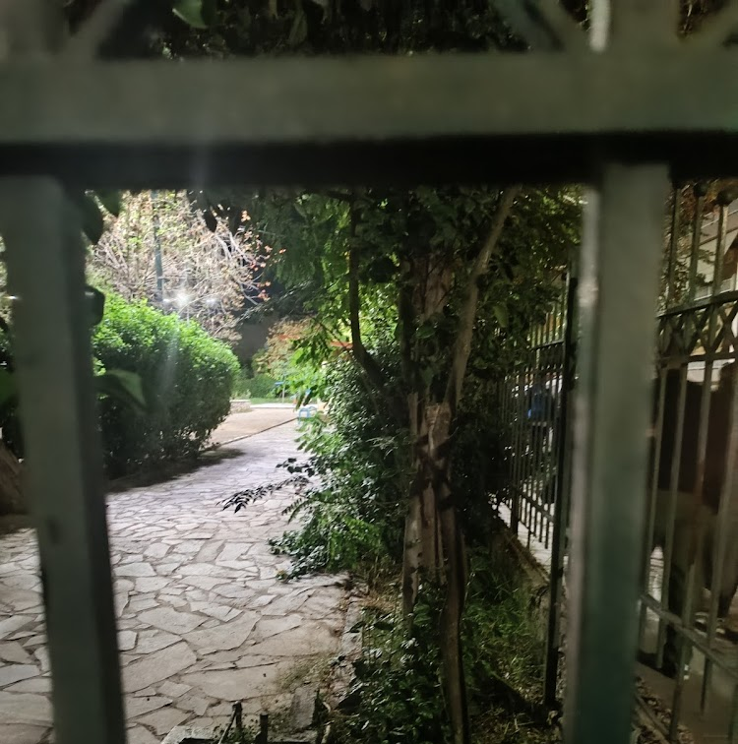
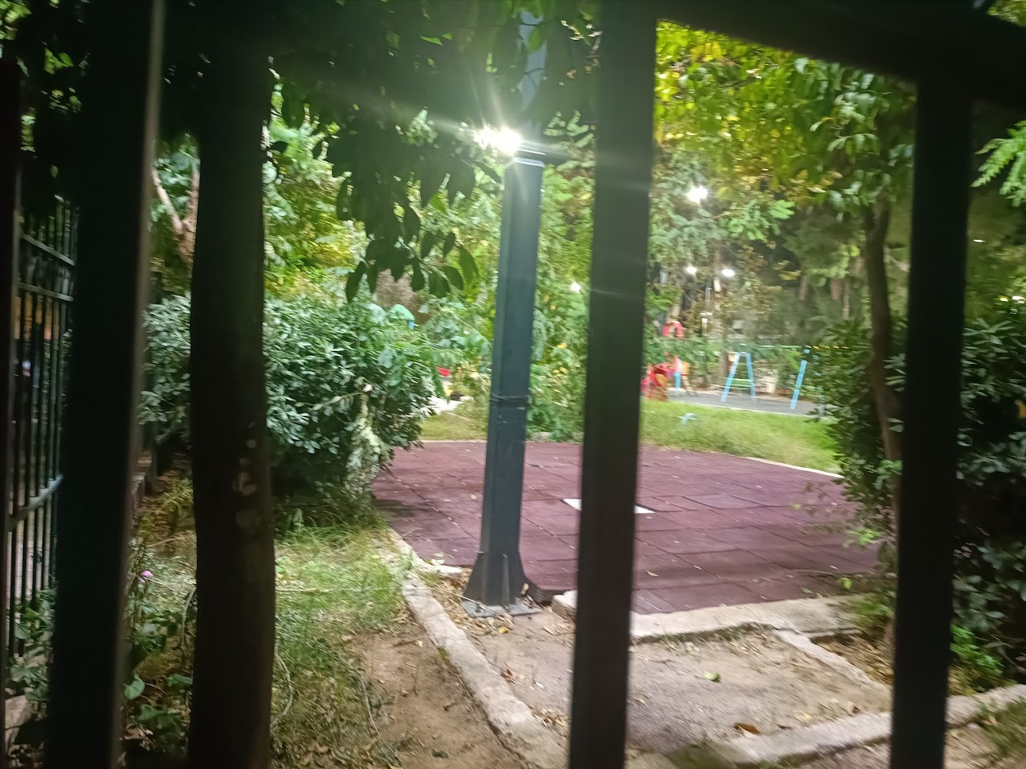
HeritACT SOLUTIONS –ELEUSIS Parasite Pavilion Site selection Options
Katherine A. Liapi, Sine Eleusis, Eleusis, March 19, 2024

Slide 8
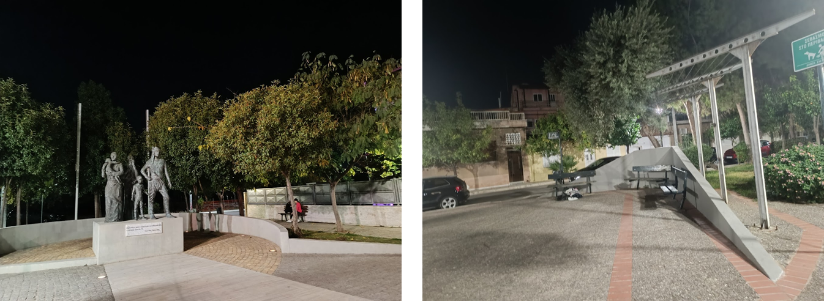
HeritACT SOLUTIONS –ELEUSIS Parasite Pavilion Site selection Options
Katherine A. Liapi, Sine Eleusis, Eleusis, March 19, 2024

Slide 9
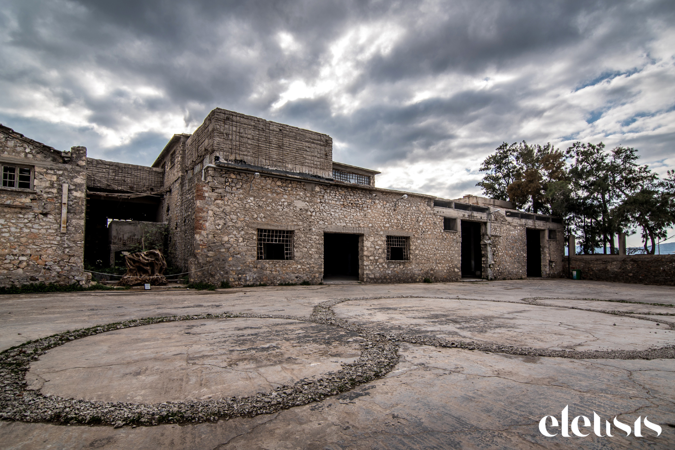
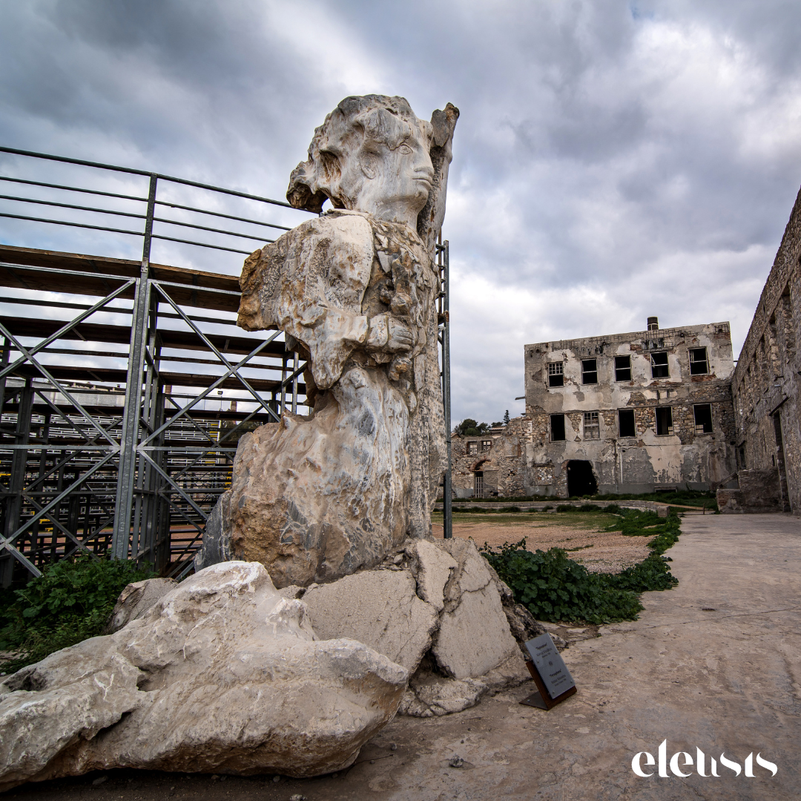
HeritACT SOLUTIONS –ELEUSIS Green Tensegrity Site selection Options
Katherine A. Liapi, Sine Eleusis, Eleusis, March 19, 2024

Slide 10
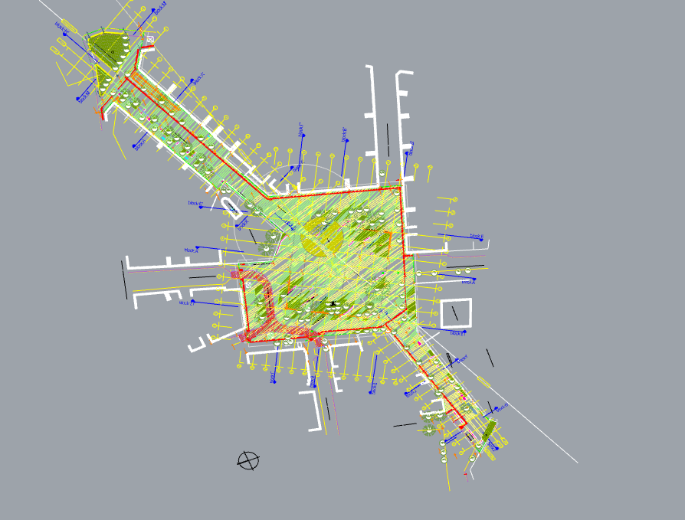
HeritACT SOLUTIONS –ELEUSIS Green Tensegrity Site selection Options
Katherine A. Liapi, Sine Eleusis, Eleusis, March 19, 2024

